Slide 1


xTRACT and xTrain Overview
electronic Research Administration (eRA)
OER, OD, National Institutes of Health

Slide 2
What is xTRACT?
The Extramural Trainee Reporting And Career Tracking (xTRACT) system is a module in the eRA Commons that allows applicants, grantees, and assistants to create Research Training Data (RTD) tables for NIH progress reports and institutional training grant applications.
The difference between completing the training data tables by using templates in Word and preparing them in xTRACT is that because xTRACT is integrated with eRA Commons, some training data will be pre-populated in the system, including trainee names, selected characteristics, institutions, grant numbers, and subsequent NIH and other HHS awards.
Once an initial table set has been completed in xTRACT, either for an application or Research Performance Progress Report, it can then be copied and edited for the following year’s submission.

Slide 3
Notice of Transition to the xTRACT System for Preparing Research Training Data Tables
Beginning with RPPRs due on or after October 1, 2019 NIH and AHRQ will require training data tables submitted with T32, TL1, T90/R90, and T15 applications and progress reports be created via the xTRACT system. System validations in the RPPR module will check to ensure that tables were created via xTRACT, and RPPRs that are not in compliance will be rejected.
Stay tuned for a new guide notice.
Current Notice Number: NOT-OD-18-133 (https://grants.nih.gov/grants/guide/notice-files/NOT-OD-18-133.html )

Slide 4
xTRACT Pre-Populates Data
xTract pre-populates data when available either from Personal Profile, eRA Systems, and xTrain itself.
Certain data created within xTRACT is available to all users, for example, user profiles, and related data such as degrees. To find a profile someone created, search for the person’s name, and make sure to search for people not affiliated with your organization.
If a profile has been set up with the person’s support and degrees, this information will be available when they are added to an RTD.
xTRACT does not update personal profiles of users, any changes made in xTRACT stay in xTRACT.
If an individual has an eRA Commons account, please use it in RTDs, rather than create a profile for them in xTRACT, as a profile will not pre-populate the individual's data that exists on their eRA Commons account.

Slide 5
Upload of Bulk Data
xTRACT allows users to upload of specific data via a CSV file. Please note, when uploading data regarding individuals, Commons IDs are required.
Users can upload:
Funding Sources for the organization
Faculty Members Data for an RTD
Participating Student Data for an RTD
Participating Trainee Data for an RTD

Slide 6
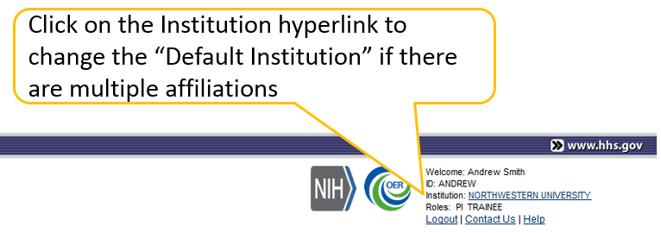
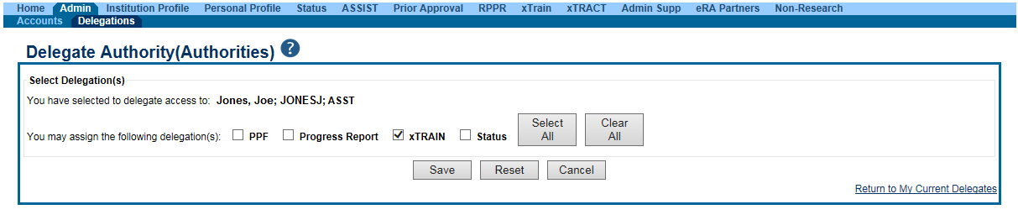
xTRACT Users
PD/PI accounts may have multiple affiliations. xTRACT will display grants based on the users current default institution.
Signing Official (SO)
Administrative Official (AO)
Business Official (BO)
Program Director/Principal Investigator (PD/PI)
PD/PI Delegate (ASST)
xTRACT delegation is granted when the PD/PI delegates xTrain to an ASST.

Slide 7
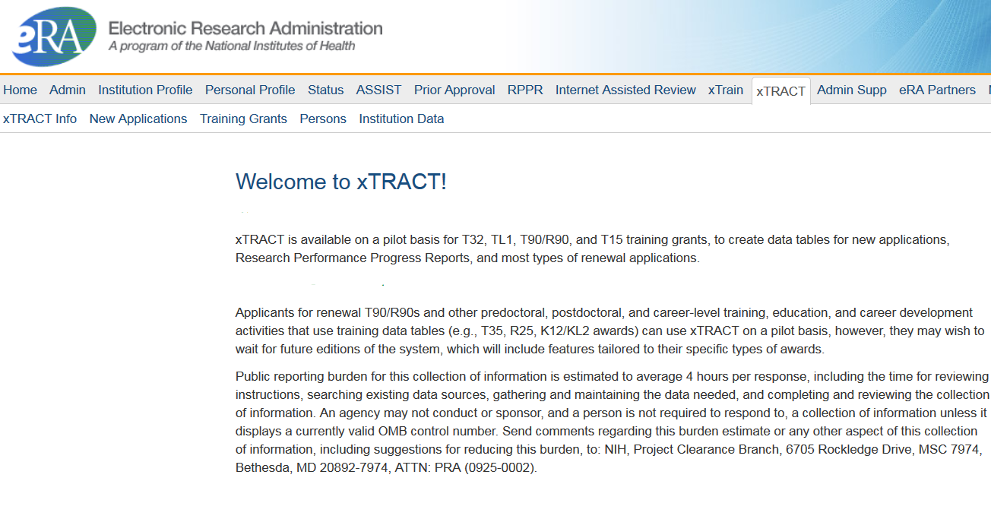
Main Menu

Slide 8
Starting Using xTRACT
To facilitate creation of RTDs for RPPRs, new applications, renewals and revisions, you may wish to do some data set-up ahead of time.
While you can create data at the time you complete an RTD, it may save time to create your Programs, Non-NIH Funding Sources, and populate individual’s employments and degrees in xTRACT ahead of time.
At this time sources of support are populated in the context of an RTD, and should be added there.
When you first start an RTD for an existing grant, such as for an RPPR, you will need to enter trainee data for everyone that has been appointed within the last 15 years. You may save yourself time by utilizing the batch upload feature here. Once this data has been saved to an RTD, you will have the option to copy data over the next year.

Slide 9
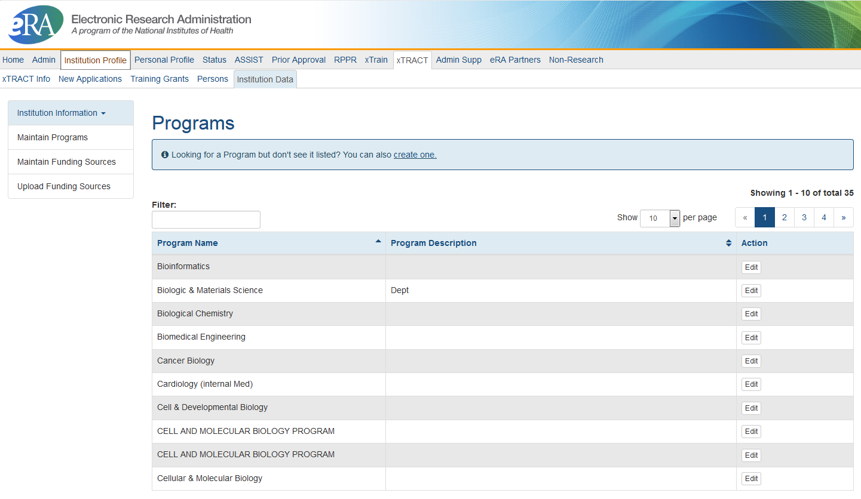
Institution Data: Maintain Programs
Institutionally-defined, interdepartmental programs.
Programs names are used in a variety of places including, Census Tables and in Applicants, Entrants, and Characteristics: Pre-doc Table.
** Departments are created by the Data Quality group at the request of the SO
Edit will allow you to modify the Program Name, and enter a Description.

Slide 10
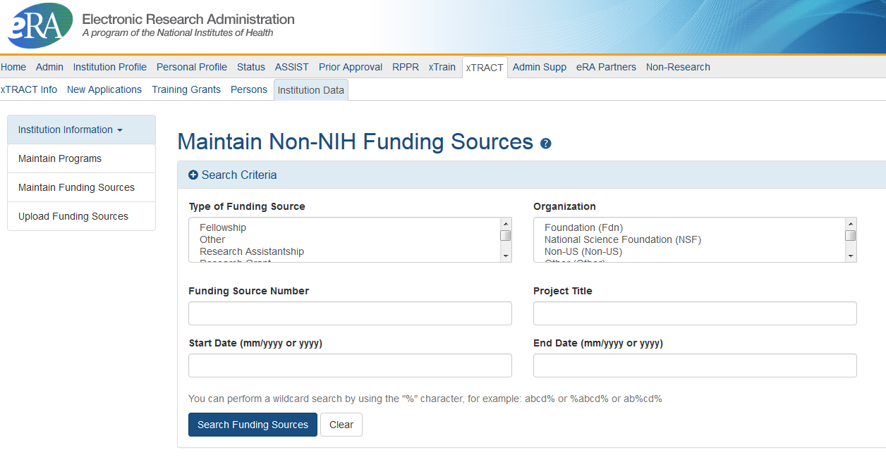
Institution Data: Maintain Funding Sources
Non-NIH Funding Sources are entered and maintained by the Institution.
Search for funding source, if one does not exist, you will have the option to create a new one.
You may also upload funding sources using tab-delimited file.

Slide 11
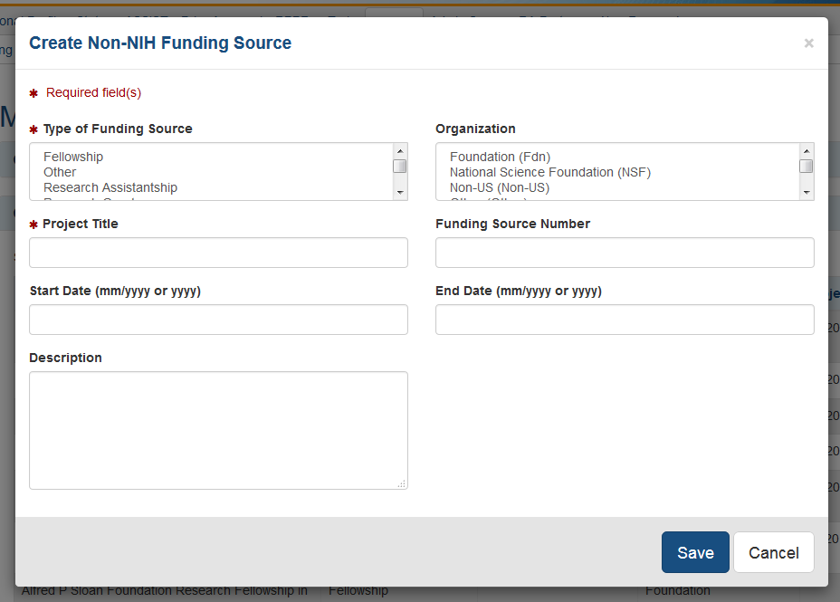
Institution Data: Maintain Funding Sources
Cont.
Types of Funding Sources:
Fellowship
Other
Research Assistantship
Research Grant
Scholarship
Teaching Assistantship
Training Grant
User may modify a funding source.
Type of Funding Source and Project Title are required; user may also provide:
Organization
Funding Source Number
Start and End Date
Description
Organization:
Foundation
National Science Foundation
Non-US
Other
Other Federal
University

Slide 12
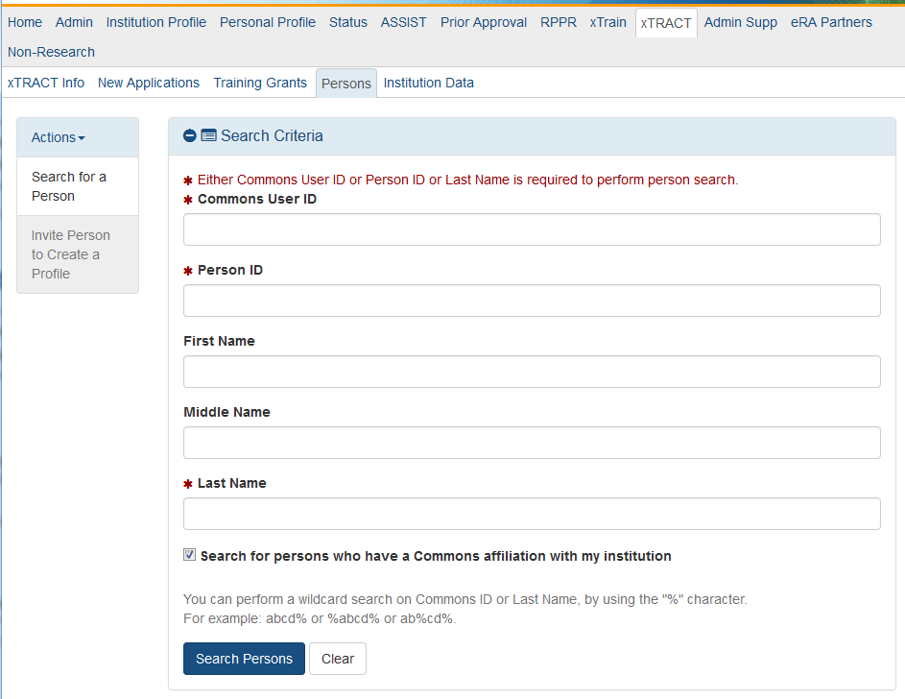
Persons
Search for an existing person record.
If the person does not have an eRA Commons account or an xTRACT Profile, you may create a Profile for them. This profile can have roles added to it later through Account Management System (AMS).
To locate someone with only an xTRACT Person Record – who does not have an eRA Commons account, uncheck “Search for persons who have a Commons affiliation with my institution”.

Slide 13
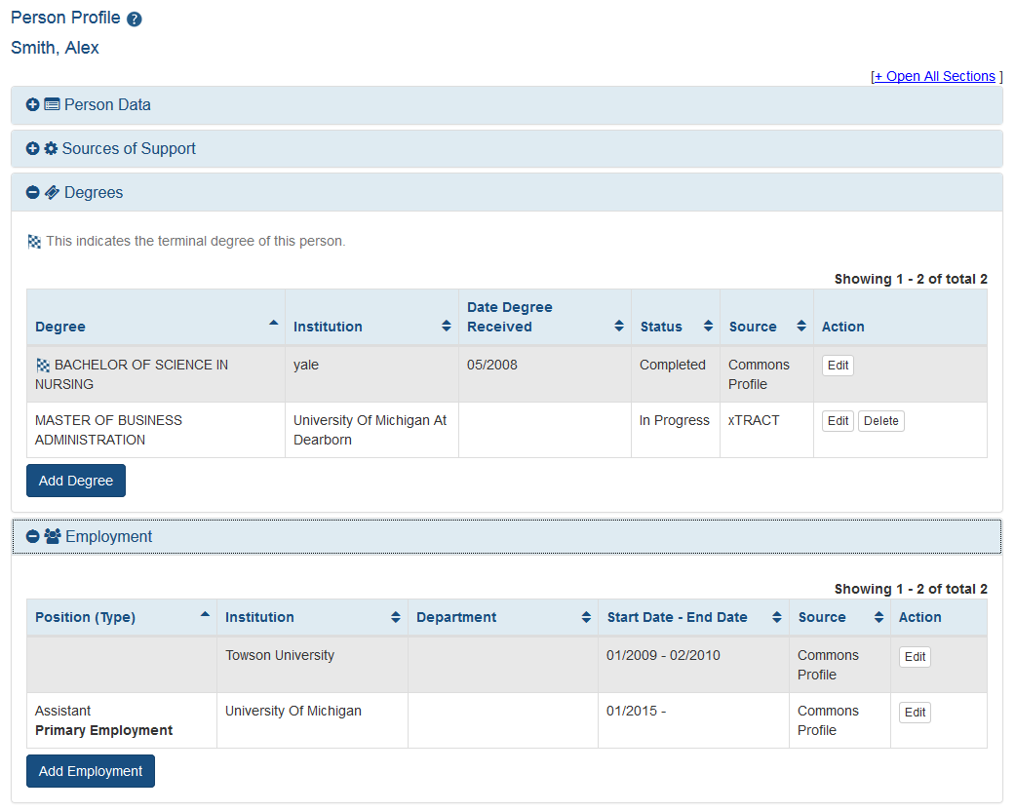
Persons: Edit Person Profile
If data was added in xTRACT, you may delete it.
Edit Person will pull data from Personal Profile (PPF) in eRA Commons.
If employment, or degree information is missing, you may add it in xTRACT.
Data entered in xTRACT will NOT be updated in PPF.
Sources of support are updated in the context of an RTD.
Data pulled from PPF may only be deleted from PPF. You may make changes to the data, these changes will not reflect in the user’s PPF.

Slide 14
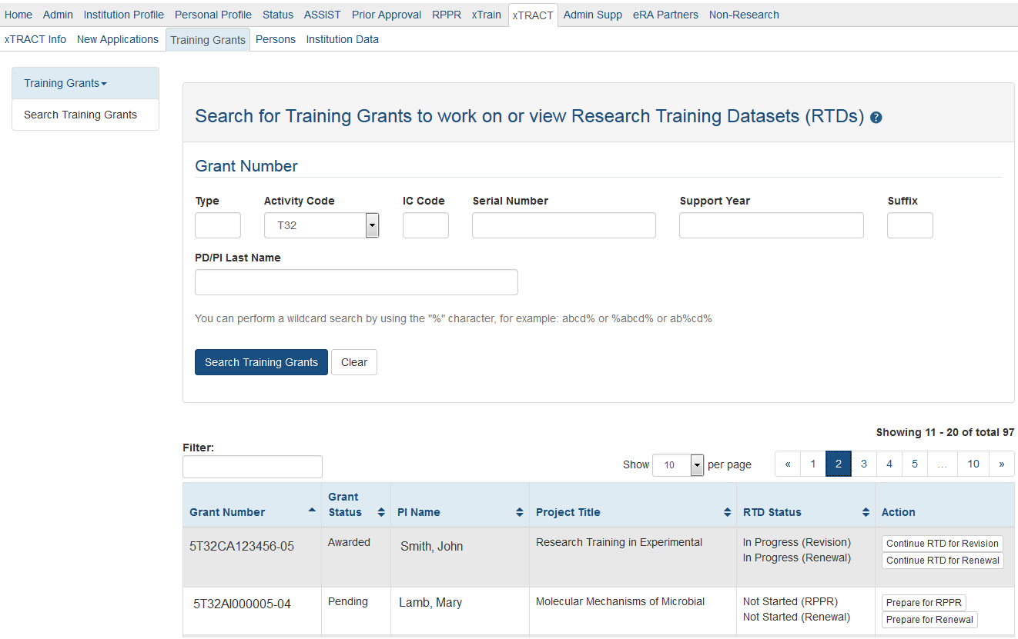
Training Grants
From the Training Grants tab, search for the grant that needs an RTD generated.
To perform a wildcard search use the “%” character.
PD/PI, ASST, AO or SO may prepare or continue an RTD for a Revision, Renewal or RPPR.

Slide 15
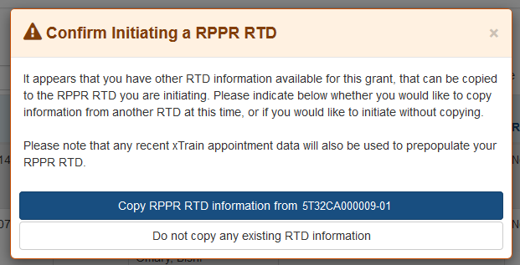
RPPR RTD
If you have previously created RTDs for this grant, xTRACT will prompt you to copy the previous RTD data.
The RPPR RTD requires the following data:
Participating Trainees.
Program Statistics.

Slide 16
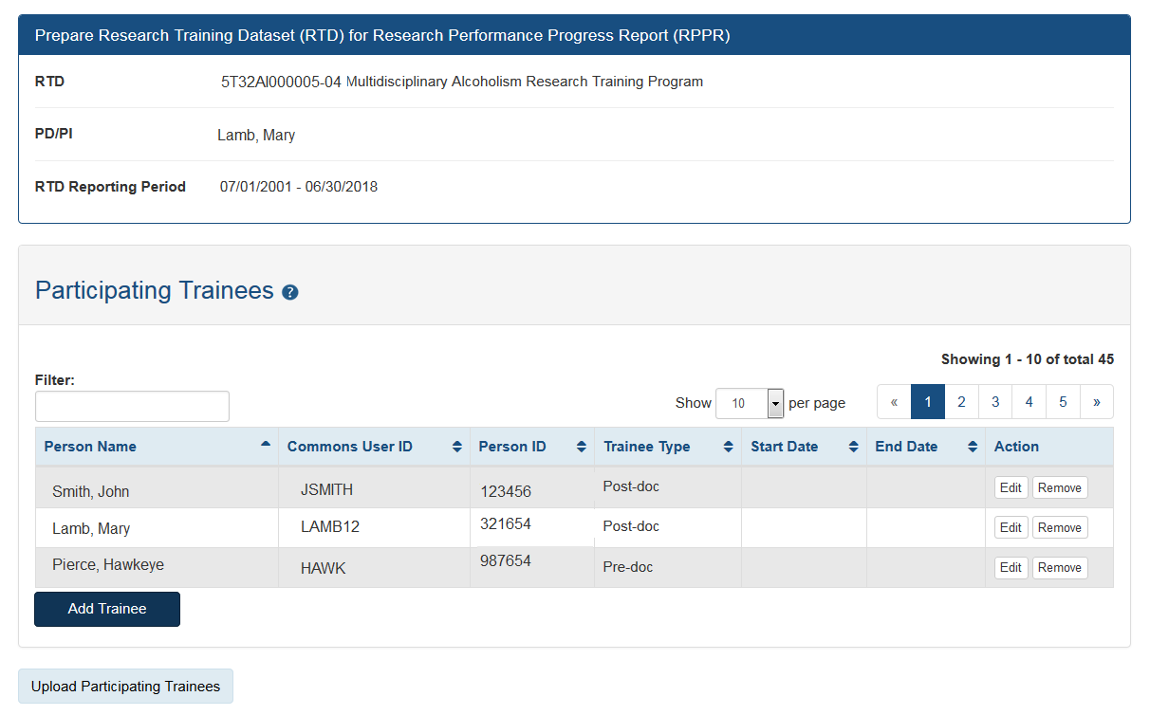
Modify RTD: Participating Trainees
Available for Revisions and Renewal and RPPR RTDs only.
The initial list of trainees will populated from xTrain.
Edit will allow you to update:
In-Training Data
Faculty Members
Degrees
Subsequent Grants
Support During Training
Post Training Positions
Publications
You may also upload Participating Trainees using a tab-delimited file.

Slide 17
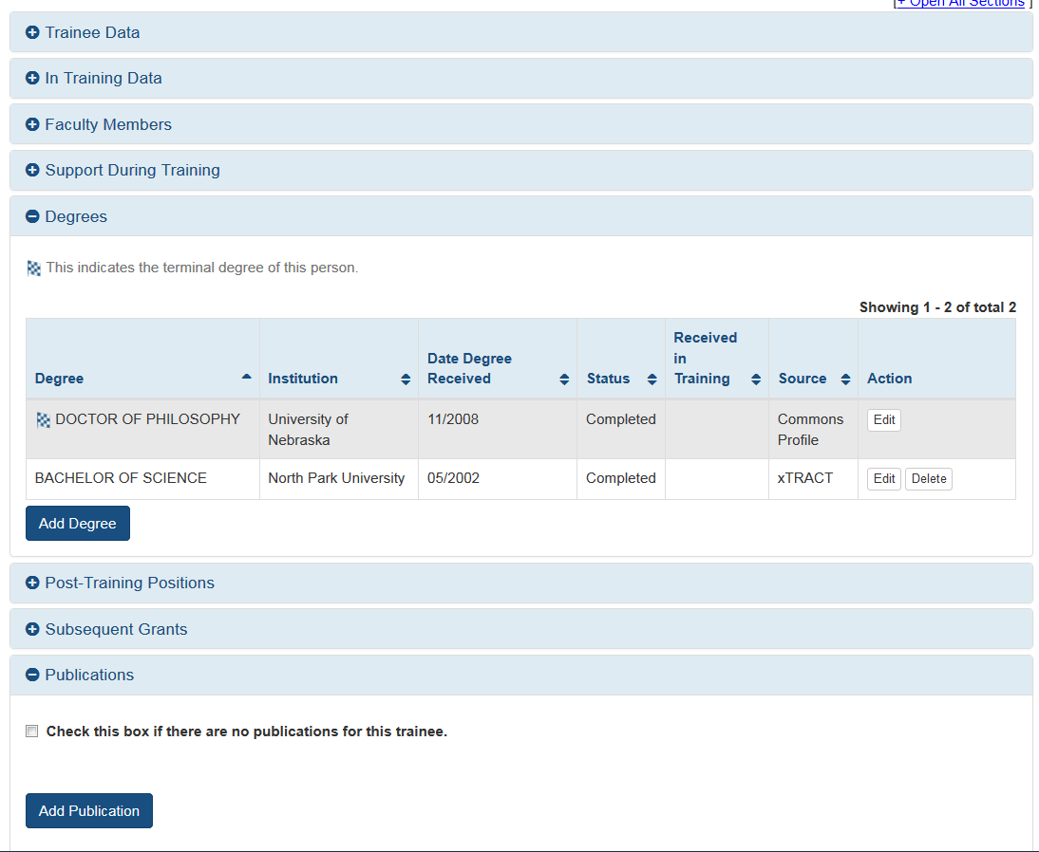
Edit Participating Trainee
Data populated from PPF or from other systems cannot be deleted in xTRACT; only modified.
If the data is modified, the delete option will only delete those changes made in xTract, not the data populated from other modules.
You may update:
In Training Data
Mentoring Faculty Members
Support During Training
Degrees
Post-Training Positions
Subsequent Grants
Publications

Slide 18
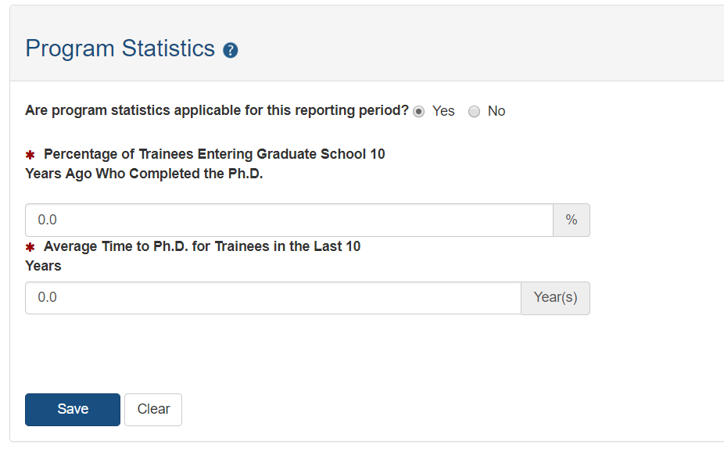
Program Statistics
Program Statistics section is available for those RTDs that have pre-doctoral trainees.
User must provide:
If program statistics are applicable for this reporting period.
Percentage of Trainees Entering Graduate School
Average Time for Ph.D.

Slide 19
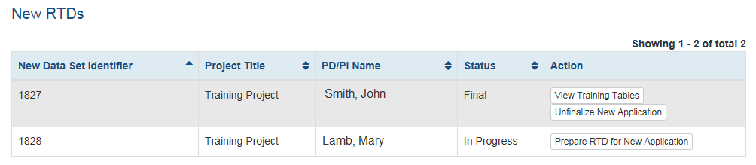
Finalize RTD
Only the PD/PI or ASST may finalize the RTD.
Review the PDF for accuracy by utilizing the Preview PDF Feature.
After an RTD is finalized, it is ready for submission.
PD/PI or ASST may utilize the “Unfinalize New Application” button in the New RTD Search to enable editing. You will have to finalize the RTD again to generate the PDF.

Slide 20
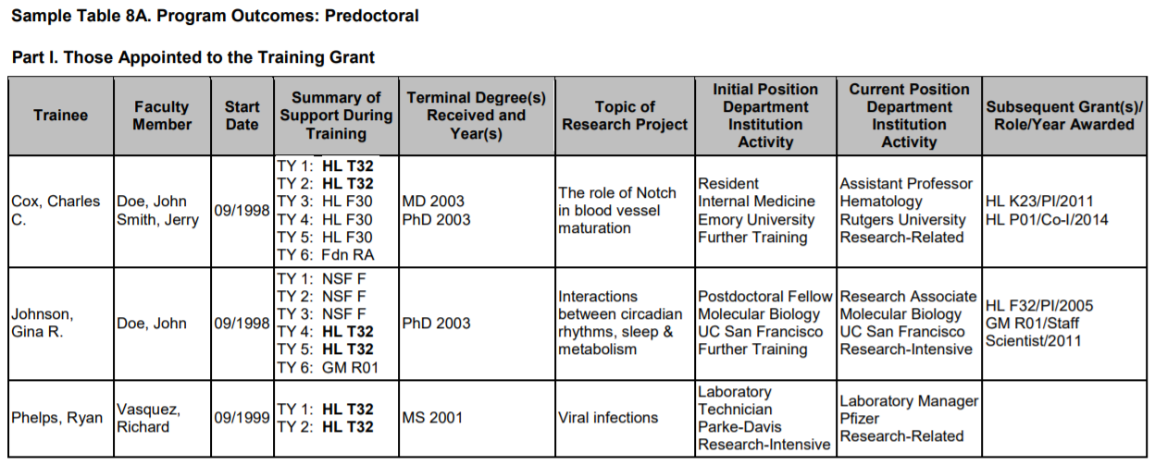
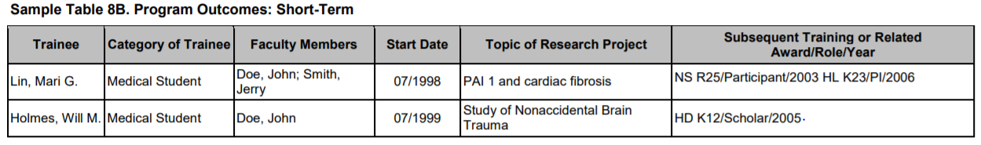
Generate
Table 8
The information that is populated into Tables 8A, 8B, and 8C, is drawn from the Participating Trainees and Participating Students sections, accessed from the RTD menu.

Slide 21
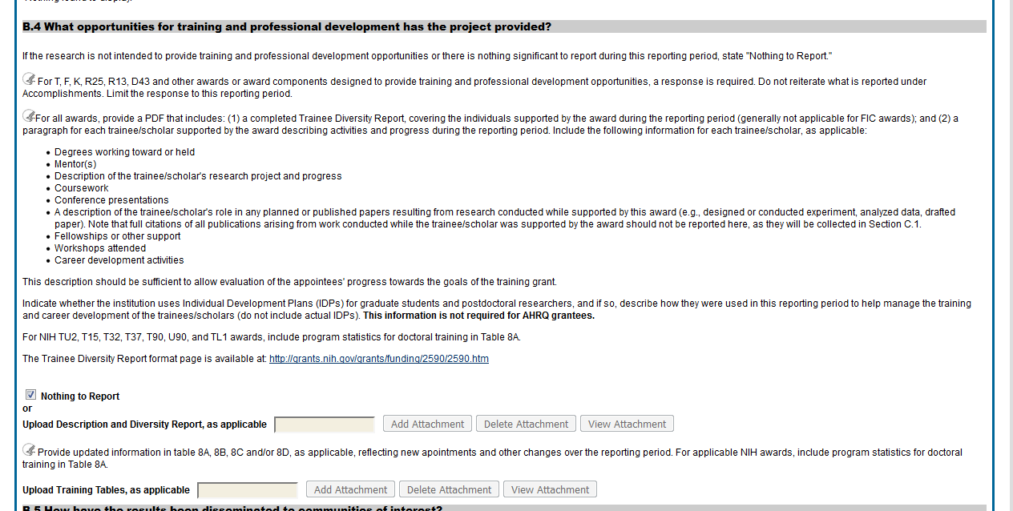
Upload RTD to RPPR
RPPR question B4 offers 2 PDF upload locations for: K12, KL2, R90, RL9, T15, T32, T34, T35, T37, T90, TL1, KM1.
Once the RTD is finalized, download the generated Table(s) 8, and attach to the second upload.
Other descriptive information and the Trainee Diversity Report, if applicable, should be attached at the first upload location

Slide 22
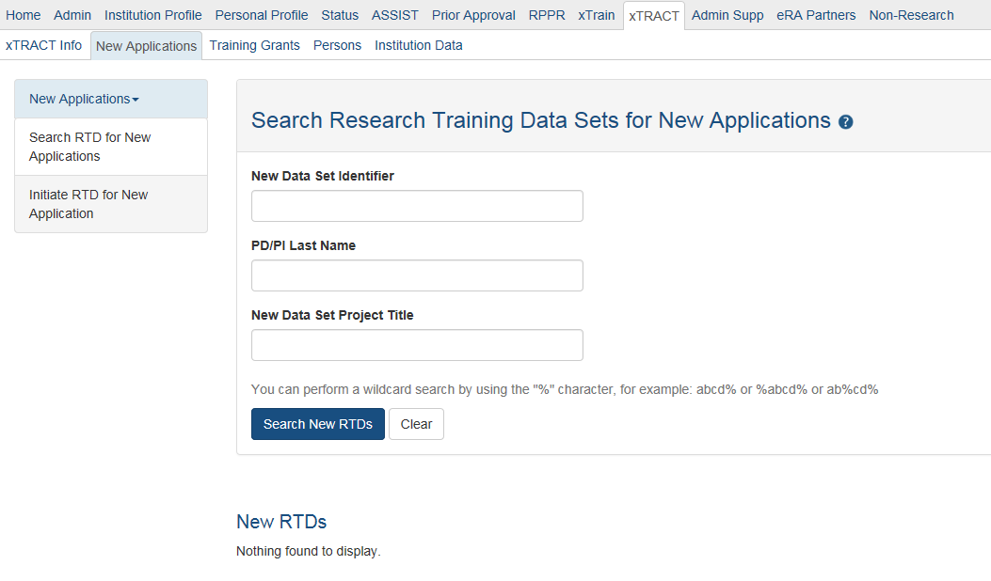
New Applications
To create an RTD for a new application, use the New Application tab.
If an RTD has already been started, you may use the search function locate it.
To perform a wildcard search use the “%” character.
Only PD/PI or ASST may create a new RTD.

Slide 23
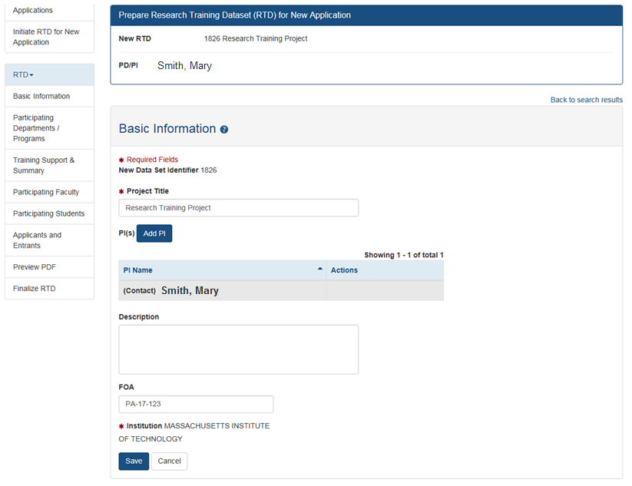
New Application RTD
The PD/PI who initiated the RTD will be marked as Contact PI.
An RTD for a New Application requires the following information:
Participating Departments/Programs
Training Support & Summary
Participating Faculty
Participating Students
Applicants and Entrants

Slide 24
Revision or Renewal RTD
For an RTD For a Revision or Renewal you will need to complete the following:
Participating Departments/Programs
Training Support & Summary
Participating Faculty
Participating Students
Participating Trainees
Program Statistics
Applicants and Entrants
Appointments

Slide 25
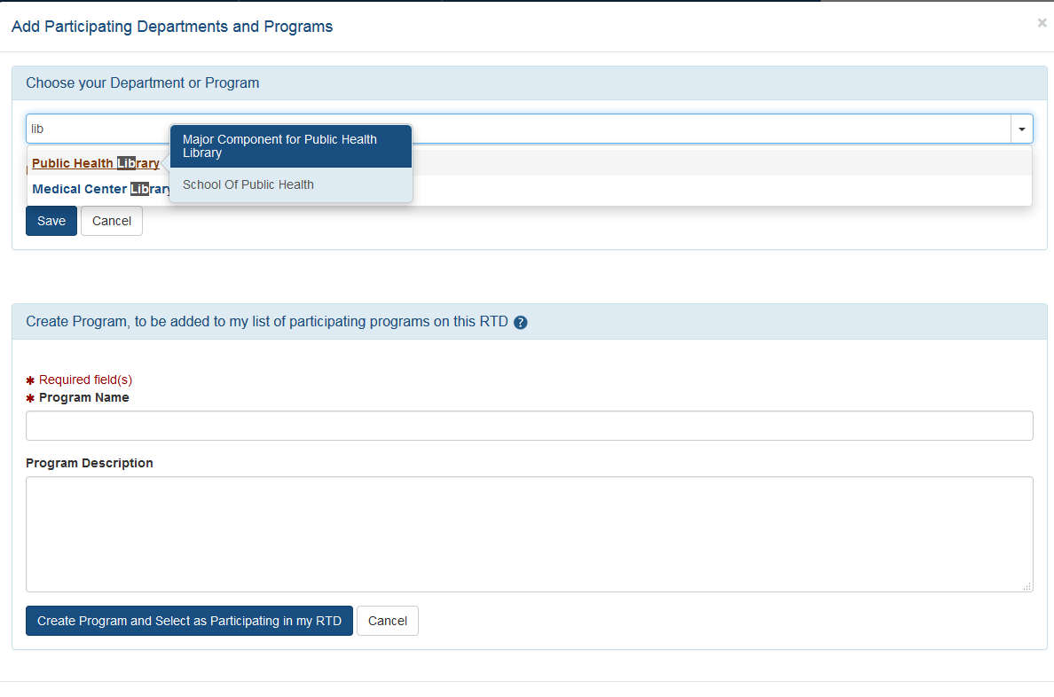
Modify RTD: Departments
Type ahead, xTRACT will bring up suggestions for existing Departments or Programs for your organization. Departments will specify their school when hovered over.
Utilize for New, Renewal or Revision RTDs.
User may create a Program for the institution in xTRACT.
xTRACT will pull Departments based on those in existence for the organization.
If the program does not exist, you may create a new one from this screen.

Slide 26
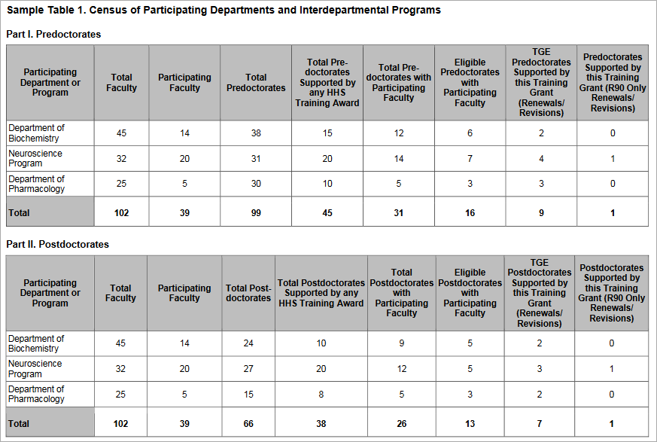
Generate
Table 1
The content of Table 1 is populated with data pulled from the Participating Department/Programs Detail component of the RTD section.
Depending on the type of application, this table may or may not be used, or only part of the table may be used.

Slide 27
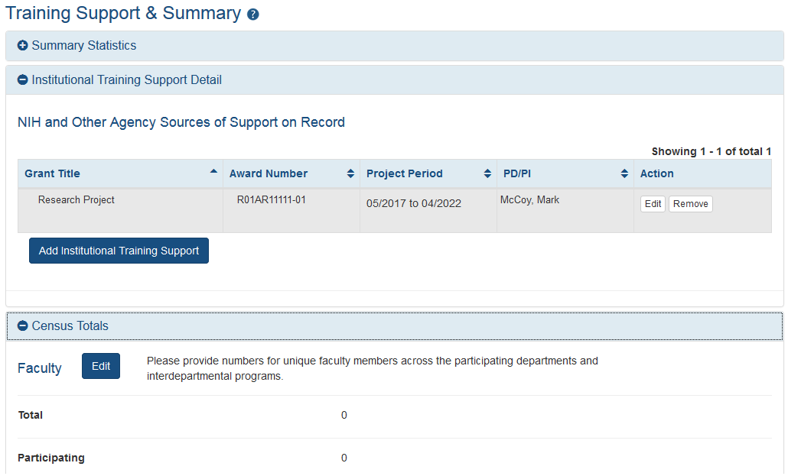
Modify RTD: Training Support
Add Institutional Training Support that will include overlapping faculty.
Utilize for New, Renewal or Revision RTDs.
Calculates and displays summary data entered for Faculty Research Support and Institutional Training Grants.
Census Totals display for Predocs and Postdocs across participating departments and programs.
Enter total and participating faculty manually; as some faculty may participate in multiple programs or departments.

Slide 28
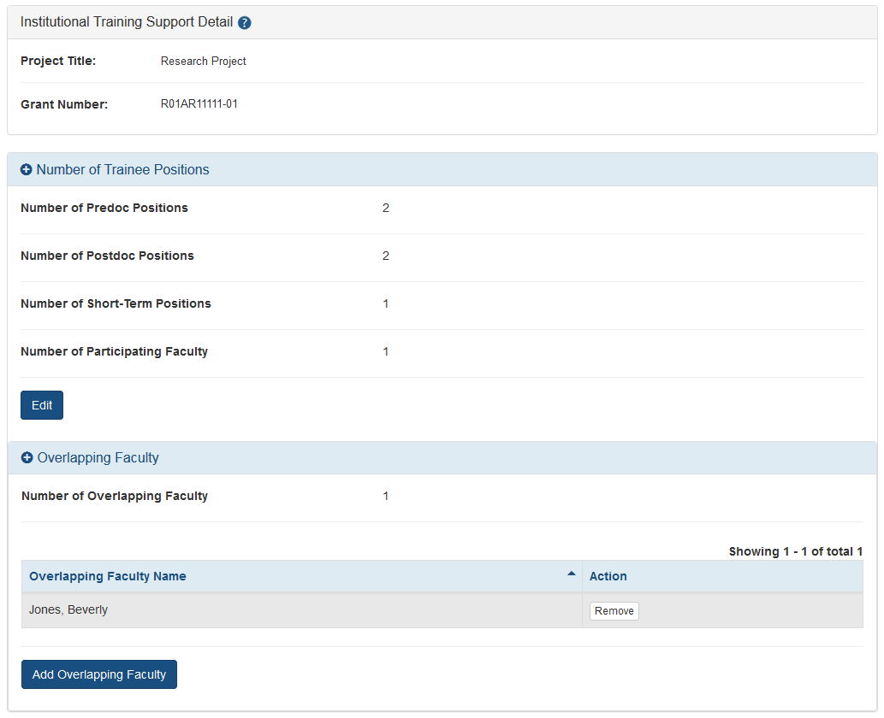
Modify RTD: Training Support
Edit chosen Institution Training Support will allow you to:
Enter the number of trainee positions under this Training Support
Identify Overlapping Faculty
xTRACT allow you to select from the faculty that you have added to the RTD.

Slide 29
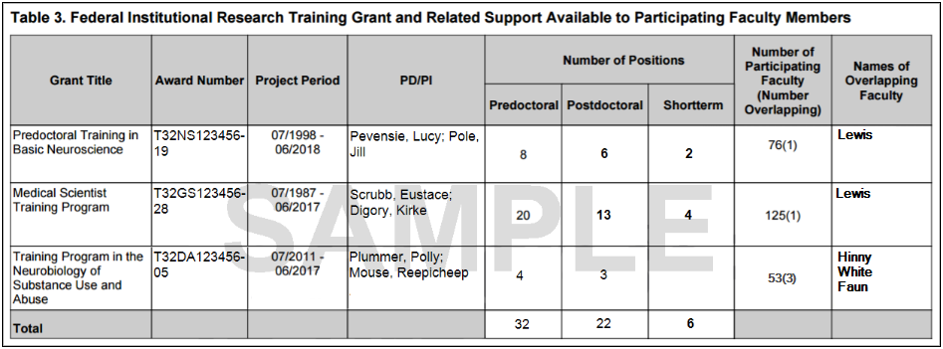
Generate
Table 3
The information in Table 3 is extracted from information in the Training Support & Summary section found in the xTRACT module in Commons.

Slide 30
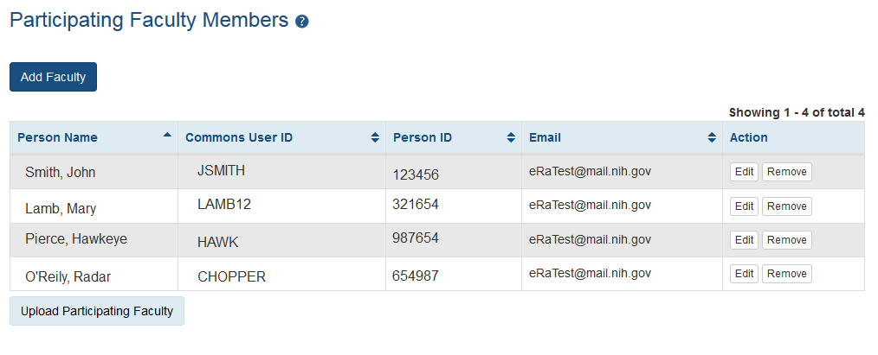
Modify RTD: Participating Faculty
Edit will allow you to update:
Faculty Member Data
Faculty Degree
Other Sources of Support
Mentoring Record
System will populate Degree Data from PPF, and will populate Research Support from NIH award data.
Add Faculty opens up the Search for Faculty screen.
Utilize for New, Renewal or Revision RTDs.
To add a Faculty member, they must have an eRA Commons ID, or an xTRACT Person Record.
If the faculty member does not have an xTRACT Person Record, you will have the option to create one after you’ve performed a search.
You may also upload Participating Faculty using tab-delimited file.

Slide 31
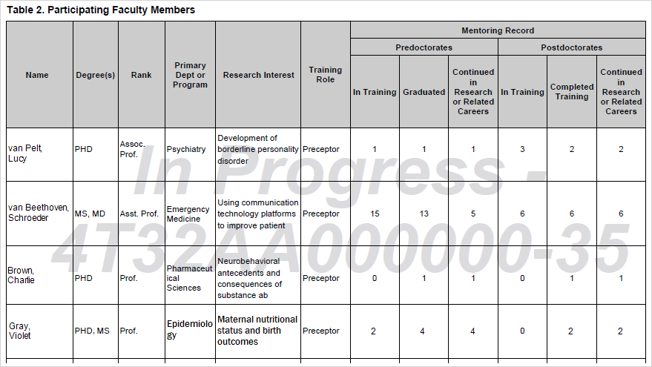
Generate
Table 2
The content in Table 2 is populated with data from the Participating Faculty section under RTD.

Slide 32
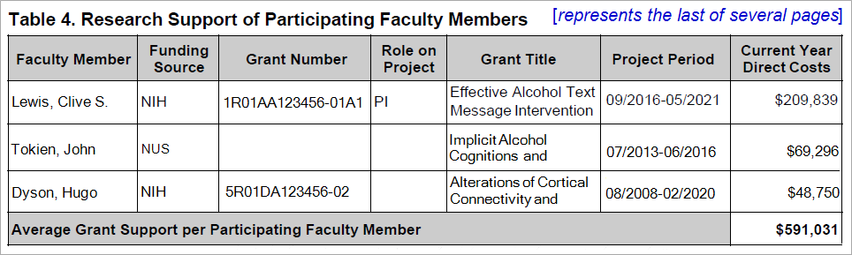
Generate
Table 4
The content in Table 4 comes from the Participating Faculty Members data which is accessed from the RTD menu in Commons. Information on Research Support is accessed individually per faculty member in that section.

Slide 33
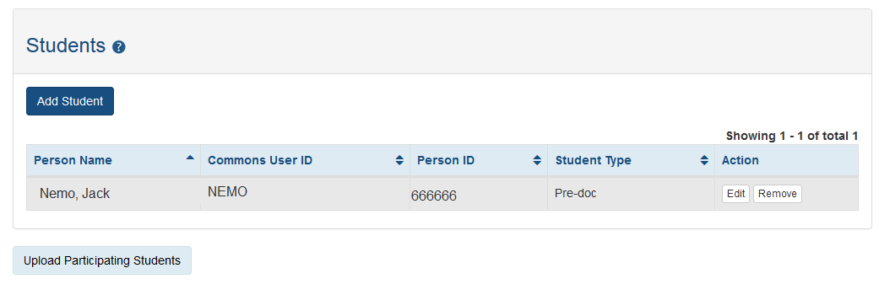
Modify RTD: Participating Students
Add Student button will open the Search for Student screen.
If the Student does not have a Commons ID or xTRACT Person Record, you will have the option to create an xTRACT Person Record after you’ve performed a search.
Utilize for:
New Applications
Predoctoral Renewal/Revision Applications requesting an expansion to postdoctoral support
Postdoctoral Renewal/Revision Applications requesting an expansion to predoctoral support
Edit will open the Participating Student Screen.
You may also upload Participating Students using a tab-delimited file.

Slide 34
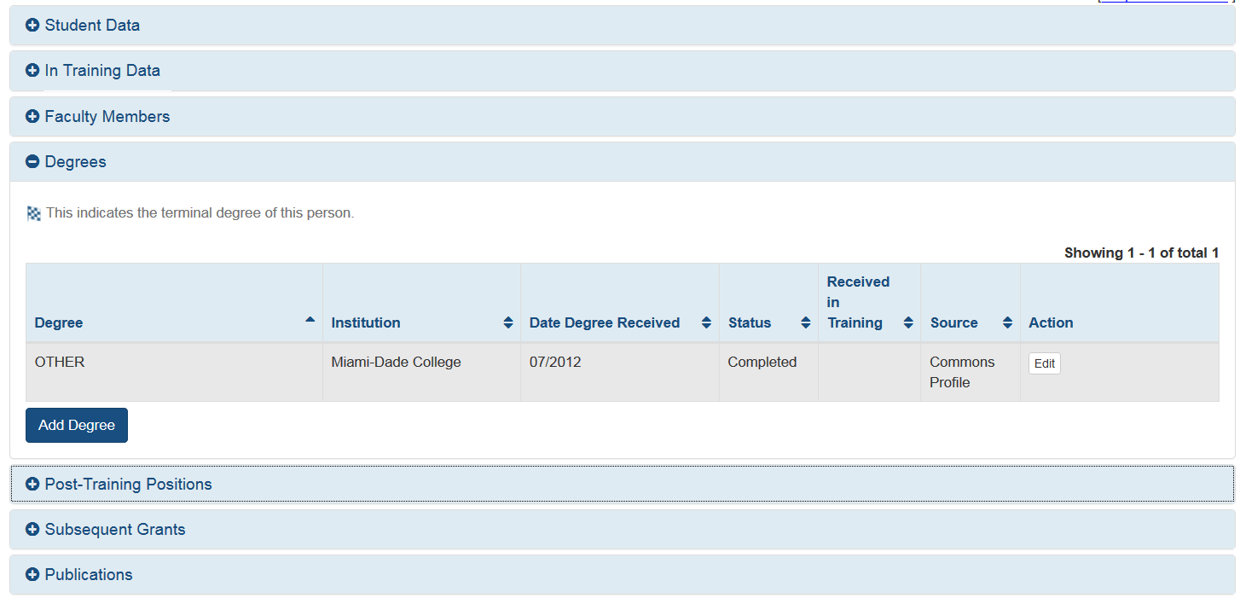
Modify RTD: Participating Students cont.
Degrees will populate from the PPF when available.
You may update:
In Training Data
Faculty Members
Degrees
Post-Training Positions
Subsequent Grants
Publications
Post-Training Positions will pre-populate when available.

Slide 35
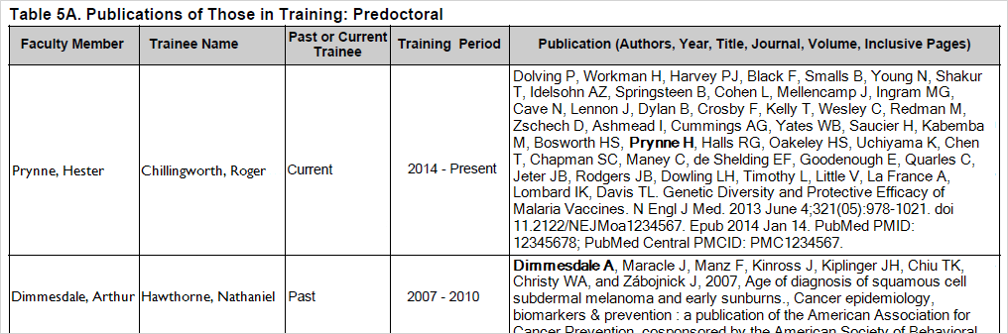
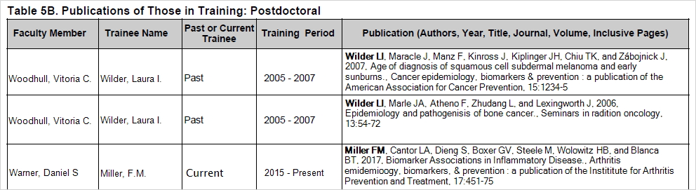
Generate
Table 5
The information that is populated into Tables 5A (predoc) and 5B (postdoc) is drawn from publication data in the Participating Trainees and Participating Students section accessed from the RTD menu.

Slide 36
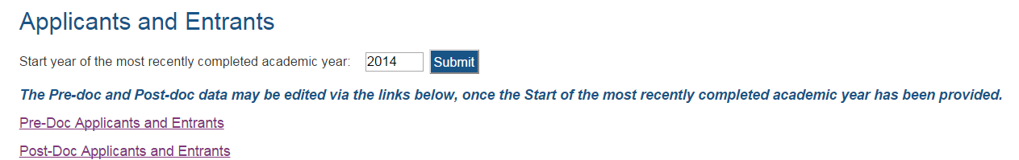
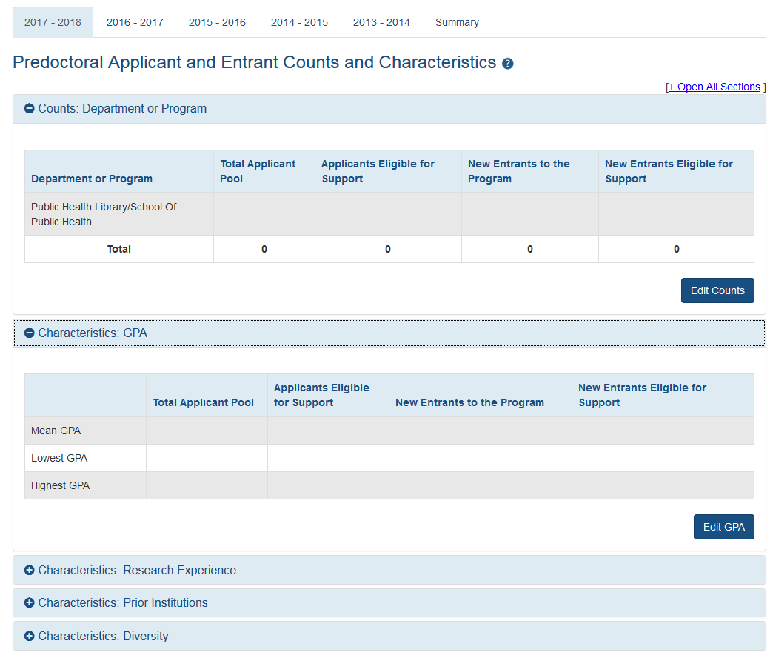
Modify RTD: Applicants and Entrants
Select the Applicant and Entrant category to provide counts and characteristics.
Utilize for New, Renewal or Revision RTDs.
Entering Start year of the most recently completed academic year sets up the last 5 academic years.
You will be given the option to enter data for Pre-Docs and Post-Docs.

Slide 37
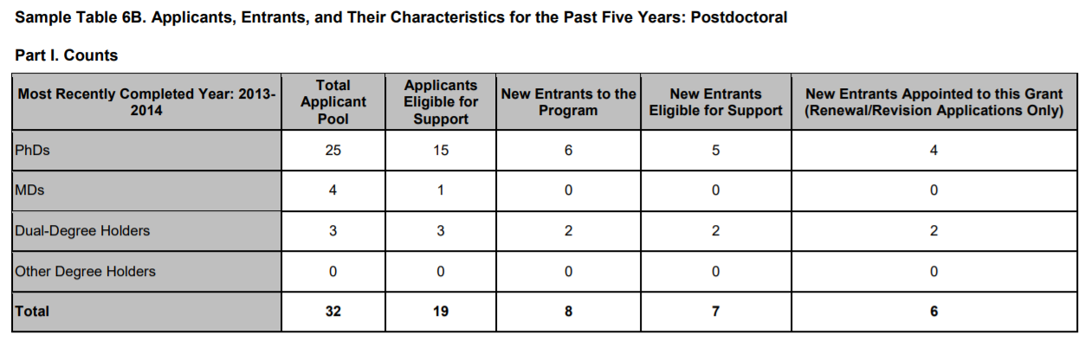
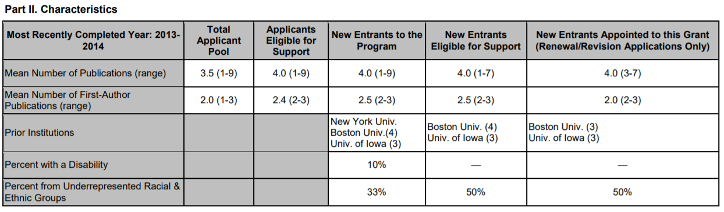
Generate
Table 6
The information that is populated into Tables 6A (predoc) and 6B (postdoc) is drawn from Applicants and Entrants section.

Slide 38
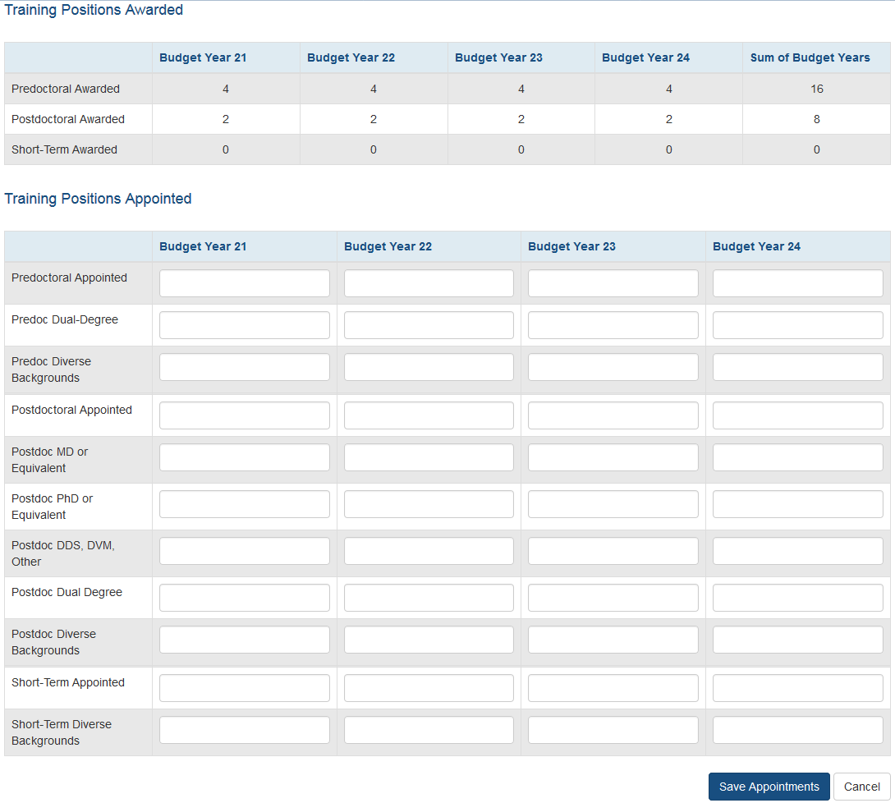
Modify RTD: Appointments
Utilize for Renewal or Revision RTDs.
Awarded Positions displayed as read-only from eRA database.
User enters Appointed Positions.

Slide 39
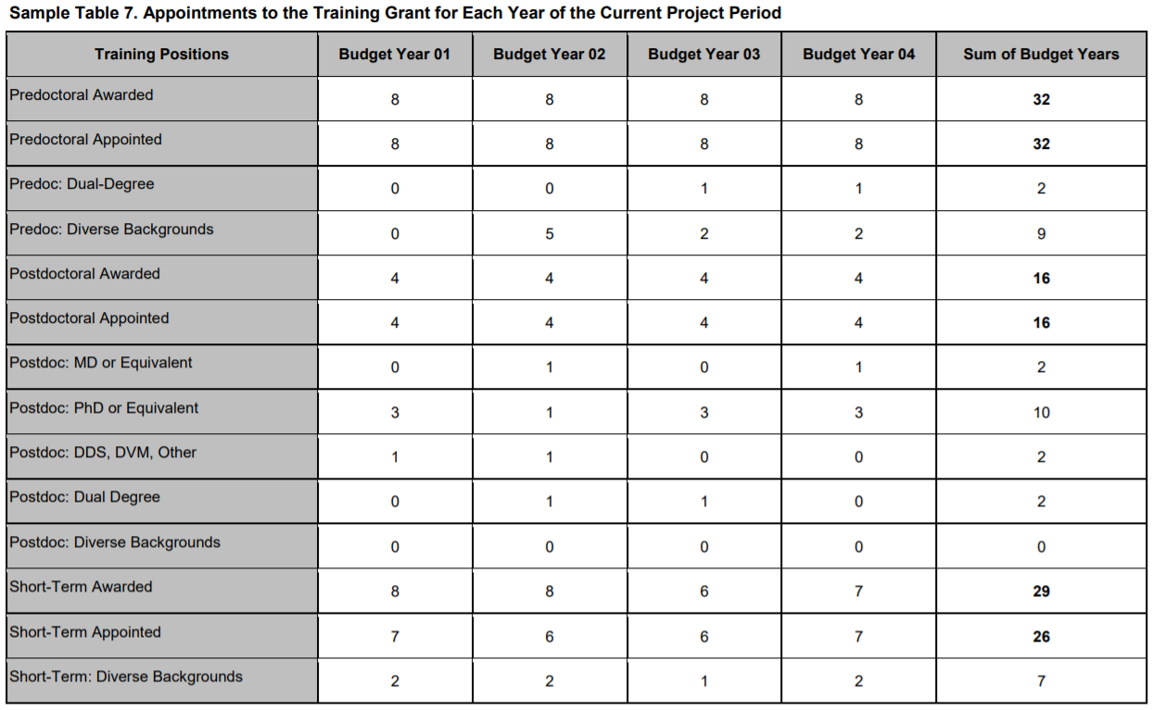
Generate
Table 7
The information that is populated into Tables 7 is drawn from Appointments section accessed from the RTD menu.

Slide 40
xTRACT Resource Links
xTRACT Online Help: https://era.nih.gov/erahelp/xtract/
xTRACT User Guide: https://era.nih.gov/files/_userguide.pdf
Training Tables: https://grants.nih.gov/grants/funding/datatables/Consolidated_Training_Tables.pdf
Instructional videos: https://era.nih.gov/era_training/era_videos.cfm#xTRACT

Slide 41
What is xTrain?
xTrain is an application that allows program directors/principal investigators, university administrators, and trainees to electronically prepare and submit PHS 2271 Statement of Appointment Forms (2271) and PHS 416-7 Termination Notices (TN) associated with institutional research training grants, institutional career development awards, individual fellowships, and research education awards.
Agency staff also uses xTrain to review and process the appointments and termination notices that are submitted electronically.

Slide 42
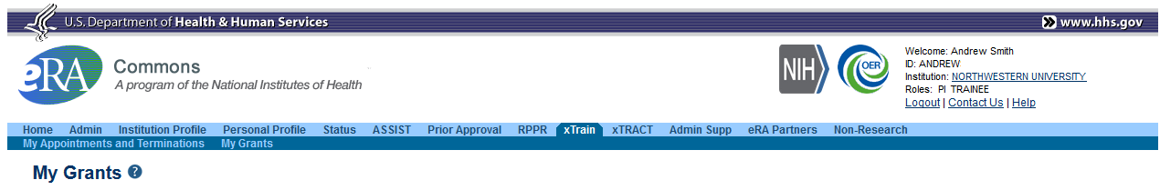
Accessing xTrain
The xTrain functions available to users are based on the “roles” associated with their accounts. If a user has a Trainee Role and a PD/PI role they will have the option to view “My Appointments and Terminations” or “My Grants”.
xTrain tab will appear for users with the following roles:
PD/PI
ASST
TRAINEE
BO
SPONSOR
Click on the Institution hyperlink to change the “Default Institution” if there are multiple affiliations

Slide 43


Example Work Flow in xTrain
PD/PI or ASST completes and routes form to the Trainee for electronic signature.
PD/PI or ASST
TRAINEE
Trainee fills out required information and routes the form back to PD/PI
PD/PI reviews form and routes it to BO
Routing captures the user’s electronic signature.
BO routes form to Agency
BO
Agency

Slide 44
What do the PD/PI and ASST do in xTrain?
PD/PI or ASST may create, modify, route, and submit forms, based on the activity code.
  Training (T) – work on and submit 2271, work on TN.
  Fellowships (F) – work on TN.
  Career Development (K/R) – work on and submit 2271 and TN.
Multi-PIs, can perform the same actions as the Contact PI.
Fellows are PD/PIs on Fellowship grants.
ASST must be delegated xTrain by a PD/PI on the grant, to access it in xTrain.

Slide 45
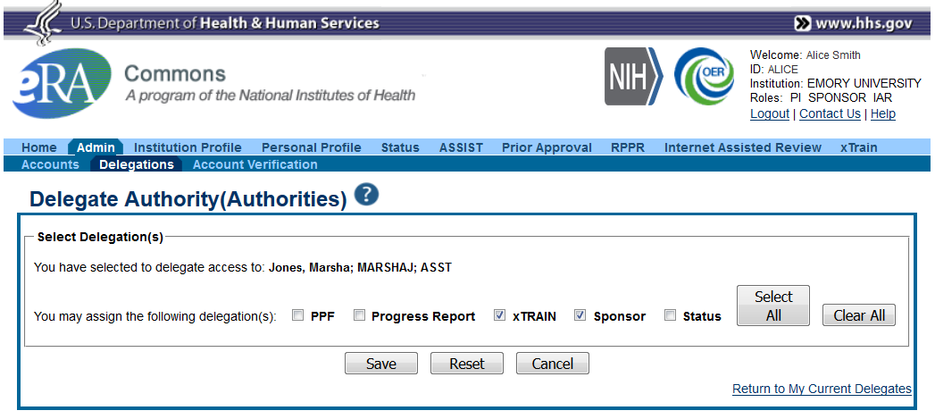
Delegating Access to xTrain
Delegations tab will display your current delegations. You may search for users at your institution to whom you wish to delegate xTrain or SPONSOR duties.
The PD/PI or the SPONSOR may delegate xTrain privileges to a user with the ASST Role.
Once delegated the ASST will have access to all of the PD/PI’s grants within xTrain.
The Sponsor delegation will allow the ASST to route forms on behalf of the SPONSOR.
ASST users may NOT submit forms to NIH.

Slide 46
What does the TRAINEE do in xTrain?
The TRAINEE is the person at grantee Institution who will be appointed to a grant.
The TRAINEE is responsible for:
Completing their Personal Profile (PPF); the 2271 Appointment Form populates certain required fields from the PPF.
Electronically sign the 2271 by routing to the PD/PI. Without the Trainee’s signature, the form may not be submitted to the Agency.
Provide the Training Received, Post Award Information and Post Award Mailing Address on the Termination form.

Slide 47
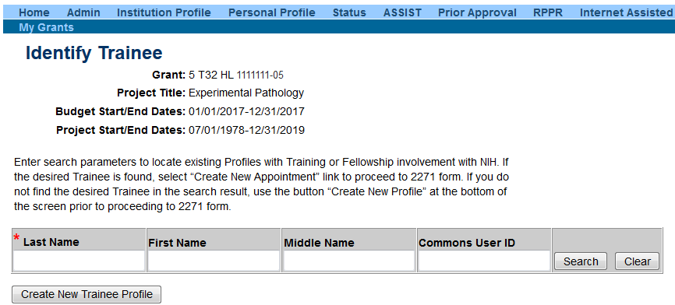
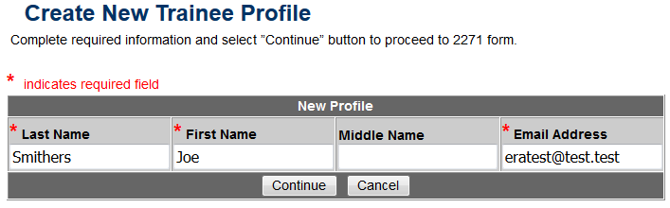
TRAINEE Account set-up
If the Trainee has an eRA Commons account, you may search for the account to create the appointment.
The TRAINEE role will be added to an existing account during the appointment process.
The PD/PI or ASST may create a new TRAINEE account by selecting the Create New Trainee Profile.
The TRAINEE will receive an invitation to complete the registration process.

Slide 48
What does the BO do in xTrain?
The BO has signature or other authority related to administering training grants.
BOs are the only users with the authority to submit Termination Notices on behalf of the institution for institutional research training programs and fellowships.
The BO is NOT involved in termination notices for Career and Research Education grants (K/R Activity codes).

Slide 49
What does the SPONSOR do in xTrain?
Applicable to Fellowship grants ONLY, the SPONSOR is the Fellow’s mentor at the grantee Institution.
When completing a Termination notice, the PD/PI should route the Termination notice to the SPONSOR for review, before the notice is sent to the BO for submission.
The SPONSOR may initiate the Termination if the Fellow is not available.
The Sponsor may delegate their duties to an ASST.

Slide 50
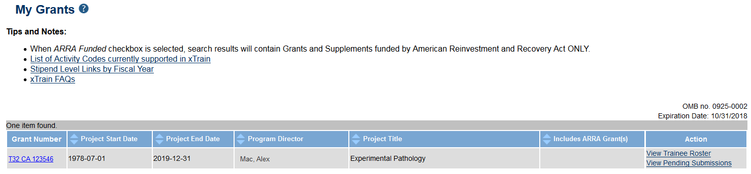
My Grants Screen
Access to Trainee Roster and Pending Submission

Slide 51
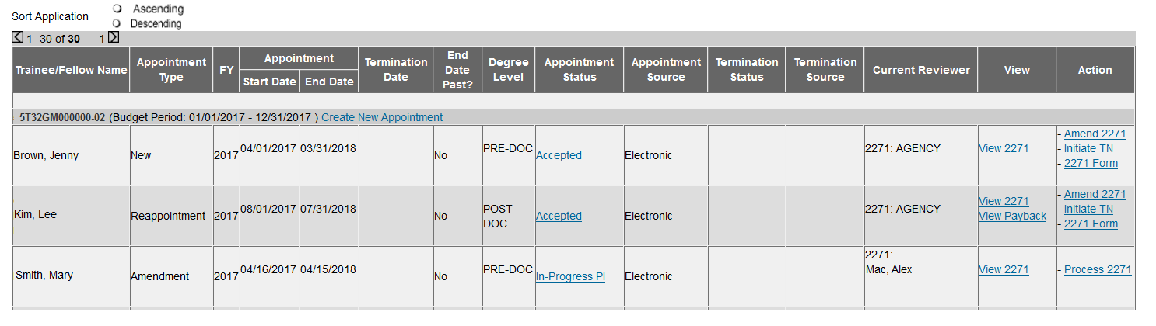
View Trainee Roster
Locate trainees to be appointed to the grant.
Status hyperlink will take you to the routing history.
Available actions for the appointment.

Slide 52

Appointment Flow
PD/PI identifies Trainee, initiates Appointment by filling out the 2271 and routes 2271 to Trainee
Trainee fills out the 2271 form and updates profile and routes it back to PD/PI
This work flow also applies to Re-Appointments and Amendments
Trainee
Program Director/ Principal Investigator
PD/PI reviews completed 2271 and routes it to Agency for final approval
Agency

Slide 53
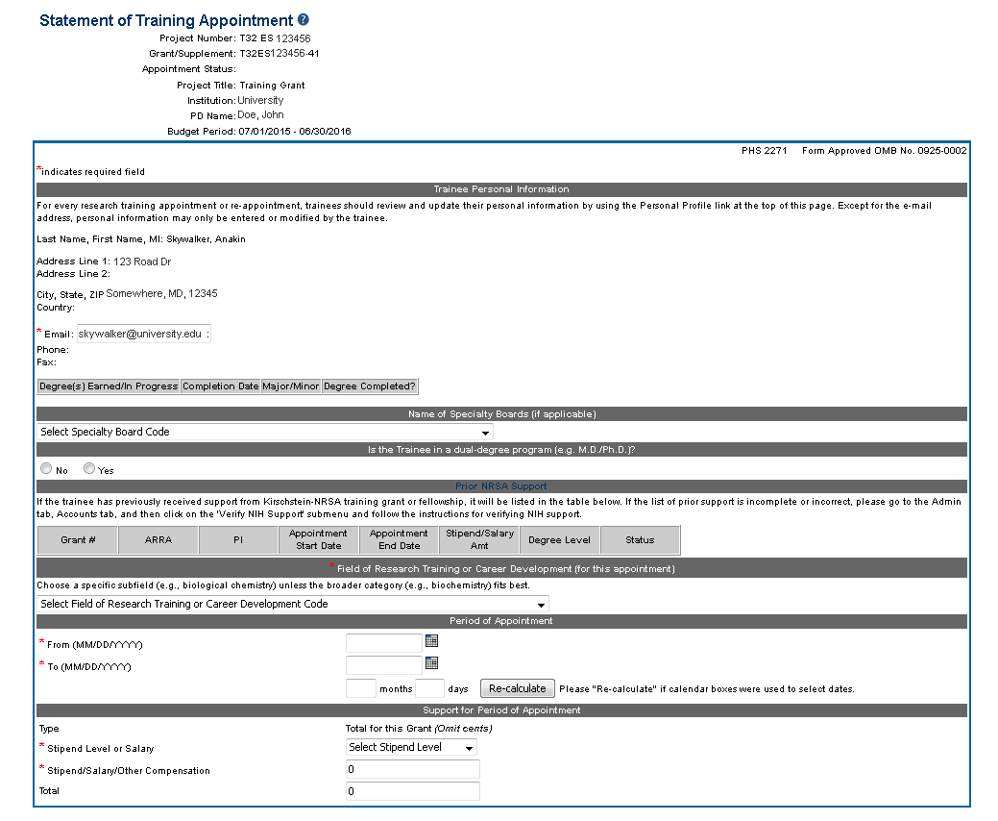
Appointment Form (2271)
Required by Training Grants (T) and Career Development Grants (K/R).
Initiated by PD/PI or ASST.
Must be electronically signed by the Trainee/ Appointee.
Prepopulates Trainee’s information, such as Prior NRSA Support and Address.
Submitted by PD/PI.
Address is populated from the Trainee’s PPF
Stipend level amounts are dictated by the Fiscal Year of the appointment.

Slide 54
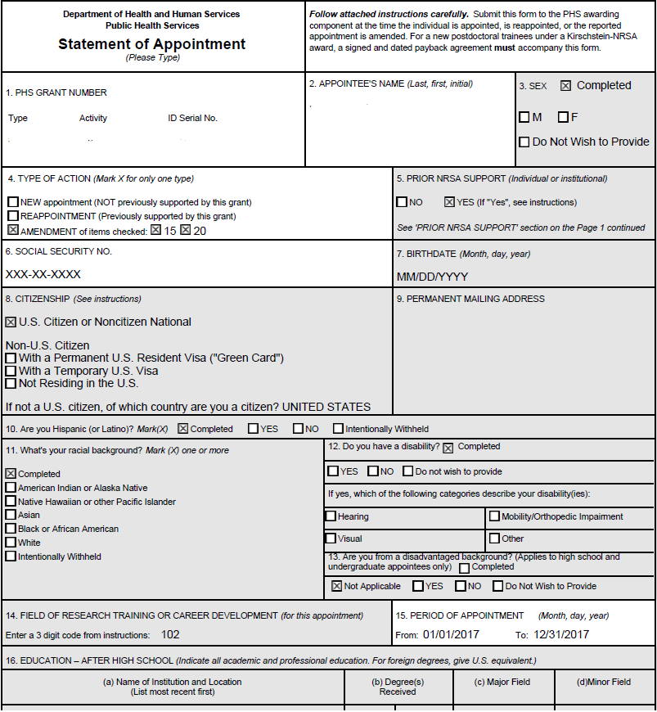
Appointment Form PDF
The PDF indicates when demographic data has been completed; data will not be displayed.
Data is populated from the Trainee’s Profile, Grant, and appointment form in xTrain.
The PDF cannot be modified, if data needs to be corrected it should be done through the appropriate module.

Slide 55
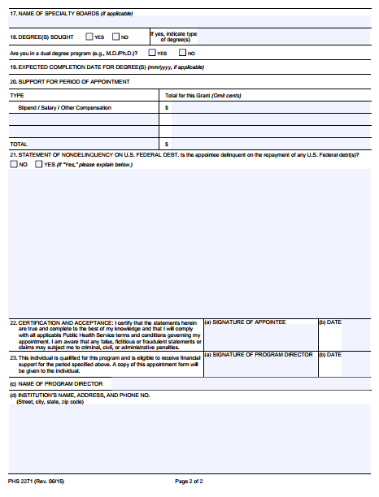
Appointment Form PDF Cont.
The PDF form captures the electronic signature of PD/PI and Trainee
The form is finalized when the PD/PI submits it to agency.

Slide 56
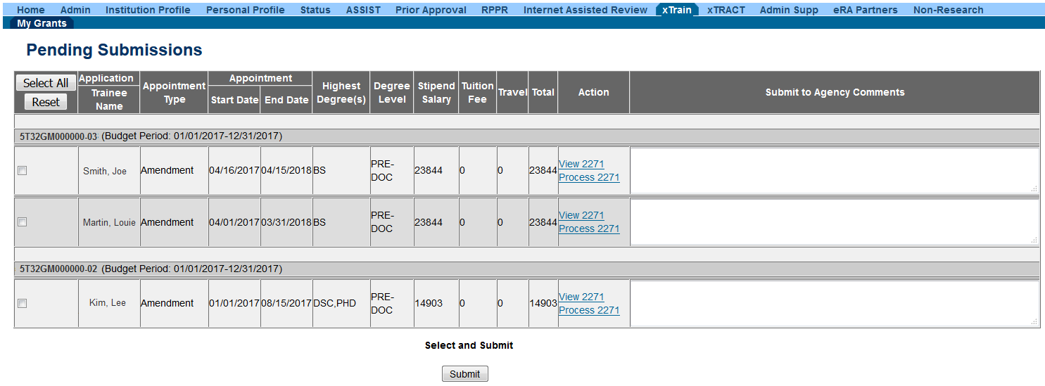
Pending Submissions
Ensure to preview the PDF before submitting to agency.
The Pending Submission Screen allows the PD/PI to submit multiple 2271 forms at once.
Forms must be In-Progress PI, and error free before submission.
Submit to Agency Comments are optional.

Slide 57
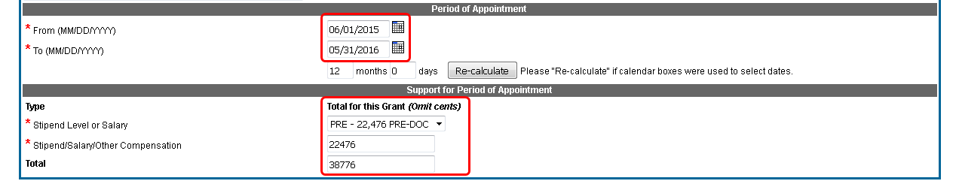
Amendments
Grantees should use an Amendment form if they need to make changes to the following:
Changes to Appointment Period
Changes to Stipend Level
Once accepted, by agency, the amendment will replace the original appointment.

Slide 58
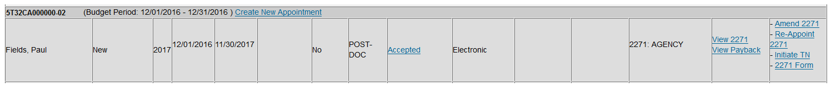
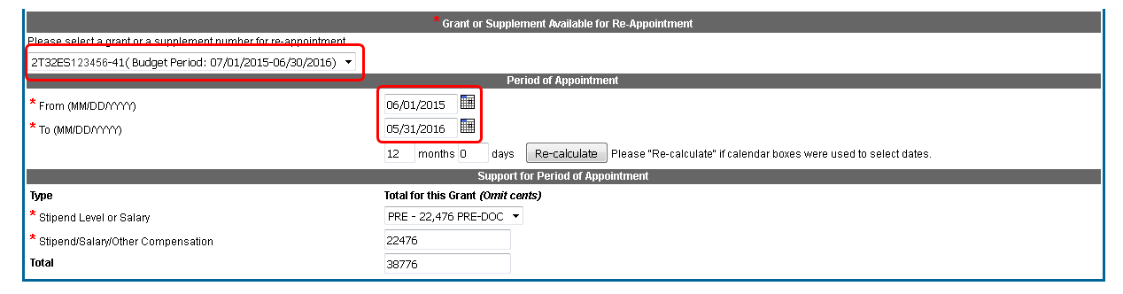
Reappointment
If a Trainee will be continuing on another year of the grant a “new” appointment form is not necessary. In the Trainee Roster the Action column contains an option to “Re-Appoint” trainee.
The PD/PI or ASST will select the grant year to which the trainee is to be re-appointed, and enter the new appointment start and end date.

Slide 59
Training (T) Termination Notice Work Flow
Program Director/ Principal Investigator
PD/PI locates Trainee on Roster, initiates a Termination Notice (TN), inputs additional info and routes TN to Trainee
Trainee
Trainee fills out required information and routes the TN back to PD/PI
PD/PI reviews TN and routes it to BO
BO approves and routes TN to Agency
Business Official
Agency

Slide 60
Career (K/R) Termination Notice Work Flow
PD/PI locates Trainee on Roster, initiates a Termination Notice (TN), inputs additional info and routes TN to Trainee
Trainee fills out required information and routes the TN back to PD/PI
Trainee
Program Director/ Principal Investigator
PD/PI approves and routes the TN to Agency
Agency

Slide 61
Fellowship (F) Termination Notice Work Flow
Fellow
(PD/PI)
PD/PI initiates a Termination Notice (TN) from the Trainee Roster, inputs additional info and routes TN to Sponsor
Sponsor
Sponsor verifies information and routes the TN to BO
BO approves and routes TN to Agency
Business Official
Agency

Slide 62
Termination Notice
Termination Notices (TNs) should be started on the last appointment period, this will terminate all previous years.
xTrain will send reminders when a TN is coming due.
The PD/PI, ASST, BO may initiate a TN at any time for a Training (T) grant.
The PD/PI, SPONSOR or BO may initiate a TN at any time for a Fellowship (F).
The PD/PI or ASST may initiate a TN at any time for a Career (K/R) grant.
TNs for T and F grants must be reviewed by at least 2 people before they can be submitted to Agency.
For T and F grants, initiated TNs are automatically routed to the assigned BO if no action is taken within 14 days.

Slide 63

Termination Form
The PD/PI, ASST, BO may initiate a TN at any time for a Training (T) grant.
The PD/PI, SPONSOR or BO may initiate a TN at any time for a Fellowship (F).
The PD/PI or ASST may initiate a TN at any time for a Career (K/R) grant.
A Business Official must be selected from the dropdown.
If a Trainee leaves the appointment early, modify the Termination Date.
Stipend may only be modified if the Termination Date is changed.

Slide 64

Termination Form cont
Trainee should provide:
Summary of training received. If summary is over 2000 characters with spaces, a PDF should be uploaded.
Post Award information such as mailing address and activities.

Slide 65

Termination Form PDF
xTrain captures the electronic signature of the users that worked on the Termination notice.
The PDF cannot be modified directly, user must make corrections within xTrain if the PDF has errors.

Slide 66
Routing and Recalling Forms
Only current reviewer can route a form; since the ASST acts on behalf of the PD/PI, the form must in In-Progress PI for the ASST to route it.
The Previous reviewer may recall the 2271 or the TN; they will be required to enter a comment, which will be sent to the person from whom the form was recalled.
Once a form has been routed to Agency it cannot be Recalled.
The PD/PI may recall a TN even if they were not the last person to review it.
The system will auto-route TNs to the BO listed on the form after 14 days.

Slide 67
xTrain Resource Links
  xTrain Web Page: application guide, quick reference sheets, FAQs, training materials:
  http://era.nih.gov/era_training/xtrain.cfm
  xTrain Quick Reference Guide for Trainees:
  http://era.nih.gov/files/xTrain_Getting_Started_Trainees.pdf
  xTrain Appointment Quick Reference Guide:
  http://era.nih.gov/files/xTrain_Initiate_Appointment.pdf
  xTrain Termination Quick Reference Guide:
  http://era.nih.gov/files/termination_appointment.pdf
  NIH Forms & Applications:
  http://grants.nih.gov/grants/forms.htm

Slide 68
Need help?
The eRA Service Desk can assist with technical issues related to xTrain.
  Hours: Mon-Fri, 7 a.m. to 8 p.m. Eastern Time (closed on federal holidays)
  Toll-free: 1-866-504-9552
  Phone: 301-402-7469
You may also submit a ticket online at: http://grants.nih.gov/support/index.html

