Slide 1
New Look, New Screens for IAR Coming May 5
electronic Research Administration (eRA)
OER, OD, National Institutes of Health
April 20, 2016
eRA Communications Office

Slide 2
Highlights
New screens; major capabilities remain the same
“Go To” dropdown navigation
Resizable screens
Meeting identifiers on all screens
Prominent look for buttons
Drag and drop, to change order of meeting materials
Easy filter present on some of the lists
Collapsible sections on the screen

Slide 3
Old List of All Applications Screen

Slide 4
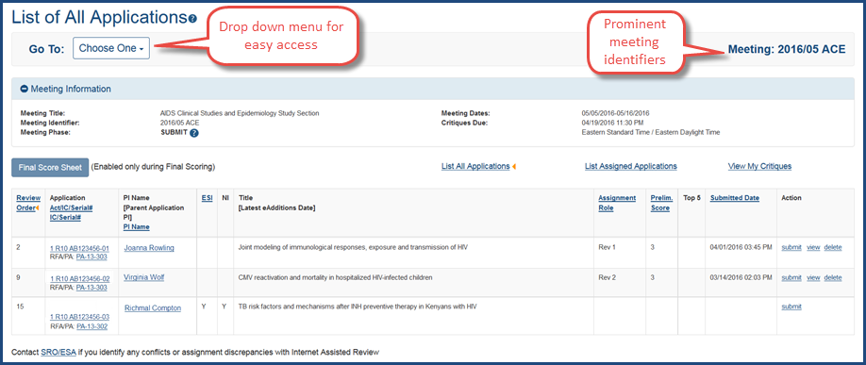
New List of All Applications screen
Drop down present on 4 screens: List of All Applications; List of Meetings; Meeting Materials; and Preliminary Score Matrix

Slide 5
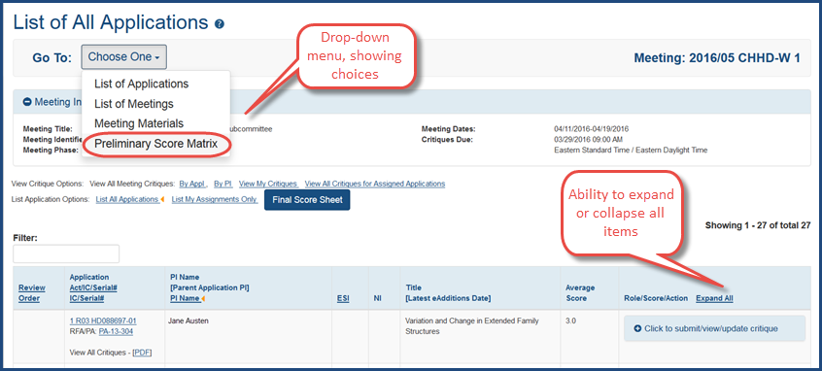
List of All Applications: Drop Down Menu

Slide 6
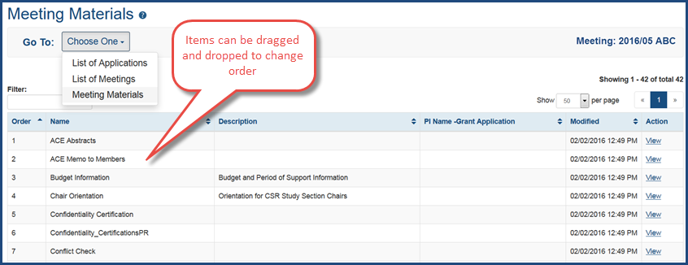
Meeting Materials Screen: Cool Feature

Slide 7
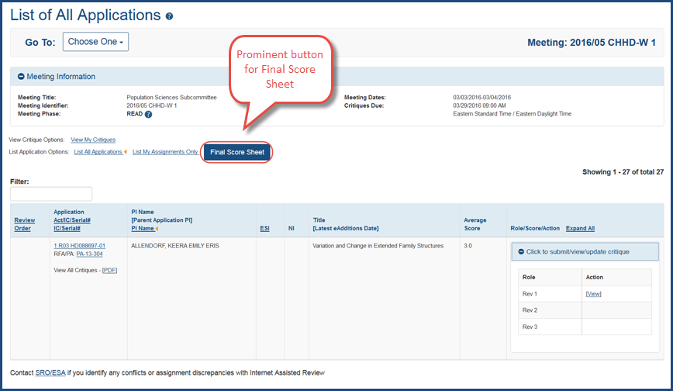
List of All Applications: Final Score Button

Slide 8
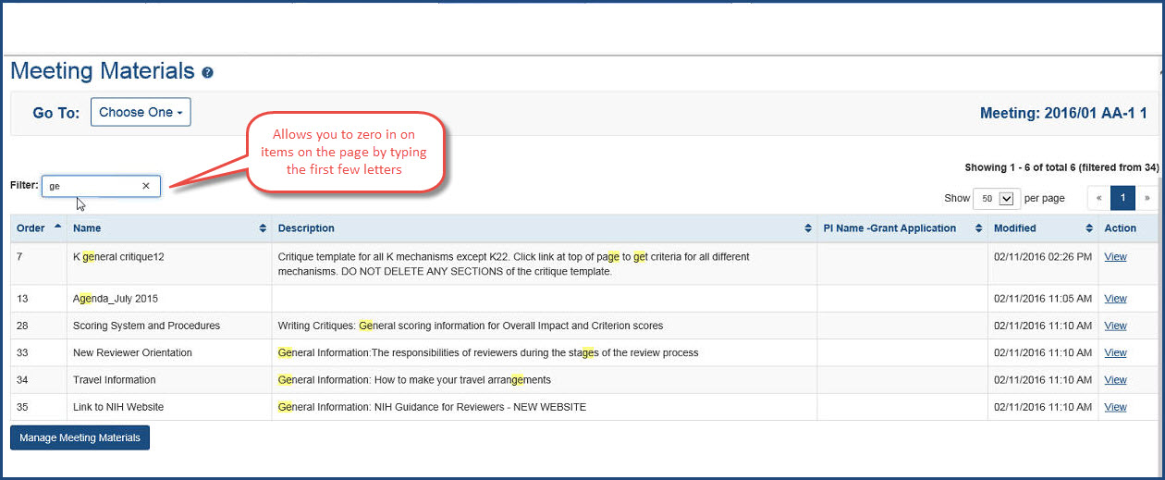
Meeting Materials screen: Filter to item(s)

Slide 9
Online Help (Coming May 5)
Look for IAR for Reviewers Online Help
https://era.nih.gov/erahelp/IAR_Rev/default.htm
Accessible from the eRA website and from IAR screens

