Slide 1
Letters Home: What I Learned at Camp NIH About ASSIST & eRA Commons
Sheri Cummins & Joe Schumaker
August 2015

Slide 2
Stuff Worth Writing Home About
No Cost Extensions,
Federal Financial Reports,
Federated Login, eRA Mobile
Delegations & Account Management
Application Submission Options,
ASSIST & Next Set of Form Changes

Slide 3
Letter Home
Dear Mom & Dad,
Camp NIH is great. I’m learning all sorts of stuff.
You’d be surprised what you have to do to submit a grant application. We learned how to use this new tool called ASSIST. It makes it A LOT easier, but there is still so much they expect us to know. Ugh!
Love,
Claire
P.S. Please send lots of chocolate!

Slide 4
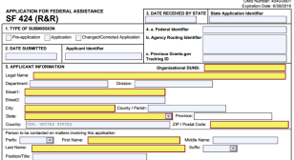
Application Submission Options
System-to-System
ASSIST
Downloadable Forms*
* Single-project only

Slide 5
ASSIST Support Timeline
Available for all multi-project programs
Support Expanding to single-project programs in 2015
NIH Guide notices announce ASSIST availability for each set of activity codes once in place
Training (Ts & Ds), DP7, K12, R13, R15, R18, R21/R33, R24, R25, R33, R34, R35, R36, R61/R33, RF1, RM1, SI2/R00, U13, U18, U34, U2R, U34, UA5, UF1, UG3/UH3, UH1, UH2, UH2/UH3, UH3, UH4, UM1
C06, DP1, DP2, DP3, DP4, DP5, G07, G08, G11, G12, G13, G20, RC1, RC2, RC3, RC4, S06, S07, S10, S11, S21, S22, SC1, SC2, SC3, UC1, UC2, UC3, UC4, UC6, UG1, UP5, X01, X02
R03, R21
R01, U01, Career Dev (Ks except K12)
SBIR/STTR (R41, R42, R43, R44, SB1, U43, U44, UB1, UT1, UT2)
Fellowships (Fs)
Jan/April
2015
July
2015
September
2015
October
2015
December
2015
Timeline:
http://grants.nih.gov/grants/ElectronicReceipt/files/Timeline_for_Single-Project_ASSIST_Support.pdf

Slide 6
ASSIST Features
Secure web-based data entry
Collaboration of multiple users
Pre-submission validation of NIH and key Grants.gov business rules
Pre-population of data from eRA Commons profiles
Pre-submission print/preview of application in NIH format
Submission status tracking for both Grants.gov and eRA Commons within a single system
And more (see NOT-OD-15-044)

Slide 7
Your application will be…
Subject to the same registration requirements
Completed with the same data items
Routed through Grants.gov
Validated against the same NIH business rules
Assembled in a consistent format for review consideration
Tracked in eRA Commons
…regardless of submission option used.

Slide 8
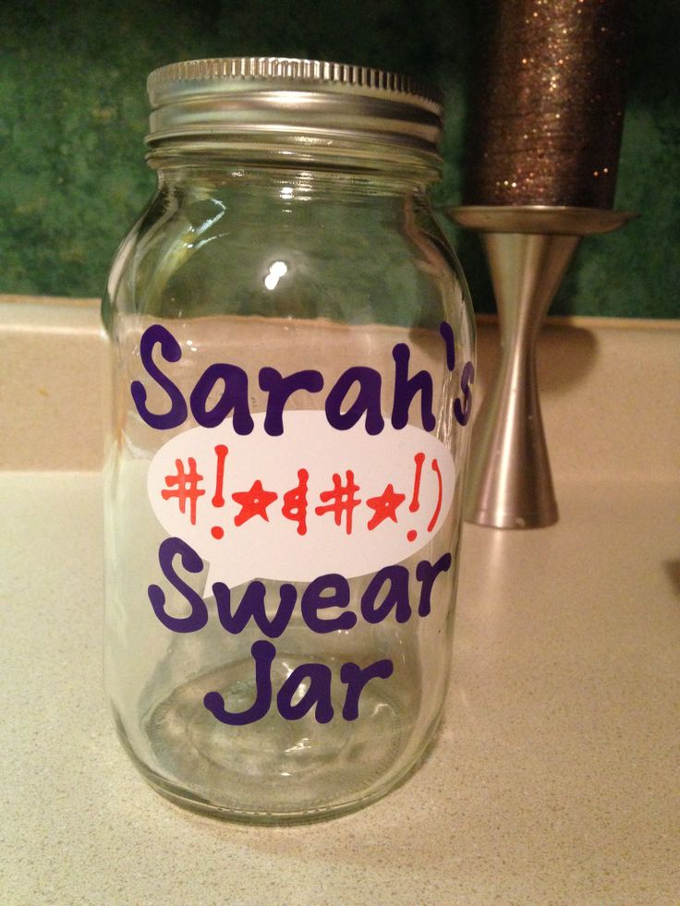
Letter Home
Dear Mom,
Remember how you said it was really hard to register for this camp? We’re learning how to register to submit grant applications.
Before we started we all had to go to Arts & Crafts to make swear jars. We thought it was silly, but by the time we got through the SAM registration we all understood. They think of everything here.
Love,
Sarah
P.S. Please send cash!

Slide 9
All Standard Registration Requirements Apply to All Submission Options
Allow a minimum of 6 weeks to complete all registrations!
http://grants.nih.gov/grants/ElectronicReceipt/files/registration_handout.pdf

Slide 10
Who needs a Commons Account?
At least 1 Signing Official (suggest having back-ups)
PD/PI(s)
Sponsor on a Fellowship application (NOT-OD-14-129)
Component leads of multi-project applications
Anyone doing application data entry in ASSIST

Slide 11
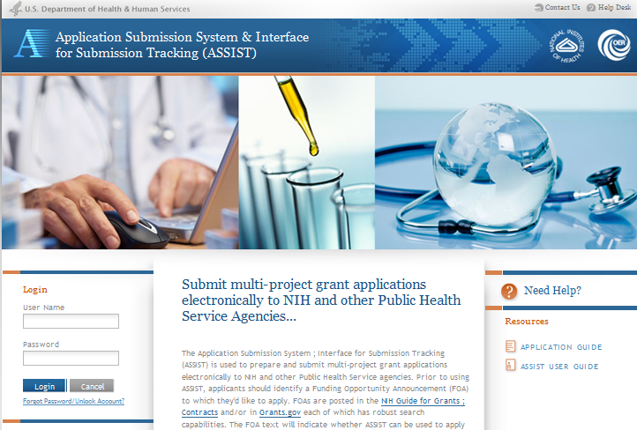
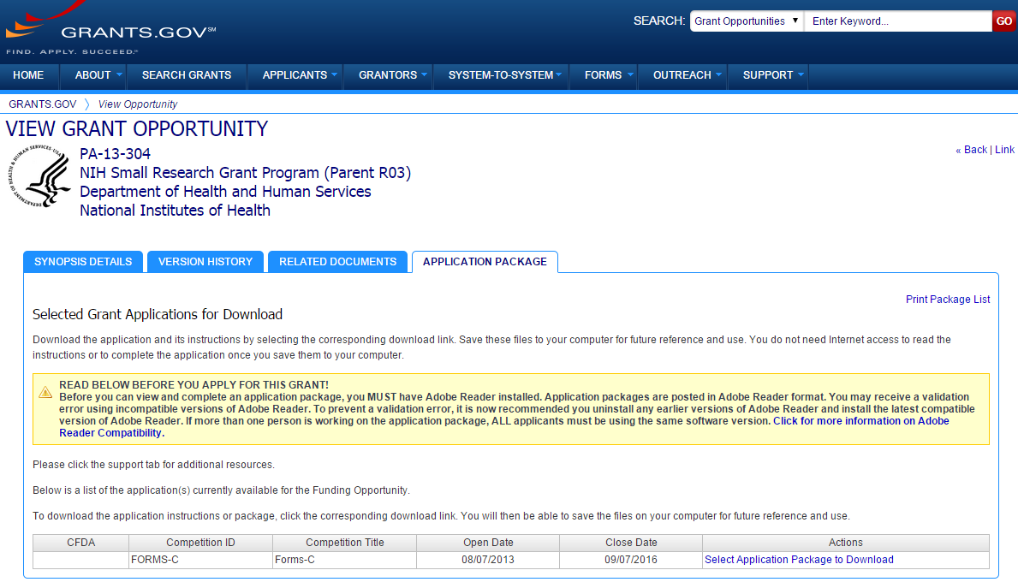
New FOA “Apply” Buttons
Excerpt from single-project FOA in NIH Guide…

Slide 12
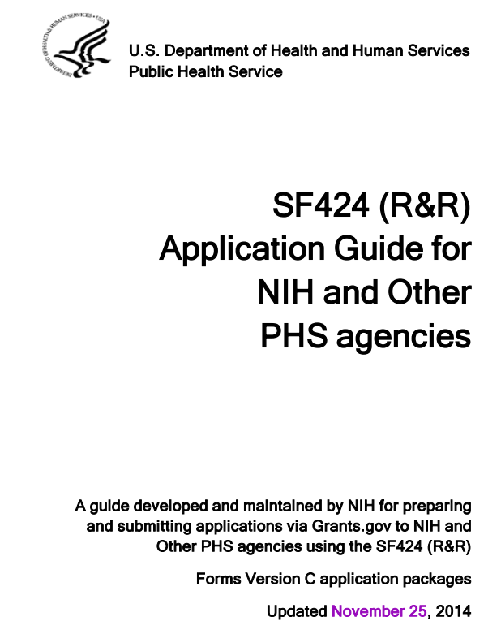
Application Guides
Looking for ways to improve instructions.
Ideas?
http://grants.nih.gov/grants/funding/424/index.htm

Slide 13
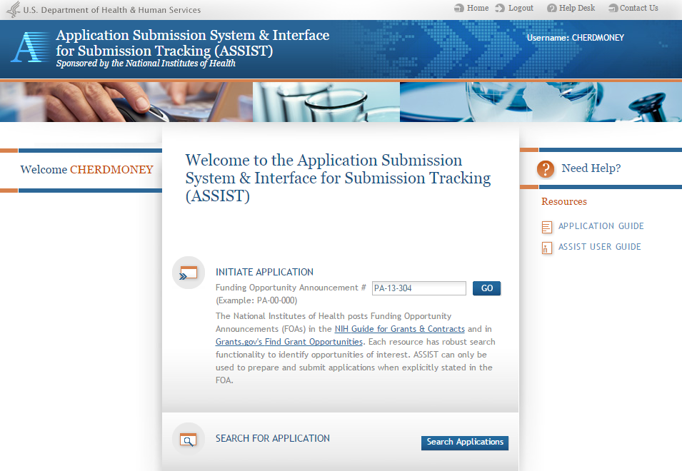
Initiating an Application Using ASSIST
http://public.era.nih.gov/assist

Slide 14
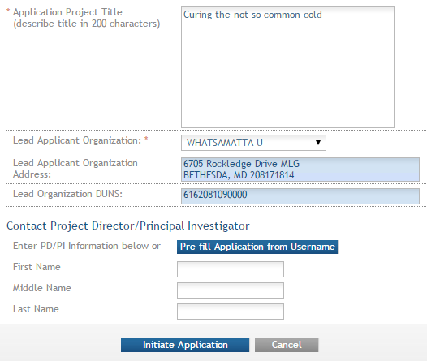
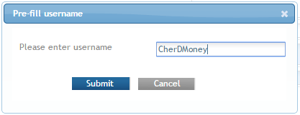
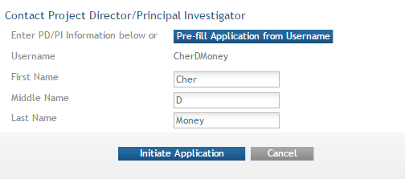
Pre-population from eRA Commons
Data pre-populated from organization selection
Can manually enter PD/PI information or provide eRA Commons username to auto-populate
14

Slide 15
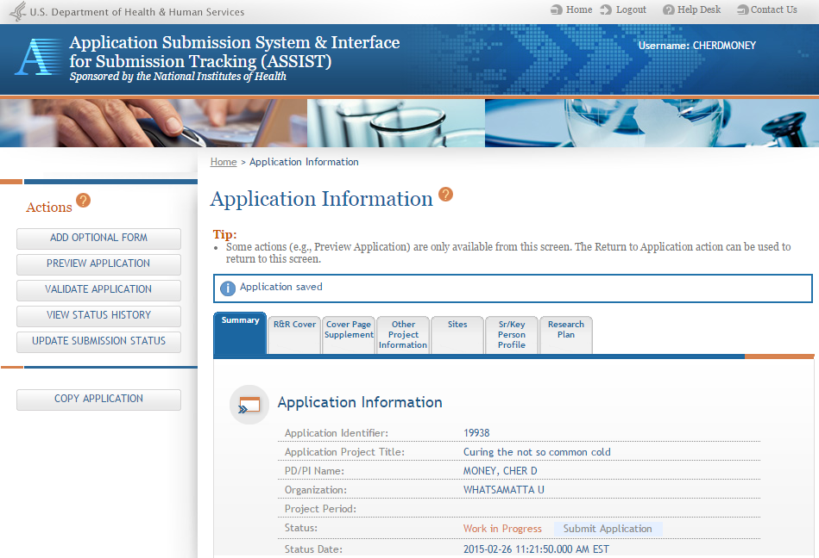
ASSIST Screen Layout
Access online help
Screen tips
ASSIST messages
Form navigation
Available actions vary based on application context and user access

Slide 16
Automatic Application Access
ASSIST automatically provides application access to some individuals based on their Commons roles or role on the application
Examples:
Users with Commons accounts that have the Signing Official (SO) or Administrative Official (AO) role have access to all applications for their organization
All PD/PIs listed in the Overall component of the application have edit access for the entire application

Slide 17
Manage Access
Performed by Signing Official (SO)
SO can give Access Maintainer authority for an application to others
Application access can be given to additional users with Commons IDs
Application access can be controlled across these variables:
Read vs. Edit
Budget vs. Non-budget data
Entire application vs. specific components (multi-project)

Slide 18
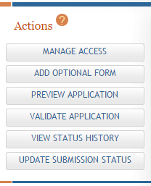
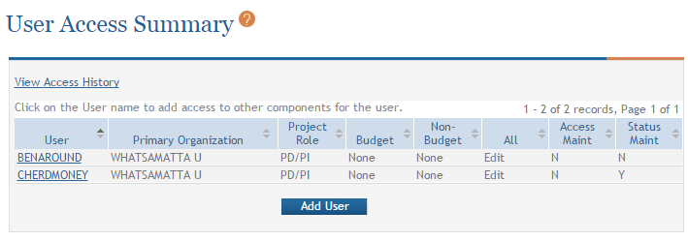
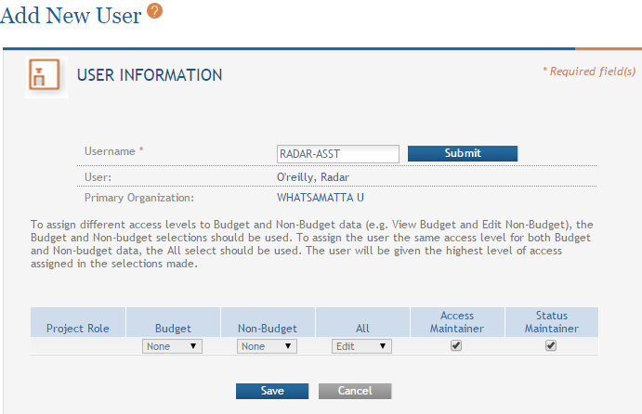
Providing Application Access to a User

Slide 19
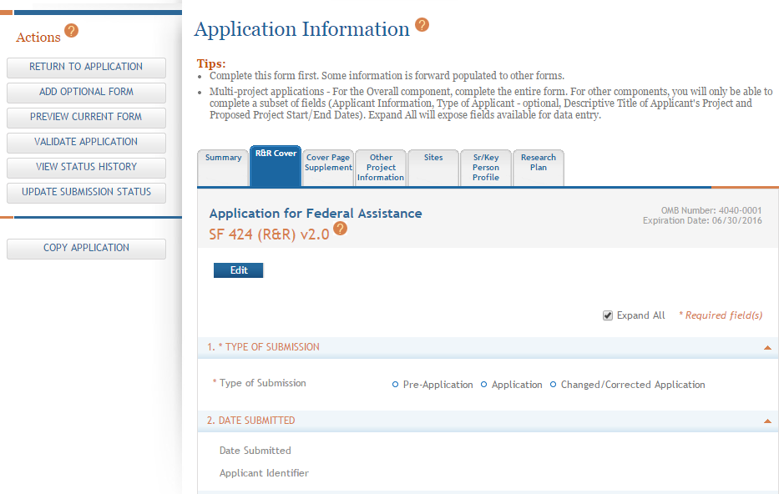
ASSIST Data Entry
Click each tab to access form data entry screens
Clicking Edit blocks other users from editing form

Slide 20
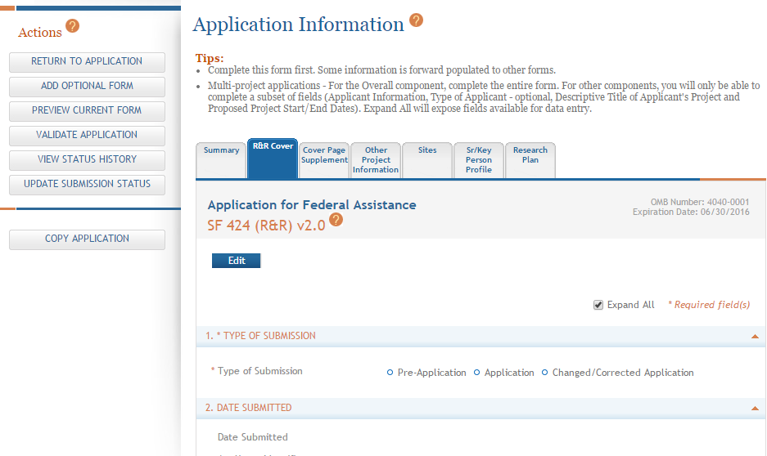
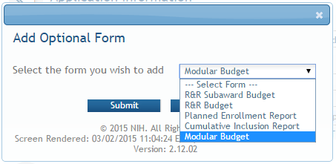
Adding Optional Forms
Select form and click Submit
The form tab is added to navigation

Slide 21
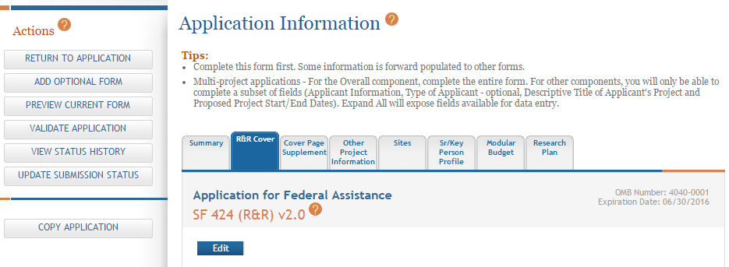
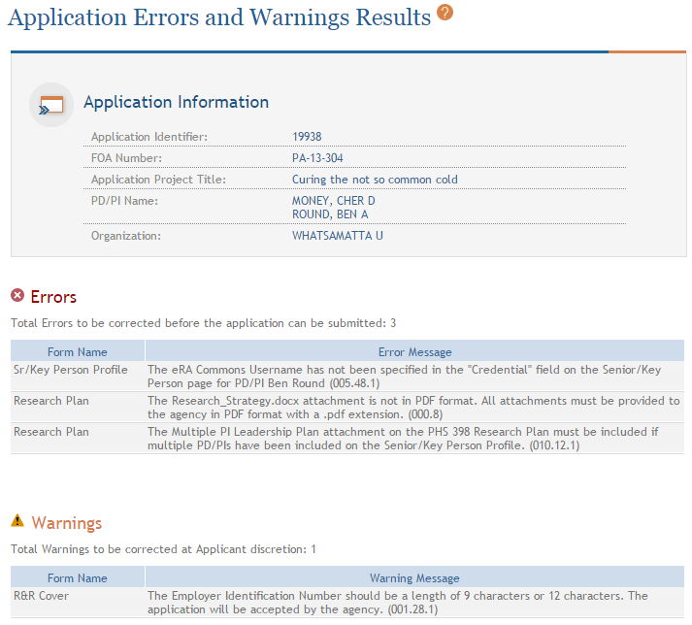
Validate Application
Errors and Warnings are displayed

Slide 22
Generating Application Preview
View last preview
Generate new preview

Slide 23
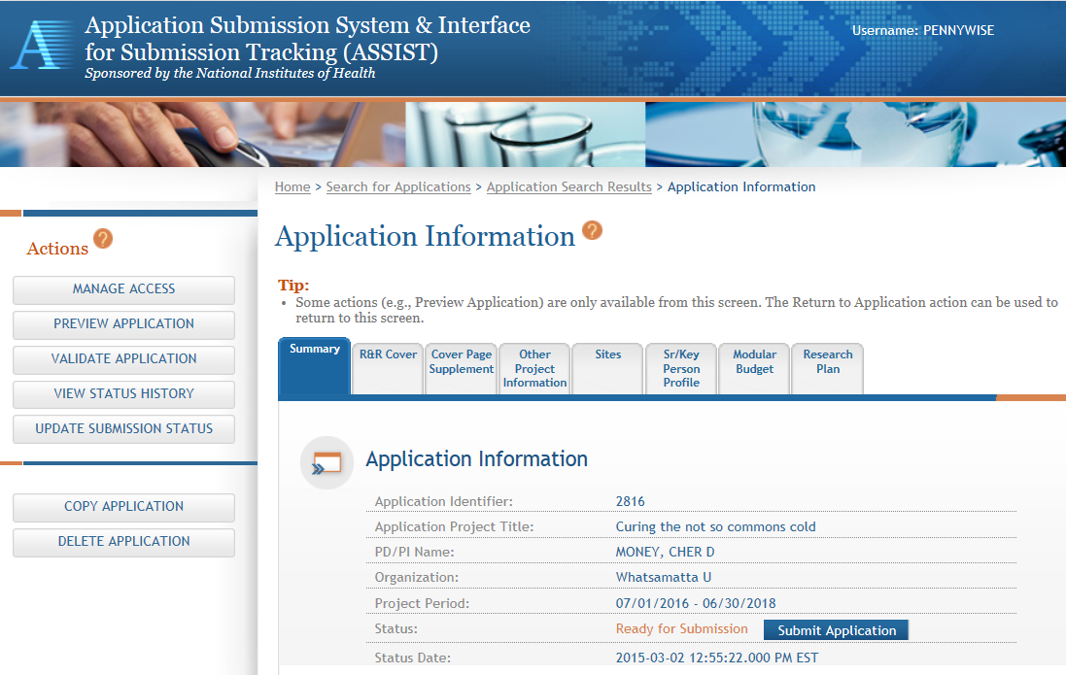
Submitting an Application in ASSIST
Must be an eRA SO and a Grants.gov AOR to submit
Submit Application button is only active for SOs

Slide 24
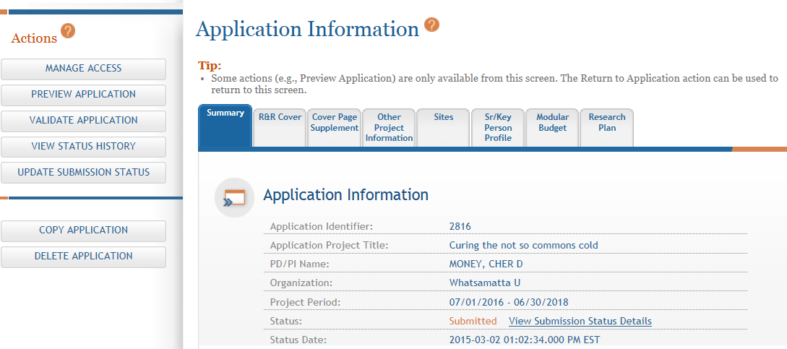
View Submission Status Details
Click View Submission Status Details
24

Slide 25
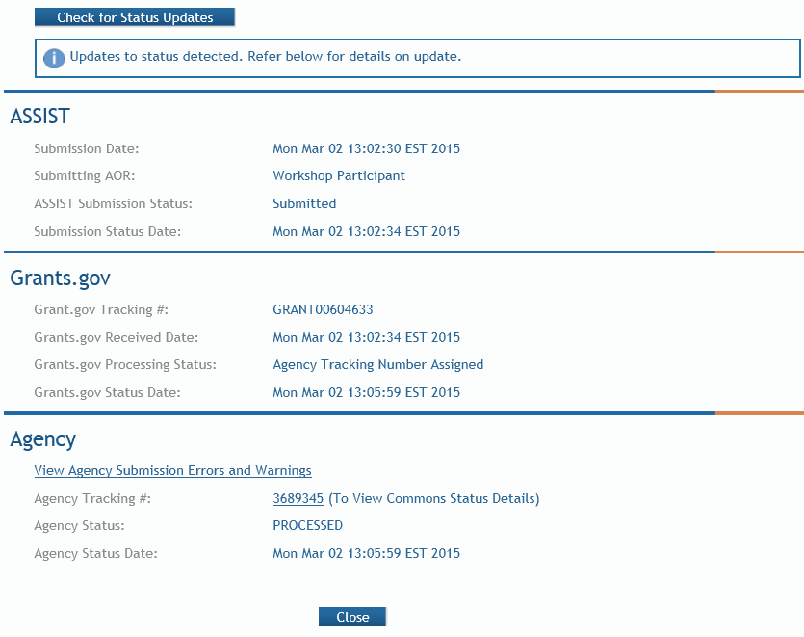
Tracking Submission Status
Happy path…
ASSIST = Submitted
Grants.gov = Agency Tracking Number Assigned
Agency = Processed
Agency Tracking # link brings you to the detailed status screen in eRA Commons

Slide 26
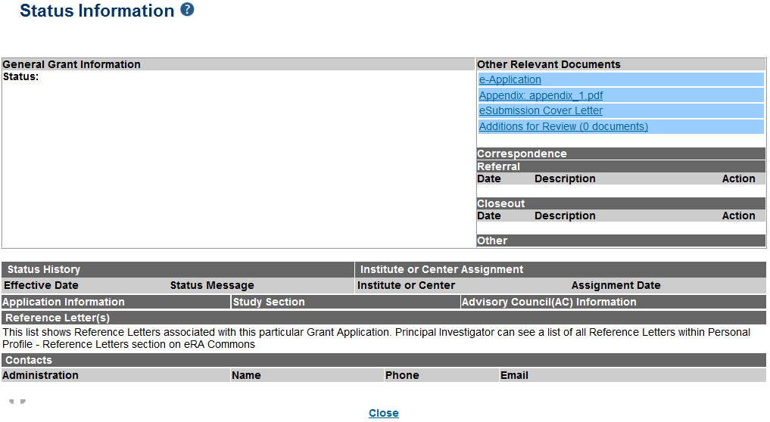
Viewing Your Application in eRA Commons
eApplication is the application image reviewers will use so check it carefully.
Also check the Cover Letter and Appendices which are stored separate from the image.

Slide 27
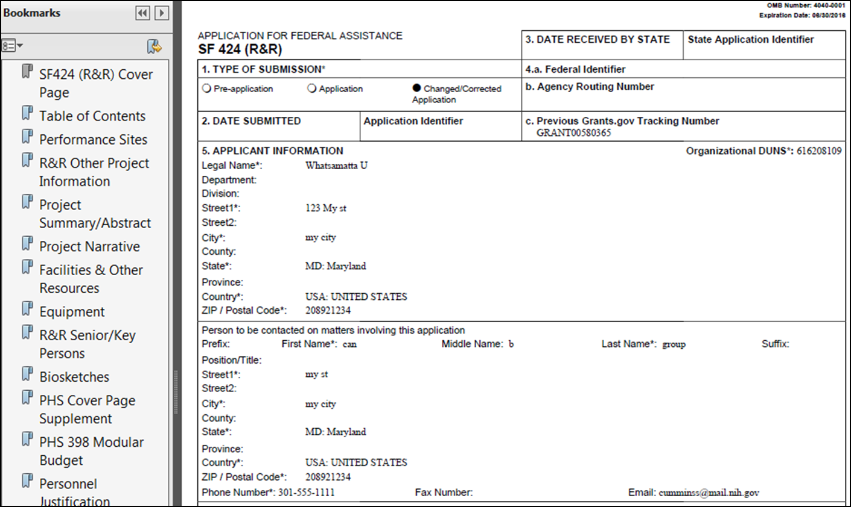
Viewing Your Application in eRA Commons
Application images are assembled in a consistent format regardless of the submission option used.

Slide 28
Letter Home
Dear Dad,
Can I come back to Camp NIH again next year?
Every time a counselor tells us about anything, they always talk about how it is now and how it’s gonna be later.
You know how Uncle Dave always say’s “You can’t step in the same river twice.” That sure is true about grants administration. It seems like the rules just keep changing.
Jeff

Slide 29
Looking Ahead
NIH’s “PHS” forms expire at the end of August
You must continue to use current forms (FORMS-C) until further notice
Our policy team is working with the Office of Management and Budget (OMB) to obtain approval to update our forms
We hope to have new form packages (FORMS-D) available for due dates on/after May 25, 2016
Too soon to confirm schedule
Keep an eye on the NIH Guide for details later this Fall

Slide 30
Letter Home
Dear Betty,
I got to play eRA Commons trivia today. They put us in teams and assigned a counselor to each team.
Guess who was on my team - Joe! He is sooooo cute and funny and he like knows everything so of course we won. Tracy was really jealous. It was awesome!
Having a great time.
Miss you!
Veronica

Slide 31
Letter Home
Dear mom and dad,
I am loving this camp so much!! I don’t want to come home. Seriously…this is better.
They said I could ask for something called a no cost extension – That means it wont cost them anything as long as you provide the basics. you know, like food, clothes, bug spray, electricity, water, etc. So can you send me that stuff?
Thanks I will see you again in 1 to 12 months! Love, Billy

Slide 32
No Cost Extension (NCE)
Electronically submit a notification to exercise one-time authority to extend without funds the final budget period of a project period of a grant.
Only SOs can submit the NCE notification
May be submitted no earlier than 90 days before end of project and no later than project end date
Can request extension of 1-12 months, in one-month increments
E-mail notification sent to NIH Grants Management staff when SO processes the extension

Slide 33
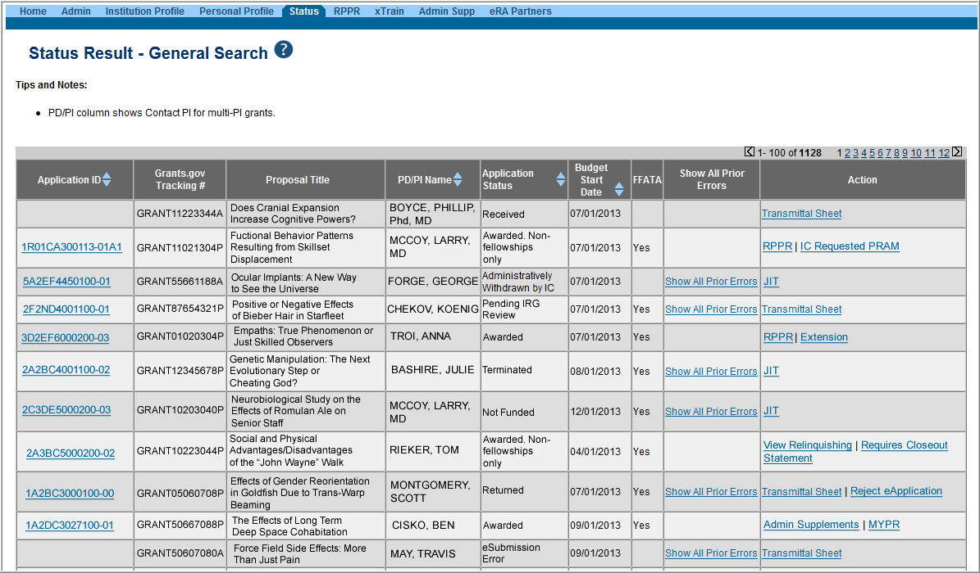
Extension link in Status screen

Slide 34
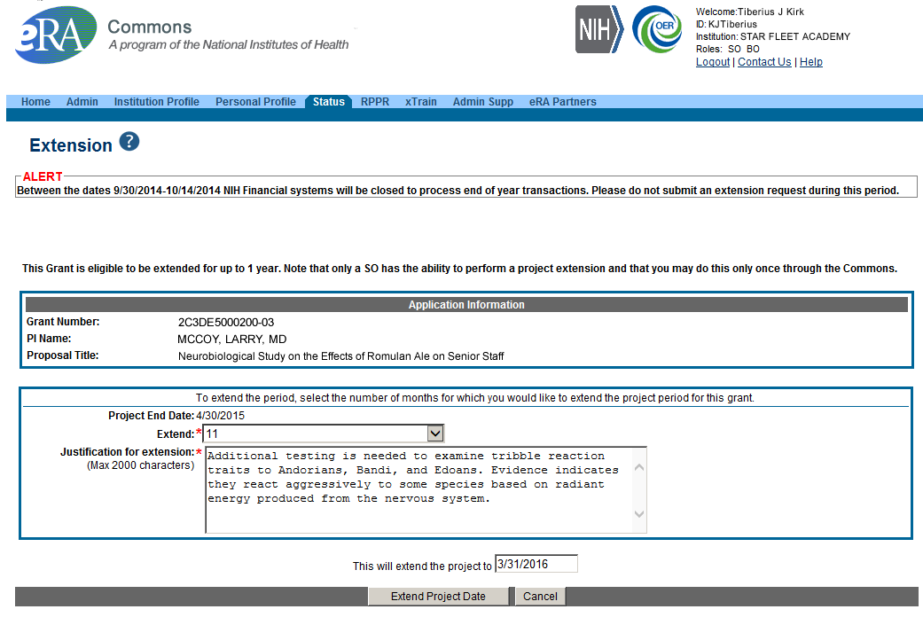
What’s Changing
Aligning with Uniform Guidance
You will need to provide NCE justification in some manner.
Developers are looking into options that will present the least amount of burden to grantees.
Check box?
Drop menu?
Who Recalls This?
Justification for Not Cost Extension
Part of Uniform Guidance Requirements
Text box supports 2000 characters
Removed as a new solution is developed
Choose an extension of 1 to 12 months.
Add justification to NCE
New calculated project end date

Slide 35
FFR Related – Policy Notices
NOT-OD-11-098
Mandating Use of the Commons to Submit No-Cost Extension Notifications

Slide 36
Letter Home
Dear Mom & Dad,
We learned about a new interface called FFR.
I thought it stood for Friendly Fir Relationship.
I was wrong. Love, Tommy
PS: pleasssee don’t share this pic
PSS: Please send goo-gone, I can’t get
the pine pitch off my legs. Thx

Slide 37
Federal Financial Report (FFR)
Allows grantees to electronically submit a statement of expenditures associated with their grant to NIH via eRA Commons
FFRs must be submitted in eRA Commons via the FFR/FSR module
Cash transaction data still submitted via Payment Management System
FSR role for users who have the authority to view, enter, and submit an FFR on behalf of institution

Slide 38
Federal Financial Report (FFR)
Annual FFR due date for NIH only: For non-SNAPs, FFR must be submitted within 120 days of the calendar quarter in which the budget period ends
Final FFR due date: based on the Project Period End Date (PPED):
Pending Status: If the FFR is not submitted and it is within 90 days of the PPED
Due Status: If the FFR is not submitted and it is between the PPED and 90 days past the PPED
Late: If the FFR is not submitted and it is more than 90 days past the PPED

Slide 39
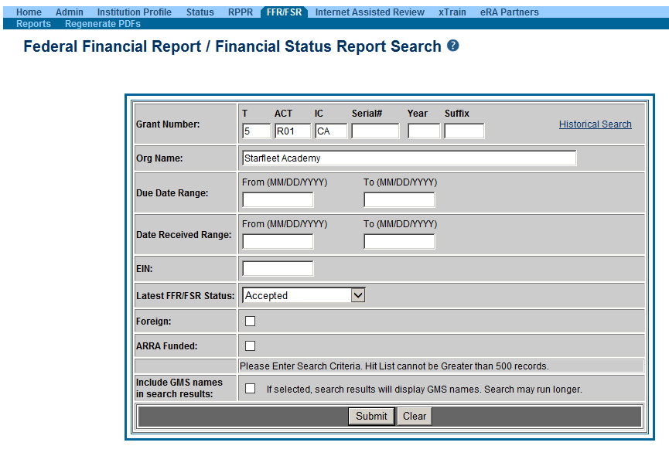
FFR/FSR Screen

Slide 40
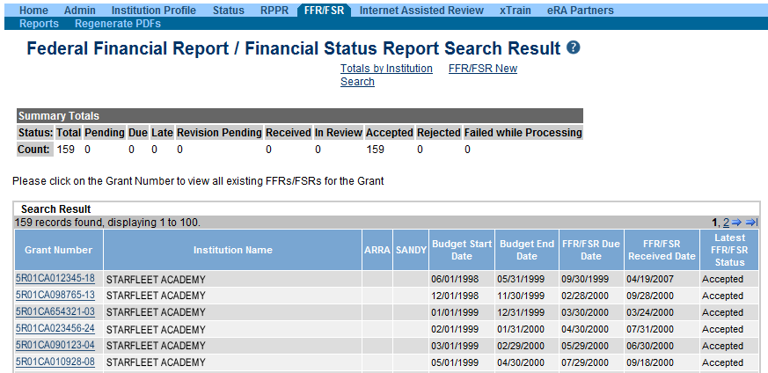
FFR Search Results
The Grant Number is a hyperlink that will take you to the FFR/FSR form.

Slide 41
FFR Details Screen
Clicking the hyperlinked grant number opens the FFR Details screen, which displays:
FFR Status:
Received, Accepted, Rejected, In Review, or Revision Pending
Available Actions:
Accepted status: View or Create New
Rejected status: View or Create New
Received status: View or Correct
Revision Pending status: View or Edit
In Review status: View

Slide 42
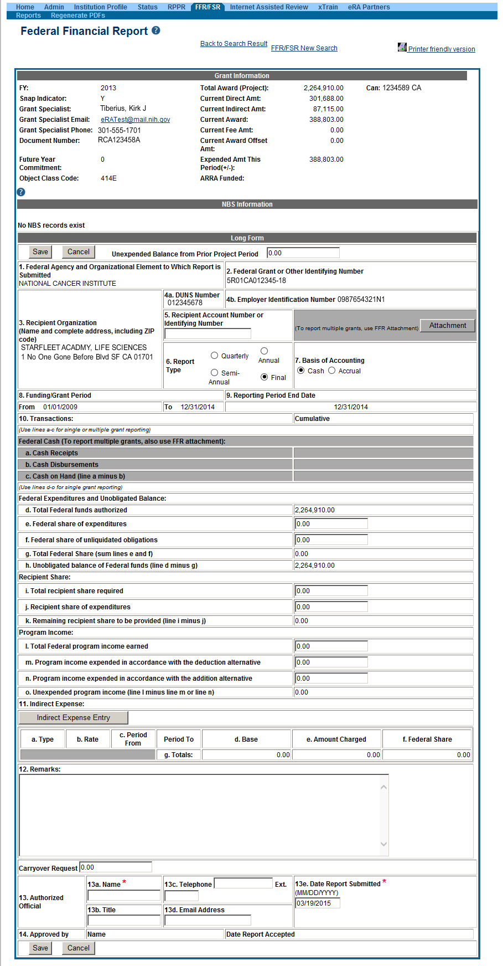
Completing the FFR
As current year entries are completed, calculations are done automatically.

Slide 43
Submitting a FFR
Once FFR/FSR is Submitted, Latest FSR status changes to Received
If a mistake is made on the FFR and the status has changed to In Review, the institution should contact the NIH OFM staff and have them reject the FFR/FSR so that revisions can be made.
OFM staff are assigned by NIH Institute/Center (IC). Contact the awarding IC to find out who the OFM staff member is to contact.

Slide 44
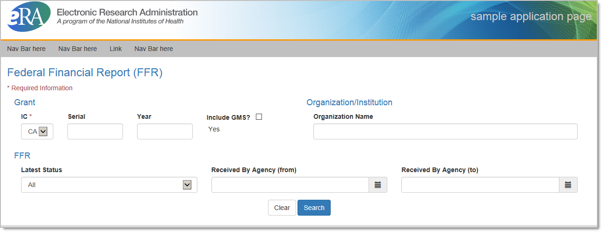
FFR Changes
New design to improve for cleaner look, better readability
Still the same functionality!

Slide 45
FFR Changes

Slide 46
FFR Related – Policy Notices
NOT-OD-14-103
Revised Timeline for Administrative Changes to NIH Domestic Awards to Transition to Payment Management System Subaccounts
NOT-OD-14-093
Administrative Changes to NIH Domestic Awards Transition to Payment Management System Subaccounts
NOT-OD-14-084
NIH Updating Grant Closeout Policies and Procedures to Align with New HHS Requirements
NOT-OD-13-120
NIH Domestic Awards to Transition to Payment Management System Subaccounts in FY 2014 and FY 2015

Slide 47
FFR Related – Policy Notices
NOT-OD-13-112
NIH Domestic Awards to Transition to Payment Management System Subaccounts in FY 2014
NOT-OD-13-111
NIH to Transition Payment for Individual Fellowships at Foreign and Federal Sponsoring Institutions, and Awards to Federal Institutions to Payment Management System Subaccounts in FY 2014
NOT-OD-13-019
Notice of Changes to Payment Management System Registration Procedures for NIH Foreign Grantees

Slide 48
Letter Home
Dear Mom,
Please send me the Netflix password. I can’t remember it.
It would be nice to have one password to get me into all my stuff!
And send junk food.
Lots of it. ASAP.
Thanx
Love you, Brandi

Slide 49
Federated Login
Initiated in October 2014 as a pilot program, the process permits eRA Commons user to authenticate to Commons using the same credentials they use for access to their institution’s resources/systems.

Slide 50
Federated Login
Expansion of the Federated Login Functionality
Federated Login is the ability for users to use their institutional user ID and password to access eRA Commons.
This functionality has now been expanded to include users with the ASST role in eRA Commons.
This option is for organizations currently registered with InCommon and who work with NIH’s Center for Information Technology (CIT) to establish the relationship between your institution and eRA Commons.
For more information on the Institution/Organization Log In functionality, review the October 17 Commons Release Notes, or the Commons Online Help System.

Slide 51
Letter Home
Dear Mom & Dad,
Camp is good. We get 1 hour of tech time each day.
With the new eRA Commons mobile friendly design, I was able to check my grant:
“Summer Camp: Getting the Kids Out of the House”
I miss you. Do you miss me? Probably not.
Love, Betty

Slide 52
eRA Mobile Executive Summary
Develop an eRA Mobile Strategy for deployment/use
Develop corresponding policies for use
Identify needs based on current mobile traffic
Focus on a mobile capable website vs. a traditional platform specific application
Get feedback and customer input

Slide 53
eRA Mobile Development Initiative
The purpose of this initiative is to:
better support a diverse user community
ensure that eRA provides efficient solutions for mobile platforms
ensure a good end user experience while using variety of the devices

Slide 54
Understand eRA mobile stakeholders
Focus on eRA customers (internal & external) mobile requirements
Mobile delivery requires new skills -
new mindsets, new architectures, and new approaches to problem-solving
Human factors analysis is important – mobile interaction and navigation (touch, swipe) critical

Slide 55
2013-2014 Statistics
Mobile traffic 2% of overall traffic
8 Commons pages
2013 statistics
85% of mobile traffic
40% of overall external traffic
2014 update – less than 1% change

Slide 56
Commons Mobile Prototype
Track the status of their grant applications through the submission process
View Basic Info:
Status
Score/percentile
SRG
View grant image
View summary statements

Slide 57
Letter Home
Dear Mom,
Guess what?!
The counselors made me an Assistant! It means I get to help with all kinds of important stuff.
But it does kind of remind me of the way Dad calls us his “minions” when we help him with yard work…
Only here they call it delegations.
With Love, Phil

Slide 58
Delegations
eRA Commons allows users to give other permission to do specific actions on their behalf.

Slide 59
Delegations
PPF
Any user can delegate to any other user at their institution the ability to edit their Personal Profile information
Status
Any PI can delegate the ability to check for application errors/warnings and to view the PI’s assembled application image
Ability to view application summary statements and scores is specifically withheld

Slide 60
Delegations
Progress Report
Any SO or a PI can delegate the ability to complete progress report information for the PI’s grants
Remember: SOs register assistants in Commons
Ability to Route and Submit is specifically withheld
This now includes the ability to update inclusion data for Progress Reports and in the Inclusion Management System (IMS)

Slide 61
Delegations
Submit
SOs and BOs can delegate to a PI the ability to submit their own progress reports to agency
The PI will be listed as the authorized submitter on the submission
xTrain
A PI can delegate authority to perform most actions within xTrain on their behalf
Ability to Submit appointments to agency is specifically withheld

Slide 62
Delegations
Sponsor
A SO or Sponsor can delegate to any user at their institution the ability to initiate and facilitate termination of a fellow
Ability to Submit a termination is specifically withheld

Slide 63
Letter Home
Dear Mom & Dad,
What kind of camp is this?
They seem kind of strict about
managing us…
Can I come home now?
PLEASE? ☹

Slide 64
Account Management Redesign
Consolidate the current Account Management System (AMS) functions to support external, NIH, and other agency accounts that are currently handled in another system.
Enhance usability of the current AMS functionality.

Slide 65
What will Change?
New Look and Feel
eRA User Interface Standard
Proposed Streamline Workflows
Create Account without Search
Improved Role Assignment Function
Consolidated Actions on Search Result screen
Provide Report function

Slide 66
Current Create Account Process
User needs to perform search prior to creating account to prevent duplicate account creation
System brings user back to Search Result page for further action once the account creation is completed

Slide 67
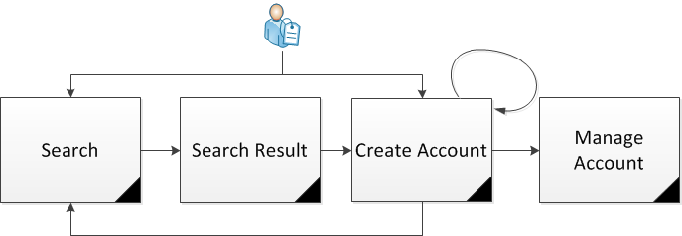
Proposed Create Account Process
Search Screen will remain to be the landing screen when entering AMS
User has the capability to create account without searching
Based on the data statistics, most users are searching without criteria to get to the Create Account screen
Same validations will be provided to prevent duplicate account creation
After account creation is completed, user is able to
Continue create another account
Manage the newly created account
Go back to Search Page perform search

Slide 68
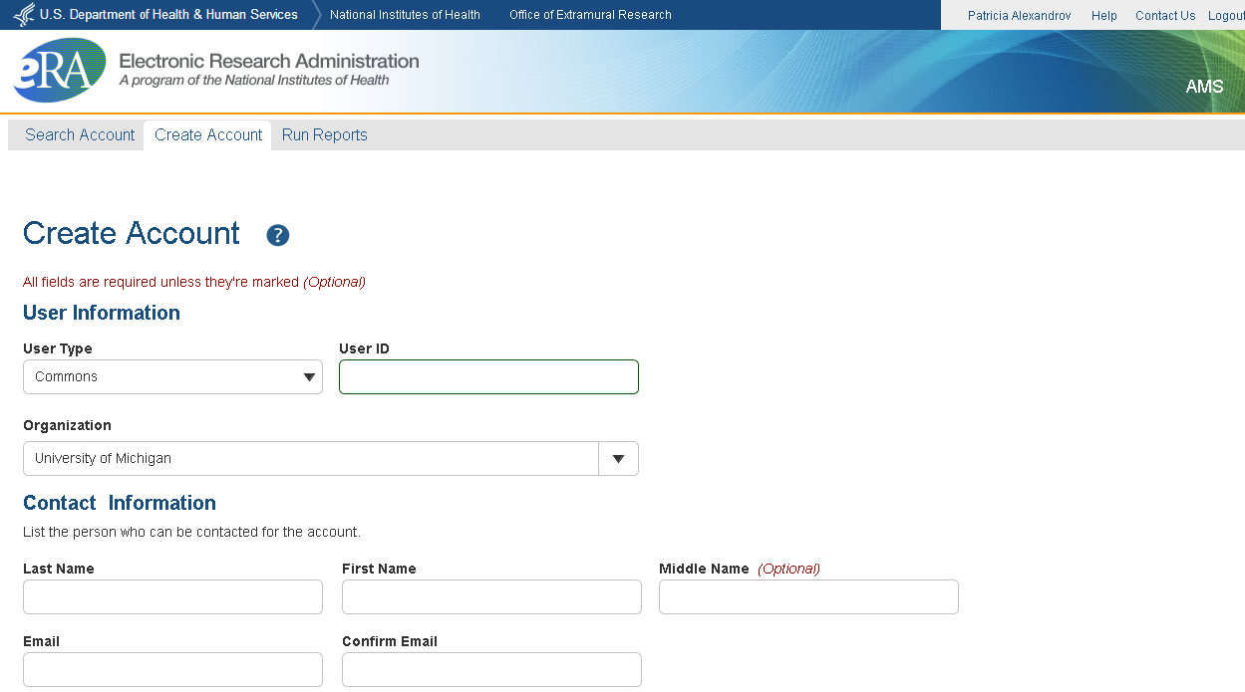
Proposed Create Account Process (Cont’d)

Slide 69
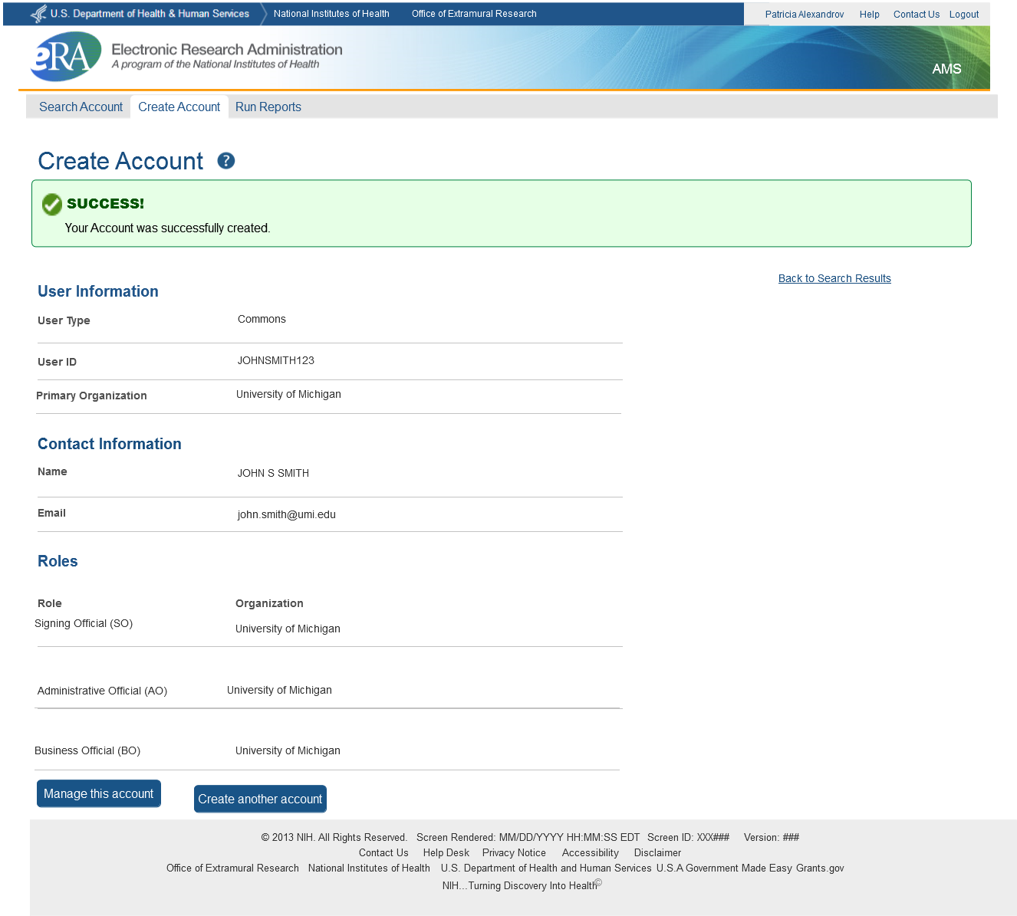
Proposed Create Account Process (Cont’d)

Slide 70
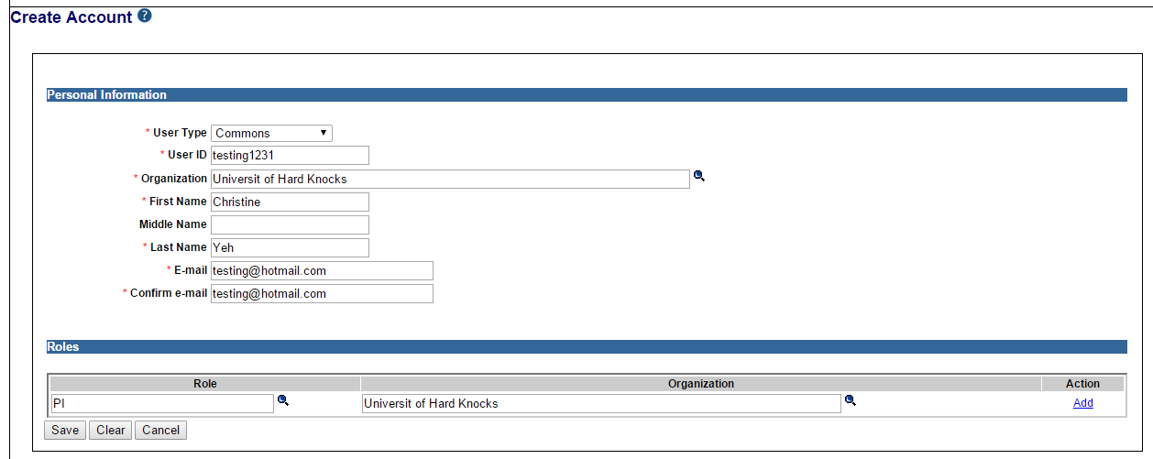
Current Assign Roles Process
Process to assign a role to an account is not intuitive – especially for new users.

Slide 71
Proposed Assign Roles Process
System provides:
A clear indicator for role assignment
Capability to multiple role selections for one organization
Capability to remove the selected roles

Slide 72
Search
Default to Search Outside Your Organization (including user’s own organization)
Capability to provide view funding & profile information for verification
Questions:
Should the system provide View Profile Information without viewing any PII data capability?
Should the View Funding information be icons or as part of the Action drop down?

Slide 73
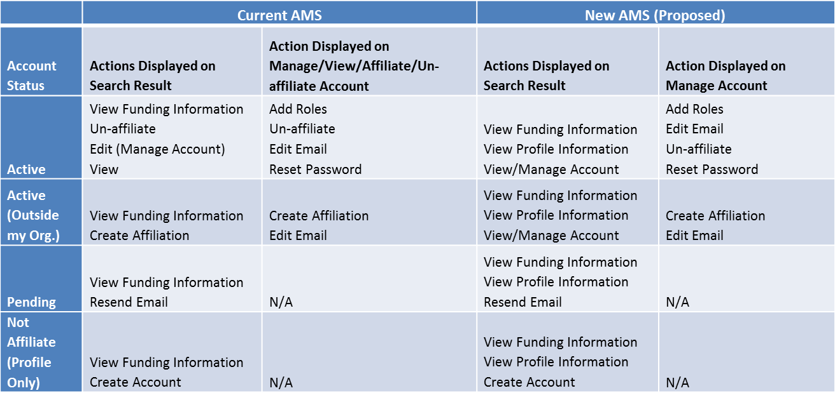
Search (cont.)
Consolidated Actions on Search Result Page depending on the user’s privileges and account status

Slide 74
Proposed Report Flow
Report feature provides:
List of accounts with Profile Incompletion
List of accounts with Role Selection

Slide 75
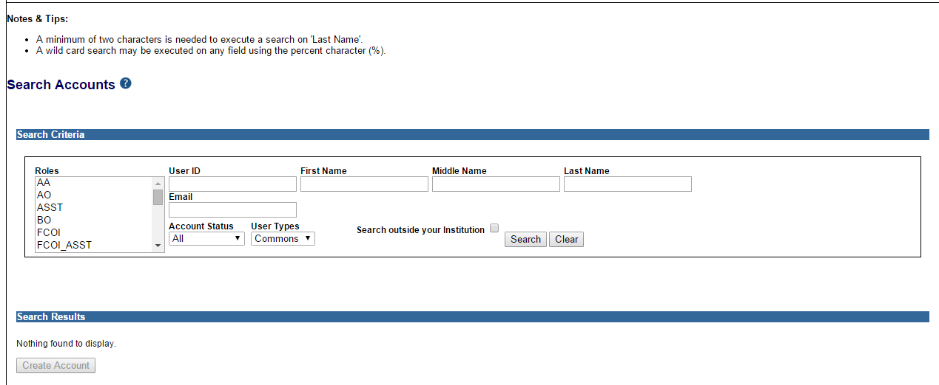
Current Search Accounts Screen

Slide 76
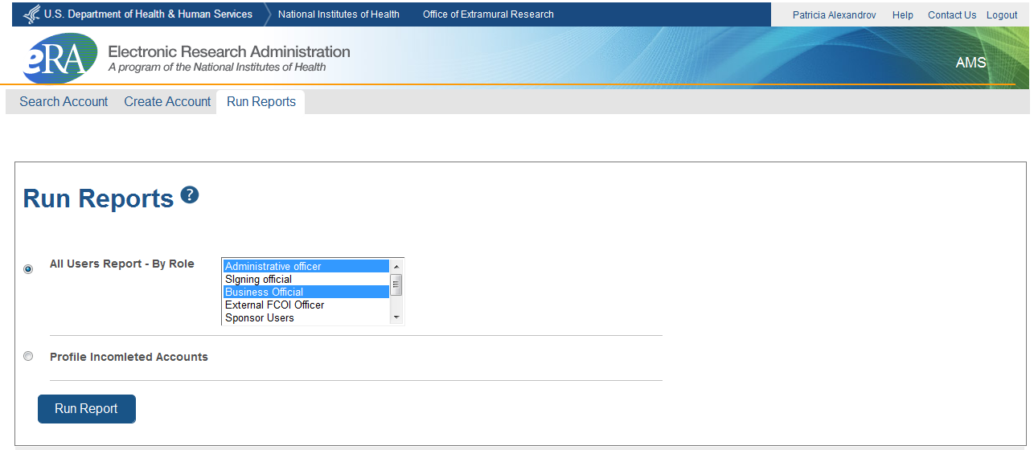
Run Report Proposed Flow

Slide 77
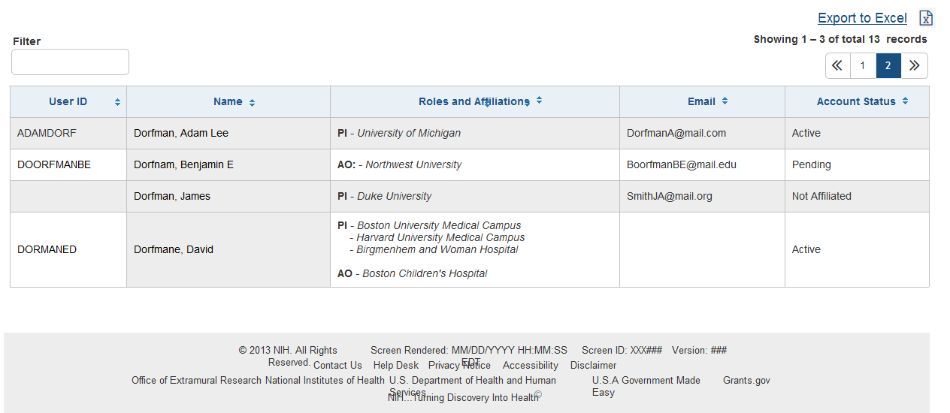
Run Report Proposed Flow (Cont’d)

Slide 78
Support
NIH eRA Help Desk
Web: http://era.nih.gov/help/
Toll-free: 1-866-504-9552
Phone: 301-402-7469
Hours: Mon-Fri, 7a.m. to 8 p.m. Eastern Time (Except for Federal holidays)
Get Connected
Subscribe to eRA listservs at:
http://era.nih.gov/about_era/get_connected.cfm
See NOT-OD-15-132 for details.

