Slide 1



NIH eRA Workshop Day
June 2014
electronic Research Administration (eRA)
OER, OD, National Institutes of Health

Slide 2
Your Workshop Team
Gabrielle Caddle
  eRA Customer Relationship Manager, xTrain & Closeout
Sheri Cummins
  OER Communications & Outreach, Grants Information
Jessie Floura
  eRA Customer Relationship Manager, eSubmission & ASSIST
Anastasiya Hardison
  eRA Help Desk & Requirements Analyst
Joe Schumaker
  eRA Communications and Outreach
Marcia Hahn
  Director, Division of Grants Policy

Slide 3

Busy Morning
Start
Accounts, Roles and Profiles
Electronic Application Submission
Break
Electronic Application Submission (cont.)
Commons Detailed Status screen
Just-In-Time (JIT)
Questions & Morning Wrap-up
Lunch
Pre-Award
9:00
~10:30
12:00

Slide 4
Busy afternoon
Post-Award
Start
Notice of Award
Financial Conflict of Interest (FCOI)
Progress Reports
No Cost Extension (NCE)
Grantee and Organizational Changes
Break
Closeout
xTrain
Final Questions & Afternoon Wrap-up
All done!
1:00
~2:30
4:00

Slide 5
Accounts, Roles and Profiles
What is era Commons?
Accounts
Password policy
Roles
Institutional Profile (IPF)
Personal profile (PPF)
Delegations
Sheri

Slide 6
What is eRA Commons?
The eRA Commons is an online interface where grant applicants, grantees and federal staff can access and share administrative information related to grant applications and awarded research grants.
Applications
eSubmission Errors/Warnings
Assurances
Assembled Application Image
Certifications
Review Assignment
Profile Data
Progress Reports
Priority Score
Financial Reports
Summary Statement
Invention Reports
Notice of Award
Training Appointment Actions
Post-award Correspondence

Slide 7
Organization Registration
Organizations must register in eRA Commons
Many organizations are already registered
  Check with your Administrative Office before starting the process
  Quick Query: http://era.nih.gov/commons/quick_queries/index.cfm#commons
For new registrations, complete the online Institution Registration Form
  Form: https://public.era.nih.gov/commons/public/registration/registrationInstructions.jsp
  Carefully follow ALL steps including printing/signing/faxing registration page and responding to email verification messages

Slide 8

Signing Official (SO)
During Commons registration, an applicant organization designates a Signing Official (SO)
  SO has authority to legally bind the organization in grants administration matters
  Equivalent to the Authorized Organization Representative (AOR) in Grants.gov
  SO is responsible for:
    maintaining institutional information
    submitting documents that require signature
    authority to act on behalf of the organization
    managing accounts

Slide 9

Account - Tips
Designate more than one Signing Official
  Certain Commons actions can only be taken by users with the SO role and you will want a back-up
Administrators should always check to see if a user already has a Commons account before creating a new account with a scientific role
  Ask the person if they already have an account, or search within the Commons
    If a user already has an account with a different organization,
    the SO should affiliate the existing account with the user’s
    new organization

Slide 10
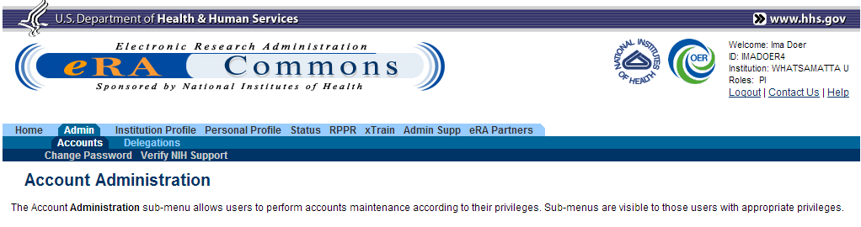
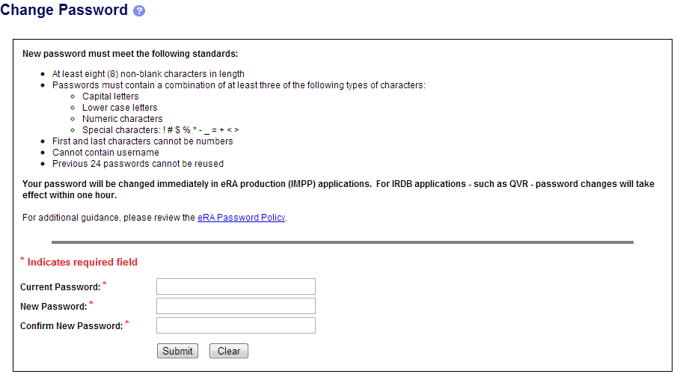
Changing a Password
Available to any logged-in user.
Enter current and new password. Click Submit.

Slide 11
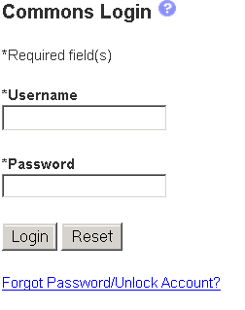
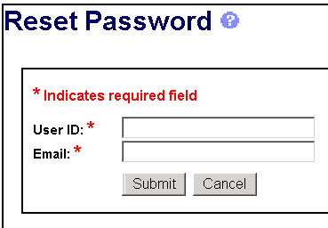
Forgot Password/Unlock Account
If the username and e-mail combination provided match what is in the system, a temporary password will be e-mailed to you.

Slide 12
Account Passwords
Password policy:
  http://era.nih.gov/files/NIH_eRA_Password_Policy.pdf
Passwords must:
  Contain at least eight (8) characters; no blank spaces
  Contain a combination of at least 3 of the following:
    Upper case letters
    Lower case letters
    Numbers
    Non-consecutive special characters: ! # $ % - _ = + < >
  Not begin or end with a number
  Not contain username
  Not be reused within one (1) year
  Be changed every 90 days

Slide 13

Navigating the eRA Commons
The eRA Commons navigation menu has three (3) levels. The top level displays the main functions (tabs) available. Clicking a top-level tab will display the second level; clicking a second-level tab will display the third level.
1
2
3

Slide 14
eRA Commons Roles
The functions that a user can perform in the Commons are based on the role(s) assigned to his or her Commons account
Full, printable list of eRA Commons roles:
  http://era.nih.gov/files/eRA_Commons_Roles.pdf

Slide 15

Roles
Administrative
  AA – Account Administrator
  AO – Administrative Official
  ASST – Assistant
  BO – Business Official
  SO – Signing Official
Scientific
  Graduate Student
  IAR – Internet Assisted Review
  PI - Principal Investigator
  Post-Doc
  Project Personnel
  Scientist
  Sponsor
  Trainee
  Undergraduate
PI
ROLES

Slide 16

Roles 2
Other
  FCOI (Financial Conflict of Interest)
  FCOI_ASST
  FCOI_VIEW
  FSR (Financial Status Reporter)
  PACR (Public Access Compliance Reporting)
IAR
PI
AA
FSR
SO
AO

Slide 17
Role - Tips
Don’t combine scientific roles with administrative or other roles on the same account
  Other combinations are fine (e.g., PI and IAR; AO and FSR)
  A person needing both scientific and administrative roles should have two separate accounts (one for scientific roles and another for other roles)

Slide 18

Institutional Profile File (IPF)
Each organization establishes and maintains their organization’s profile data
Depending on their role, users can view and/or update Institution Profile information
  Only SOs can edit IPF information
  IPF displayed as a read-only page for users with all other Commons roles
  Includes two sections: Basic and Assurances & Certifications
Central repository for registered organization information
Terminology Check:
‘Organization’ = ‘Institution’ = ‘Entity’

Slide 19
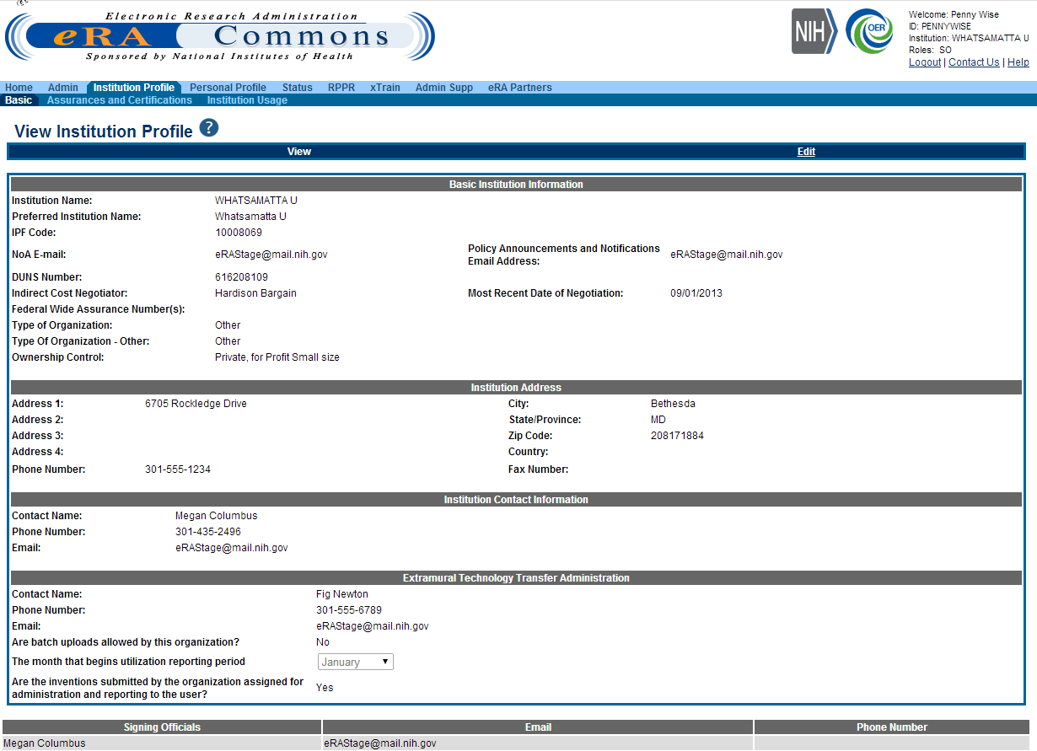
IPF - Basic
Basic: general information about the institution
  Name, address, Institution Contact information, list of Signing Officials, etc.
Only SOs can edit Institution Profile

Slide 20
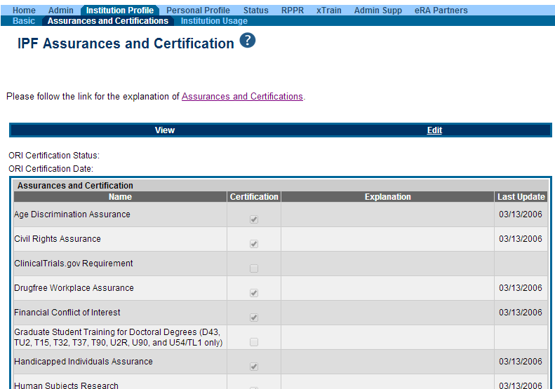
IPF – Assurances and Certifications
Assurances and Certifications: data elements that comprise assurance/certification information about an institution
  List of certifications
  (e.g., Financial Conflict of
  Interest, Human Subjects
  Research, Vertebrate
  Animals, etc.)
Understand what you are agreeing to!

Slide 21
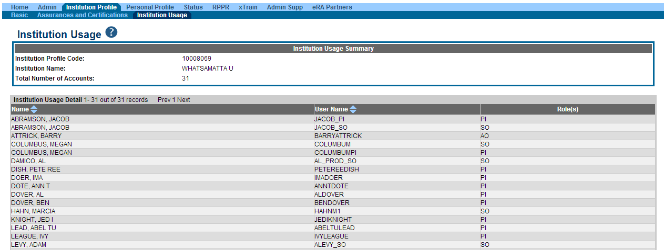
IPF Sections
Institution Usage: summary of institution’s users
  Lists Name, User Name and Role(s) of each user

Slide 22
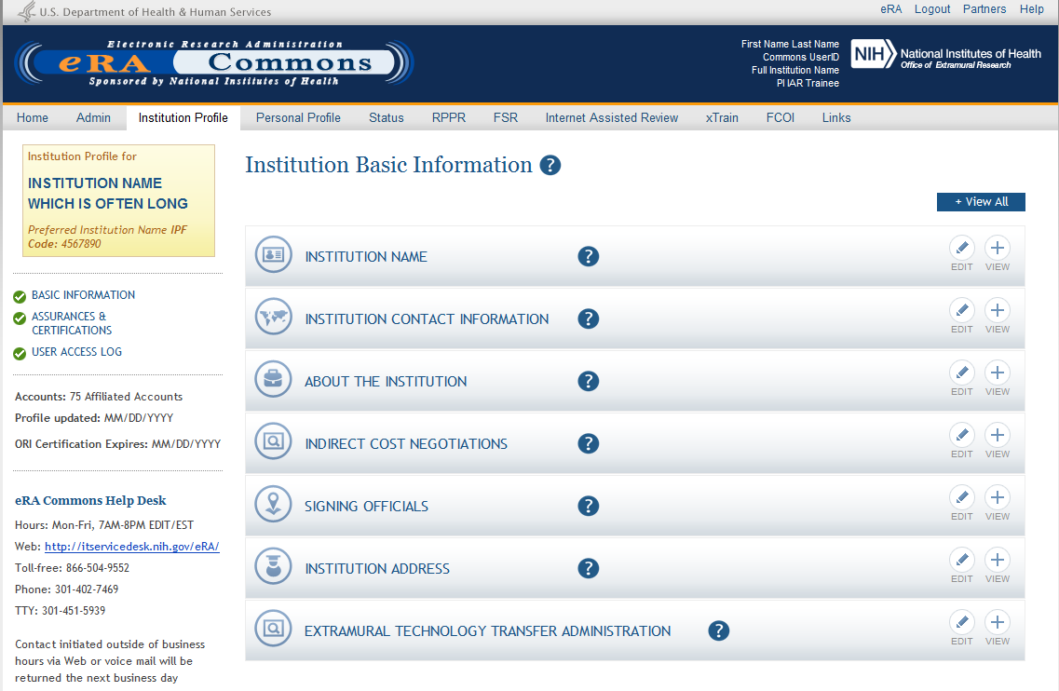
New IPF View
Coming July 2014, new IPF screen!

Slide 23



Personal Profile (PPF)
Individual Commons users are responsible for keeping their profile information accurate
Includes information such as:
  Name
  Demographics
  Employment history
  Education
  Reference Letters
  Publications
Very few staff members at NIH have access to change information (for emergencies only)
Central repository for individual user information

Slide 24
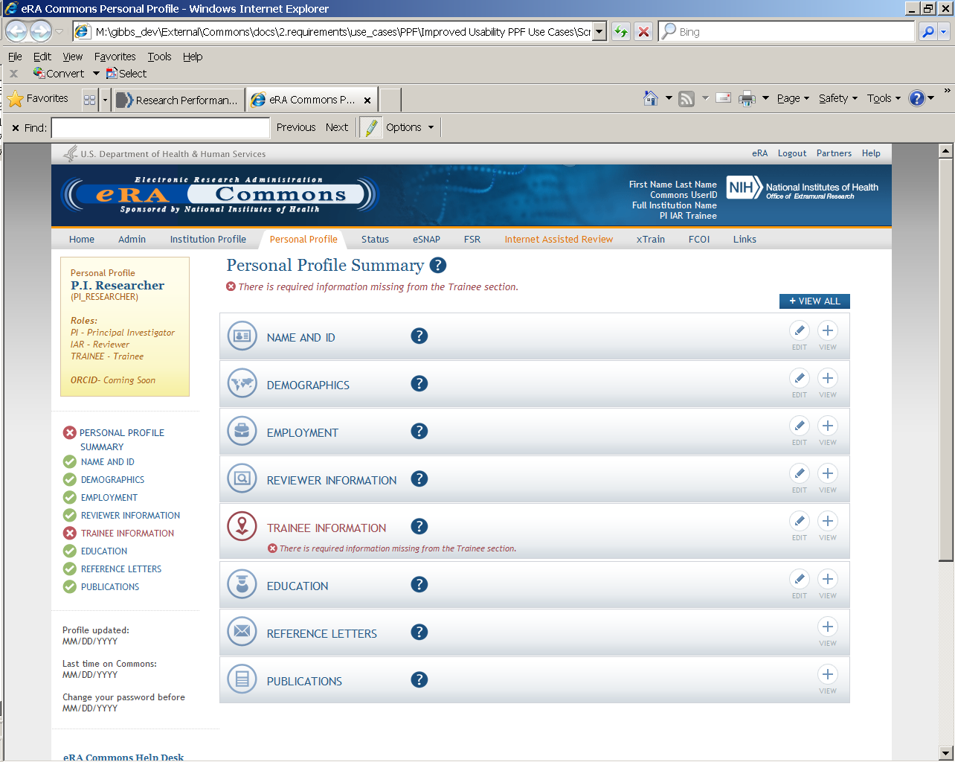
Personal Profile

Slide 25

Personal Profile Information is used to…
Verify information submitted in grant applications
Send you agency notifications
Complete aggregate reporting
Determine eligibility for Early Stage Investigator (ESI) and New Investigator (NI) status
Determine a reviewer’s eligibility for the Continuous Submission application submission policy

Slide 26

Terminology Check
New Investigator
  A PD/PI who has not previously competed successfully as a PD/PI for a substantial independent research award.
    See: http://grants.nih.gov/grants/new_investigators/index.htm
Early Stage Investigator
  An individual who is classified as a New Investigator and is within 10 years of completing his/her terminal research degree or is within 10 years of completing medical residency (or the equivalent).
Continuous Submission
  As a way of recognizing their service to NIH, reviewers with substantial review service are permitted to submit their research grant applications (R01, R21, or R34) on a continuous basis and to have those applications undergo initial peer review in a timely manner.
    See: http://grants.nih.gov/grants/peer/continuous_submission.htm

Slide 27
PPF- Tips
When you change your password, you will be automatically redirected to the Personal Profile tab—take a moment to review and update your information
Be especially diligent about keeping your email addresses current
  Email addresses are used to retrieve forgotten passwords and for communicating grants-related information

Slide 28

Delegations
PPF
Status
Progress Report
Submit
xTrain
Sponsor
eRA Commons allows users to give other users permission to do specific actions on their behalf

Slide 29
Delegations
PPF
  Any user can delegate to any other user at their institution the ability to edit their Personal Profile information
Status
  Any PI can delegate to any user at the PI’s institution with the ASST role the ability to access their status information, including the ability to check for application errors/warnings and to view their assembled application images
    Ability to view application summary statements and scores is specifically withheld

Slide 30
Delegations
Progress Report
  Any SO or a PI can delegate to any user at the PI’s institution with the ASST role the ability to complete progress report information for the PI’s grants
    Remember: SOs register assistants in Commons
    Ability to Route and Submit is specifically withheld
Submit
  SOs and BOs can delegate to a PI the authority and ability to submit their own progress reports to agency
    The PI will be listed as the authorized submitter on the
    submission

Slide 31
Delegations
xTrain
  A PI can delegate to any user at their institution with the ASST role the authority to perform most actions within xTrain on their behalf
    Ability to Submit appointments to agency is specifically withheld
Sponsor
  A SO or Sponsor can delegate to any user at their institution the ability to initiate and facilitate termination of a fellow
    Ability to Submit a termination is specifically withheld

Slide 32
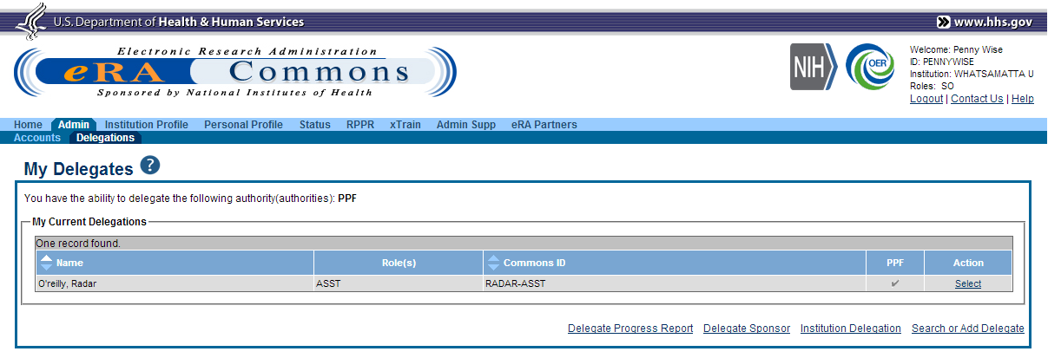
Delegation (SO)

Slide 33
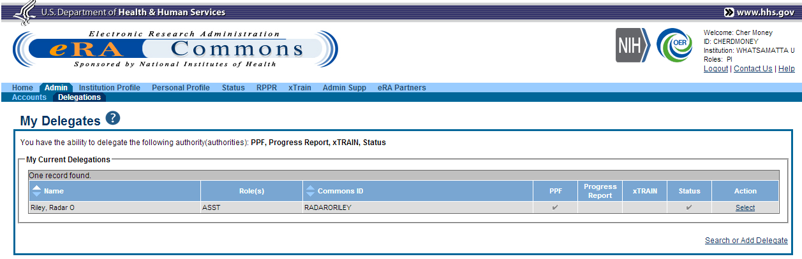
Delegation (PI)

Slide 34
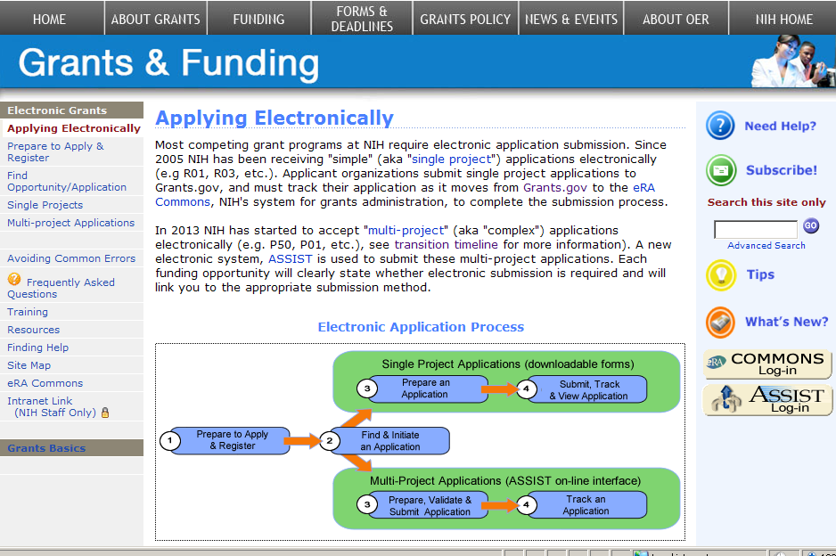
Electronic Application Submission (eSubmission)
http://grants.nih.gov/grants/ElectronicReceipt/

Slide 35
eSubmission: Prepare to Apply & Register
Registrations
High-level process
Software needed
Submission methods
Submission plan

Slide 36

Electronic Submission -100% electronic for competing applications
NIH is now receiving 100% competing grant applications electronically.
Electronic submission is required for all, except Non competing submissions, such as :
  Merit Extensions – Type 4
  For Multi Project Applications in response to:
    Administrative Supplements - Type 3
    Change of Organization Status – Type 6
    Change of Grantee Organization – Type 7

Slide 37

Separate, but linked systems
Grants.gov
  Federal-wide portal to find and apply for Federal grant funding
  Used by all 26 Federal grant-making agencies
eRA Commons
  Agency system that allows applicants, grantees and Federal staff to share application/grant information
  Used by NIH and a few other HHS divisions
IMPORTANT: Each system has its own registration and application requirements.

Slide 38


Get Registered
Grants.gov
  Applicant Organizations only
  Designate E-Business Point of Contact (E-Biz POC)
    Approves Authorized Organization Representatives (AORs) to submit applications
  No registration needed to find opportunities or download forms
eRA Commons
  Applicant Organization & PD/PI
  Project Leads for multi project applications
  Designate Signing Official (SO)
    Registers or affiliates Project Director/Principal Investigator (PD/PI)
  Commons IDs needed to prepare multi-project applications in ASSIST

Slide 39
Registration - Tips
If not yet registered, start the process at least 6 weeks before the deadline
  Once DUNS number is obtained, Grants.gov and eRA Commons registrations can be done in tandem
  NIH 2-week “good faith effort” for Commons registration
Set-up multiple AOR and SO accounts
Update System for Award Management (SAM) information yearly to keep credentials active
  Formerly called Central Contractor Registration (CCR)

Slide 40
Registration - Tips
Log in to accounts prior to deadline to ensure you have access to the systems
PIs should update their Commons profile prior to submitting (e.g., degree info used to determine Early Stage Investigator eligibility)

Slide 41
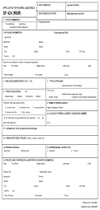
Process Overview
AOR/SO
Find and download announcement, instructions and form package.
Prepare application per institution & agency guidelines.
Authorized Organization Rep. (AOR) submits application via Grants.gov.
eRA downloads application and verifies compliance with application instructions.
PI/SO check submission status and view assembled application in eRA Commons.

Slide 42

Obtain Software
Adobe Reader required for form-based submission
Internet browser required for ASSIST application preparation/submission and to work within eRA Commons
  http://era.nih.gov/browser_support_ext.cfm
PDF conversion program
  Attachments must be converted to PDF format
Grants.gov download software page
  http://www.grants.gov/help/download_software.jsp

Slide 43
Identify Submission Method
Downloadable Adobe forms
  Single-project applications only
Commercial service provider or custom system-to-system (S2S) solution using XML data stream
  Ask your administrative office if this is an option
  http://grants.nih.gov/grants/ElectronicReceipt/sp.htm
ASSIST (Application Submission System & Interface for Submission Tracking)
  Multi-project applications only

Slide 44
Multi project Submissions - ASSIST
Submit application via a Web based interface (No more paper!)
Uses current eRA Commons credentials for access
Populates data from eRA Commons profiles
Prior to submission
  Runs validations on federal wide and agency business rules
  Print/preview applications in the format used by the agency
  Automatic generation of table of contents, headers, footers, page numbers, etc.

Slide 45

Make a Submission Plan
Application preparation responsibilities
Sharing applications in progress
Internal review & approval process
Internal deadlines
Post-submission responsibilities
Administrators and PIs must work together!

Slide 46
eSubmission: Find & Initiate an Application
Finding opportunities
Downloading application package
Application instructions

Slide 47



Search For Opportunity
NIH Guide for Grants & Contracts
Grants.gov Search Opportunity

Slide 48

Parent FOAs
http://grants.nih.gov/
Use for investigator-initiated research.
Select Parent FOA for your chosen grant program
(i.e. R01, R03, R21, etc.).

Slide 49
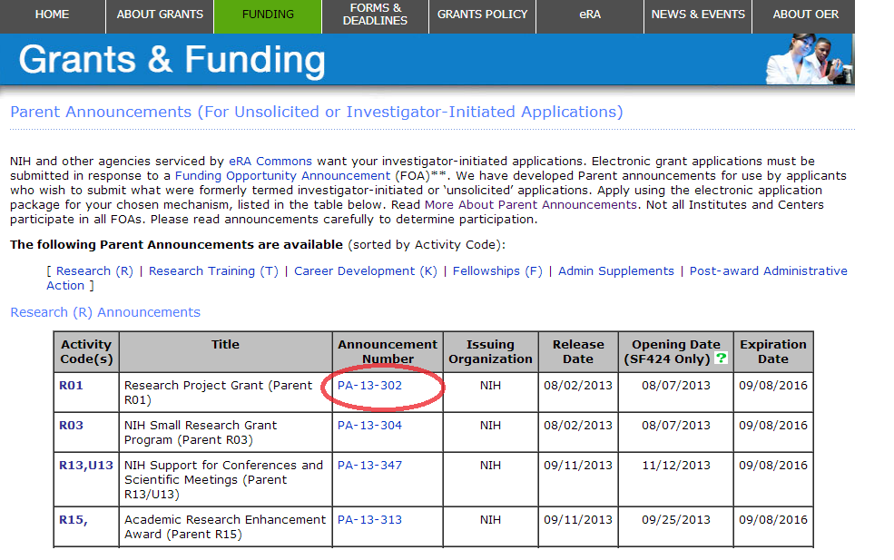
Use Announcement Number to link to FOA

Slide 50
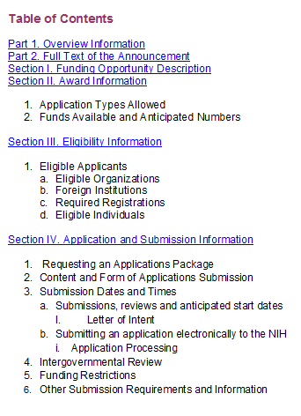
FOA-Specific Application Information
Pay special attention to Section IV. Application and Submission Information
  Includes any FOA-specific submission instructions
  Instructions in FOA supersede instructions in the application guide

Slide 51
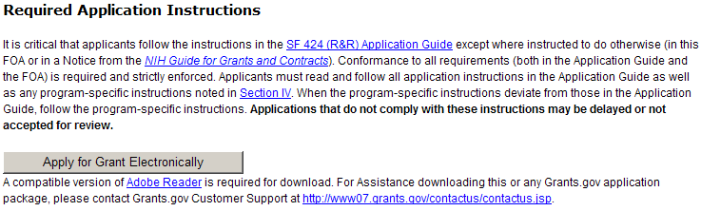
Download Application Package
Excerpt from PA-13-302 FOA
Links to Grants.gov Download Application page for the FOA
Competition ID & Title used to help identify appropriate application package.

Slide 52
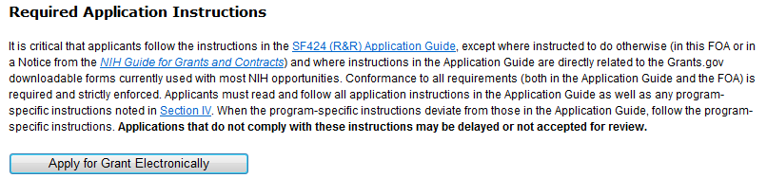

FOAs for Multi-project Programs Link to ASSIST

Slide 53
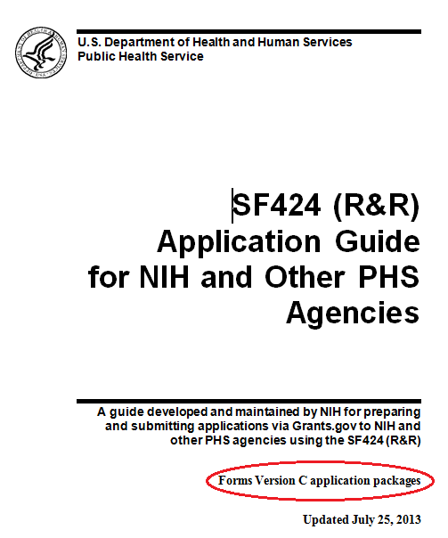

Application Guide
Read and follow application guide instructions
Agency-specific instructions are marked with the
HHS logo

Slide 54
Application Guide - Tips
Be sure to select the appropriate application Guide for your opportunity
  Based on type of grant program
    Application Guide SF424 (R&R)
    SBIR/STTR Application Guide SF424 (R&R)
    Individual Fellowship Application Guide SF424 (R&R)
  Supplemental Grant Applications instructions for human subjects and policies required for:
    All Competing Applications
    All Progress Reports
  http://grants.nih.gov/grants/funding/424/index.htm

Slide 55
eSubmission: Prepare Your Application
Working with adobe forms

Slide 56
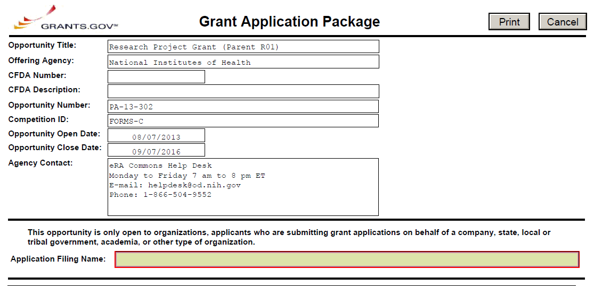
Downloadable ADOBE FORMS
*Application Form Screen - Top*
Make sure you have the correct application package.
FOA information is automatically populated and not editable.
Mandatory Grants.gov fields highlighted with red box.

Slide 57
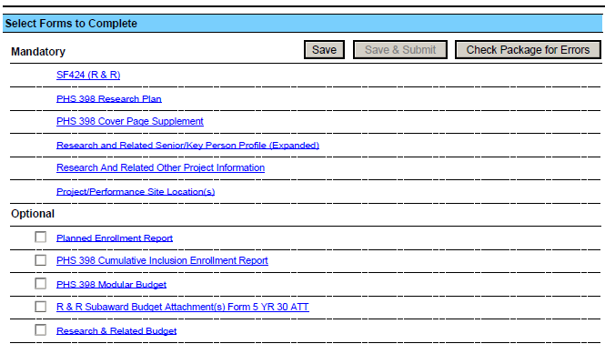
Downloadable ADOBE Forms
*Application Form Screen - Bottom*
Save the package locally.
Complete the SF 424 (R&R) form first—info from this form pre-populates fields in other forms in the package.
See application guide to determine which Optional documents you need to complete.

Slide 58
Tips
Follow FOA-specific guidelines (e.g., special attachments, specific section headings)
Follow application guide requirements
Follow guidelines for fonts and margins
Do not include headers or footers
  Section headings as part of the text are encouraged
Take advantage of posted ‘Additional Format Pages’
  http://grants.nih.gov/grants/funding/424/index.htm

Slide 59
Take Advantage of Available Resources to
Avoid Common Errors
FOA and Application Guide instructions:
  http://grants.nih.gov/grants/funding/424/index.htm
Annotated Form Set:
  http://grants.nih.gov/grants/ElectronicReceipt/communication.htm#forms
Avoiding Common Errors Web page:
  http://grants.nih.gov/grants/ElectronicReceipt/avoiding_errors.htm
PDF Guidelines:
  http://grants.nih.gov/grants/ElectronicReceipt/pdf_guidelines.htm
Excruciatingly detailed validations documentation:
  http://grants.nih.gov/grants/ElectronicReceipt/files/SF424RR_Validation.pdf

Slide 60
eSubmission: Submit, Track & View Application
Submitting an application
On-time submission
Tracking - Grants.gov
Tracking - eRA commons
Viewing your application in commons
Rejecting an application
Submission complete – happy dance!

Slide 61
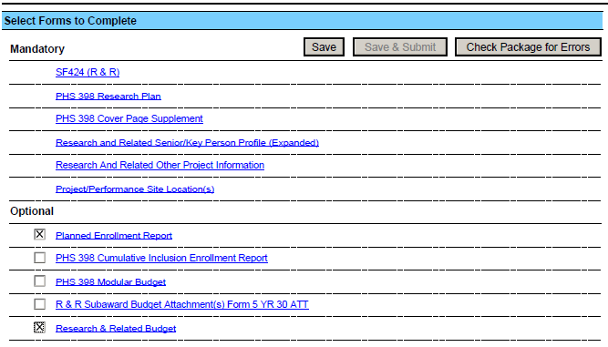
Submit Application (AOR only)
Save & Submit button will not become active until application is saved and mandatory information is completed.
Check Package for Errors button only checks to make sure the application meets Grants.gov requirements. Agency requirements checked upon submission.

Slide 62
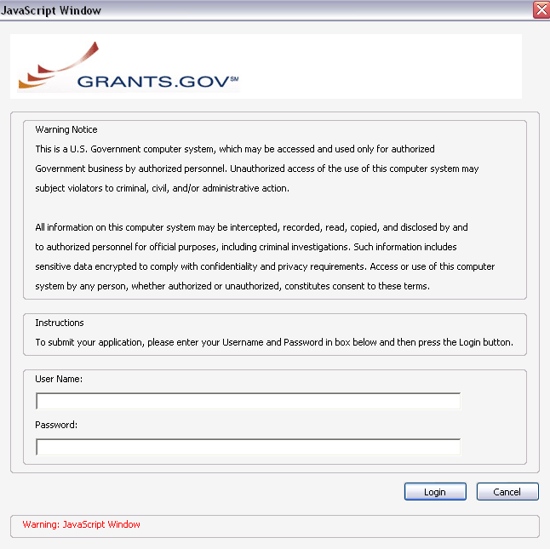
Submit Application
AORs: Enter your Grants.gov username and password—you must be fully registered to successfully submit an application.
Only AORs with active SAM registration can submit!

Slide 63
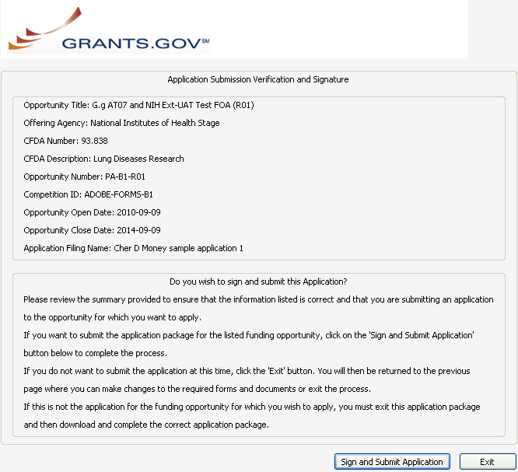
Submit Application
Click Sign and Submit Application button to record electronic signature and initiate submission process to Grants.gov.

Slide 64
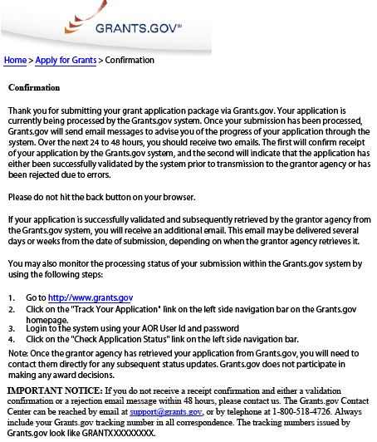
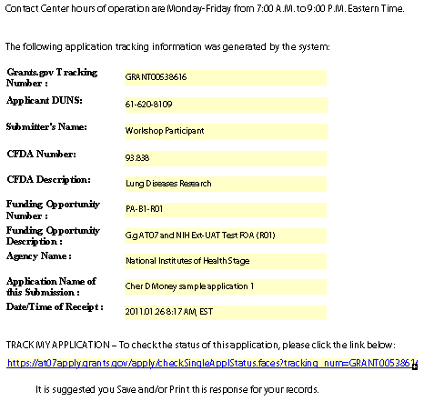
Submit Application
Print/save your confirmation screen info.
Grants.gov Tracking #
Date/Time Stamp - due 5 p.m. local time of the applicant organization on deadline date

Slide 65

On-time Submission
Important reminders:
  NIH recommends submitting early (days, not minutes!) to allow time for correcting any errors found during the application viewing window prior to the due date
  NIH’s late policy does not allow corrections after the due date
  All registrations must be completed before the due date
Error-free applications must be accepted by Grants.gov with a time stamp on or before 5:00 p.m. local time of the submitting organization on the due date.

Slide 66
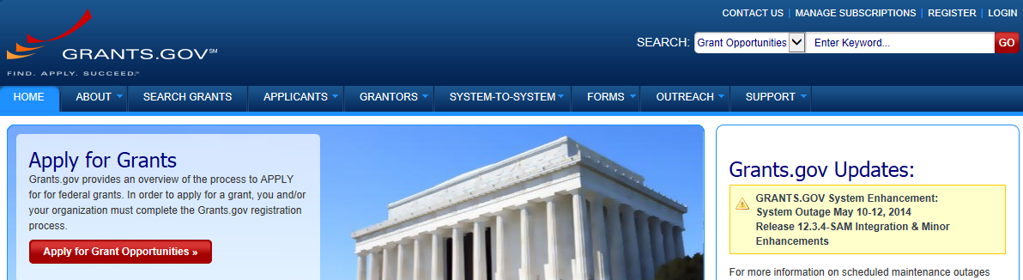
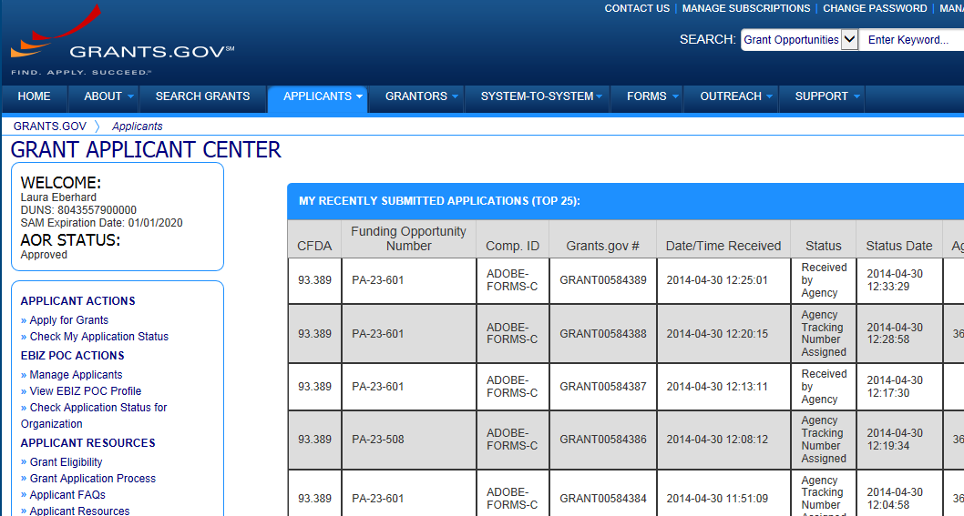
Track Application – Grants.gov
Grants.gov application status

Slide 67
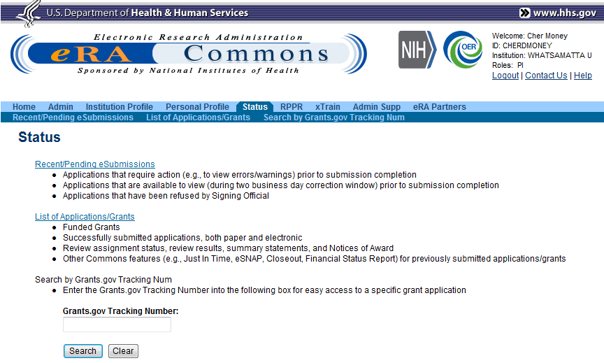
Track Application - Commons
Select Recent/Pending eSubmissions
Or provide Grants.gov tracking number from e-mail notification

Slide 68
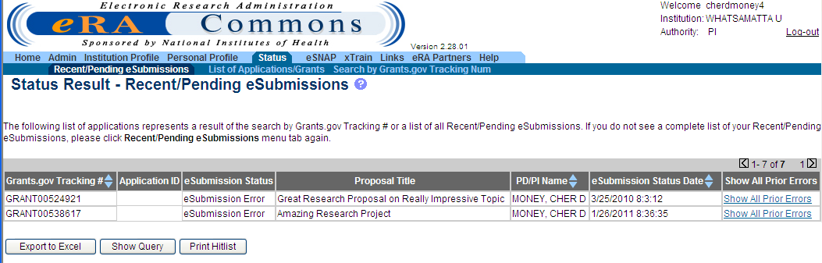
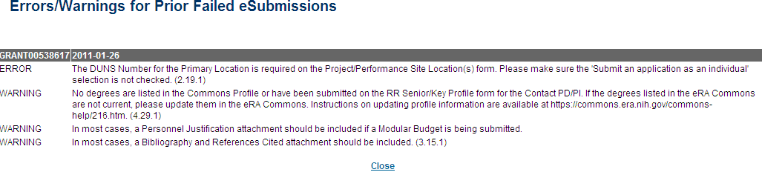
Track Application - Commons
Indicates eSubmission Error
Grants.gov tracking #
Grants.gov tracking #/date are displayed, followed by the list of errors/warnings for each submission attempt

Slide 69



Corrective submissions must be made BEFORE the submission deadline!
Errors stop application processing and must be corrected
  In ASSIST, cannot submit until errors are corrected
Warnings do not stop application processing and are corrected at the discretion of the applicant

Slide 70

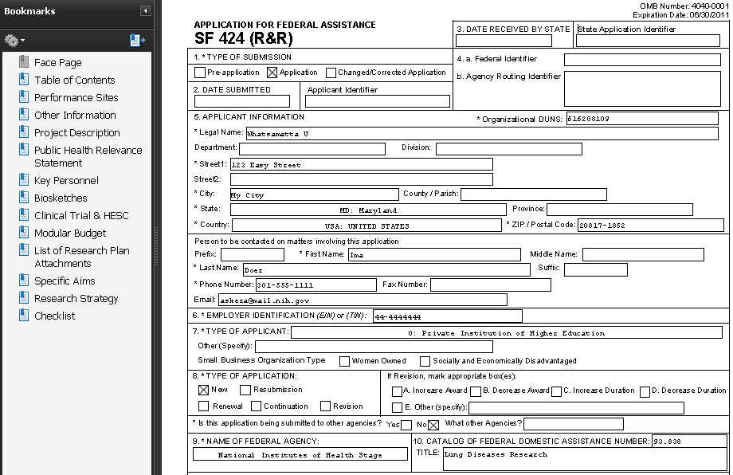
View Application Image
Once an error-free application is received by NIH, the eRA system will:
  Assemble the grant application image
  Insert headers (PI name) and footers (page numbers) on all pages
  Generate Table of Contents and bookmark important sections
  Post the assembled application image in the PD/PI’s eRA Commons account
  Send notification

Slide 71

Application Viewing Window
Applicants have two (2) business days to view the assembled application image before the application automatically moves forward for further processing
SO can Reject application within viewing window and submit a Changed/Corrected application before the submission deadline
If you can’t VIEW it, we can’t REVIEW it!

Slide 72
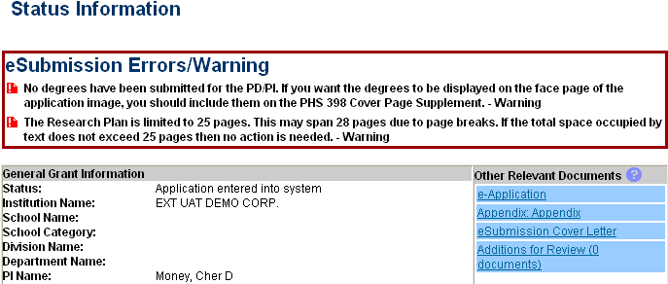
View Application Image in Commons
Status is Pending Verification
Follow link to detailed status info
Follow e-Application link to view assembled application image
View Appendices and Cover Letter

Slide 73
View Application Image in Commons
TIP: Carefully review the entire application.
This is your chance to view/print the same application image that will be used by Reviewers!

Slide 74
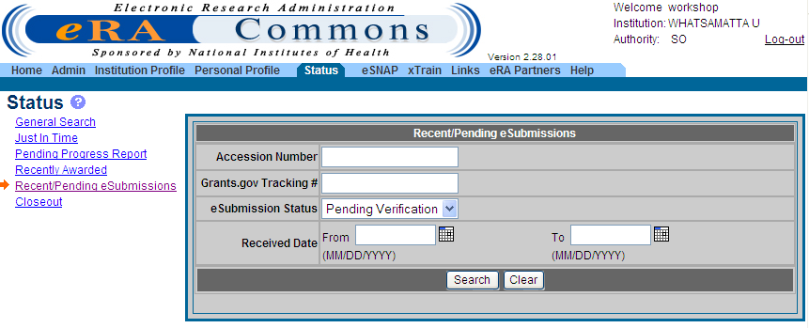
Reject eApplication
PIs: If the application image in the eRA Commons
does not properly reflect the submitted material, work
with your SO to reject the application!
Must have SO role
Enter Search Criteria
Click Search
Select Recent/ Pending eSubmissions

Slide 75
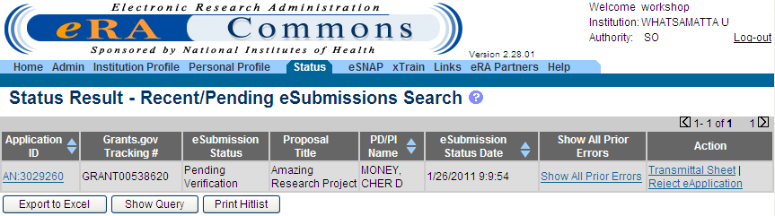
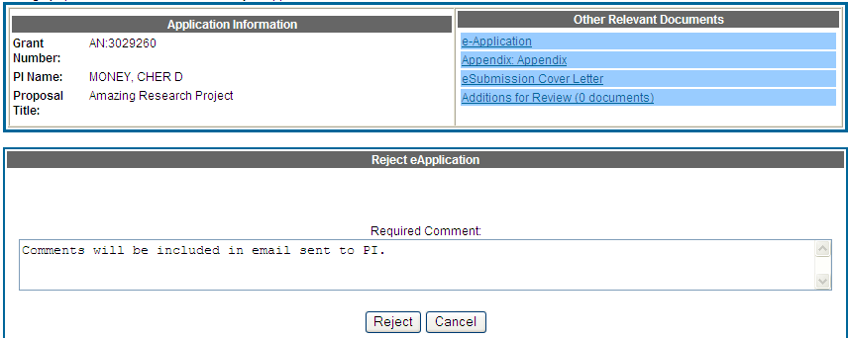
Reject eApplication
Enter comment to be sent with e-mail notification
75

Slide 76

Submission Complete!
If no action is taken during the two business day viewing window, the application automatically moves forward for further processing at NIH
Any subsequent application changes are subject to the NIH policy on late submission of grant applications and the NIH policy on post-submission application materials

Slide 77

Dealing with System Issues
Applicants should follow NIH’s standard ‘system issue’ procedure if they run into problems beyond their control that threaten their on-time submission: http://grants.nih.gov/grants/ElectronicReceipt/support.htm#guidelines

Slide 78

Start Live eSubmission Demo
The following set of slides are for your reference and contain many of the points made during the demo.
Sheri & Jessie

Slide 79
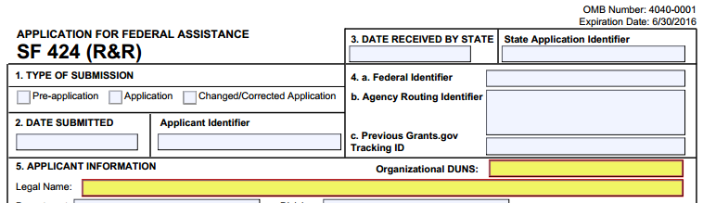
Avoid Common Errors
Does the DUNS number on the SF424 (R&R) cover form match the DUNS number used for Grants.gov & Commons registrations?

Slide 80
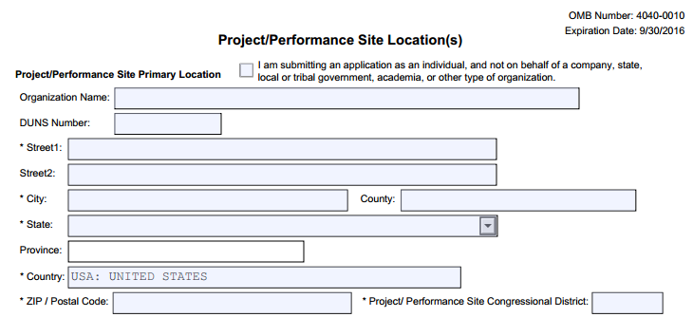
Avoid Common Errors
Primary site DUNS is required by NIH and is enforced with an agency validation

Slide 81
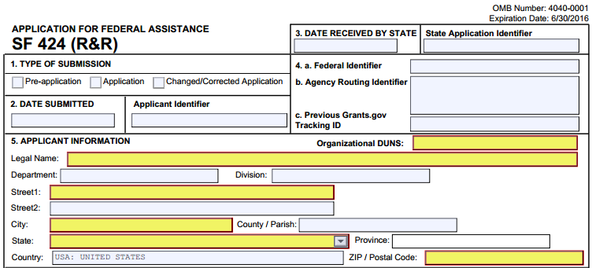
Avoid Common Errors
Did you provide correct Type of Submission (#1), Federal Identifier (#4), and Type of Application (#8) information on the SF 424 (R&R) cover form?
Use Application for first submission attempt for the same deadline
Use Changed/Corrected when submitting again to correct eRA-identified errors/warnings

Slide 82
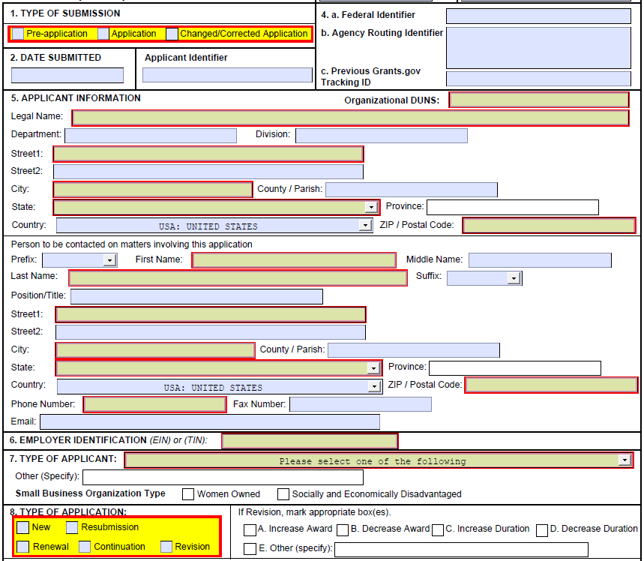
Fed ID & Type of Application
Federal ID & Types of Applicationis
If Resubmission/Renewal/Revision in field #8, use Institute and serial #
of previous NIH grant/app (e.g., use
CA987654 from 1R01CA987654-01)
If Changed/Corrected in field #1, then enter previous Grants.gov tracking number
See Application Guide for definition of application types

Slide 83
Terminology Check
Type of Application on SF424 (R&R), field #8
Term | Notes
New | An application that is submitted for funding for the first time. (Type 1)
Renewal | Competing for additional years of funding to continue original project. (Type 2)
Revision | Request for additional funds for a current award to expand the scope of work. Applicants should contact the awarding agency for advice on submitting any revision/supplement application. (Type 3)
Resubmission | Application previously reviewed. A revised or amended application that addresses reviewer feedback. (A1)
Continuation | NIH does not use the SF 424 (R&R) for Continuation applications. (Type 5; progress reports for simplified non-competing (SNAP) applications are submitted directly to eRA Commons; for others, paper apps. are still submitted.)

Slide 84
Avoid Common Errors
Did you include the eRA Commons ID in the Credential field of the R&R Sr/Key Person Profile form for all PD/PIs?
If submitting a Multiple-PD/PI application, did you give all PIs the PD/PI role on the Sr/Key Person Profile form?
  For multi-project, multi-PD/PI applications, all PD/PIs for the entire application should be included in the Overall Component

Slide 85
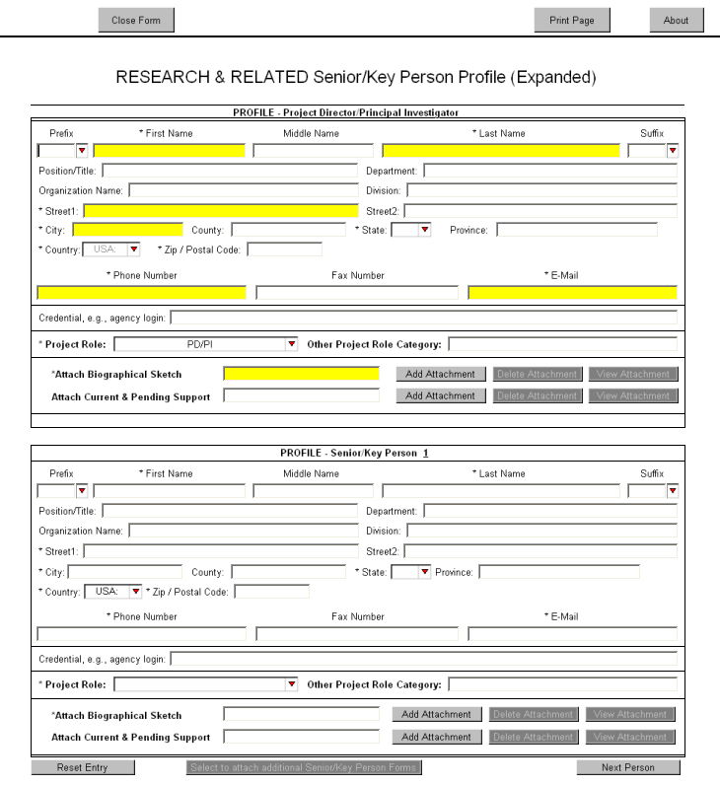
Credential Field
eRA Commons
username must be supplied in the Credential field
Enter PI Commons Username
For multiple PD/PI applications, select the PD/PI role for each PI and provide their eRA Commons username in the Credential field
Enter PI Commons Username
Select PD/PI role for each PI

Slide 86
Avoid Common Errors
Did you include Organization name for all Sr/Key listed on the R&R Sr/Key Person Profile (Expanded) form?
PD/PI Organization will auto-populate from SF 424 (R&R) cover if available.
NIH requires the Organization name for all Sr/Key listed.
Organization Name
Enter Organization Name

Slide 87
Avoid Common Errors
Did you include all required attachments?
  Whether an attachment is required or not is often based on how the applicant answers specific questions throughout the application
  Examples:
    Human Subjects = Yes, then Human Subjects section of the PHS 398 Research Plan required
    Vertebrate Animals = Yes, then Vertebrate Animals attachment is required
    More than one entry on the R&R Sr/Key Person Profile form with the role of “PD/PI,” then the Multiple PD/PI Leadership Plan attachment on the PHS 398 Research Plan form is required

Slide 88
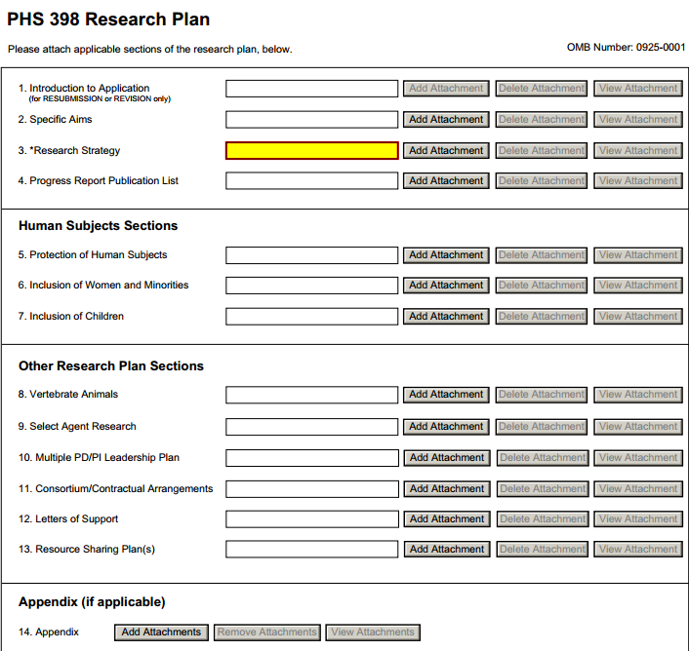
Conditional Requirements
Annotated form sets available on the Resources page of the Applying Electronically website are a great resource for helping identify many conditional requirements.
Annotated form sets:
http://grants.nih.gov/grants/ElectronicReceipt/communication.htm

Slide 89
Avoid Common Errors
Are all your attachments in PDF format?
  Use simple PDF-formatted files
    Do not use Portfolio or similar feature to bundle multiple files into a single PDF
    Disable security features such as password protection
  Keep file names to 50 characters or less
  Use meaningful filenames
    Other Project Information form, Other Attachments section
    Appendices
  Do not include headers or footers
    Section headings as part of the text (e.g., Specific Aims, Background & Significance) are encouraged
  Follow guidelines for fonts and margins
PDF Guidelines: http://grants.nih.gov/grants/ElectronicReceipt/pdf_guidelines.htm

Slide 90
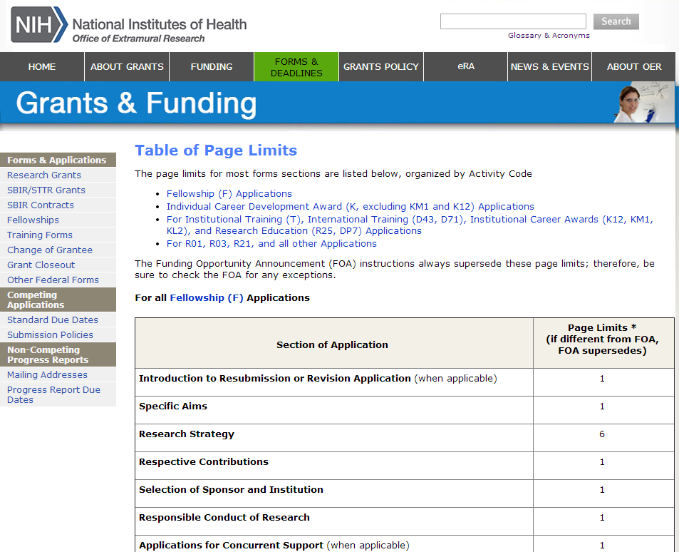
Avoid Common Errors
Did you follow all specified page limits?
Find page limits in:
FOA text
Application guide
Table of Page Limits web page
  http://grants.nih.gov/grants/forms_page_limits.htm

Slide 91
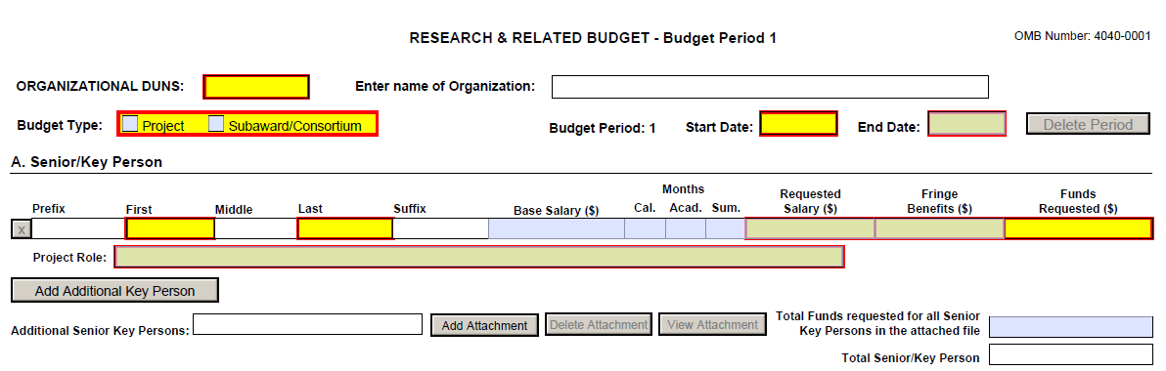
Avoid Common Errors
Did you include effort > 0 for all Sr/Key personnel listed on the R&R Budget form?
  Use either calendar months or a combination of academic and summer months
  PD/PI must have effort >0 for every budget period

Slide 92
Notes on Personnel
R&R Budget Form | Senior/Key Personnel
Include only personnel employed by (e.g., receiving salary from) your organization. | Include all personnel considered senior or key, regardless of employer.
Consultants should be included in Section F Line 3 Consultants, not in Sections A or B. | Include if considered senior or key, regardless of employer.
If effort is unknown include in Section B (e.g., other significant contributors). | Effort commitments not relevant to this section.

Slide 93
Avoid Common Errors
Did you follow all special instructions noted in Section IV. Application and Submission Information of the announcement?
  When the application guide and FOA instructions differ, the FOA wins
  FOA-specific requirements are not typically system-enforced
  Applications that do not comply with the instructions may be delayed or not accepted for review

Slide 94
End Demo & Return to Presentation

Slide 95

What’s Coming
Expanding ASSIST for use with single-project application preparation and submission
  If you would like to participate in user acceptance testing, please contact:
  Jessie Floura
  FlouraJ1@mail.nih.gov
  Visit the eRA Booth during the
  conference to sign-up
Expand ASSIST to support single projects

Slide 96

eSubmission – Policy Notices
NOT-OD-14-091
  A new Biosketch format has been piloted to extend the page limit from four to five pages.
NOT-OD-14-074
  Effective April 17th, 2014 will accept a new (A0) application following an unsuccessful resubmission (A1) application.
NOT-OD-13-091
  NIH Announces the availability of new application instructions and forms for:
    Paper-based PHS 398
    Electronic SF 424 (R&R) Applications

Slide 97
eRA Commons Detailed Status Screen
Verifying ESI & Ni status
Tracking reference letters
Identifying nih contacts
Checking review assignments
Viewing referral and review correspondence
Joe

Slide 98

Video - Status
http://era.nih.gov/era_training/tutorials/SO-PI_Status/
All eRA Video Tutorials:
http://era.nih.gov/era_training/era_videos.cfm

Slide 99
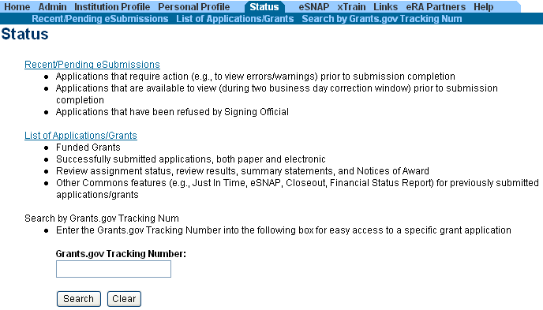
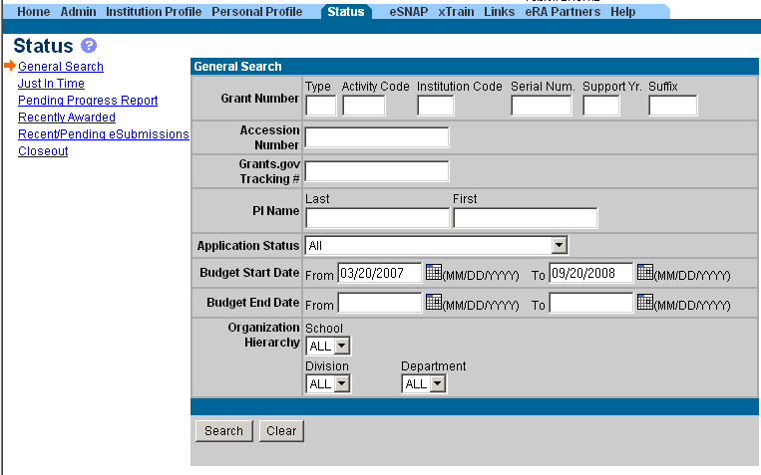
PI & SO Status Views
Principal Investigators can view their Recent/Pending eSubmissions or List of Applications/Grants.
Signing Officials can search/view all submissions for their institution.

Slide 100
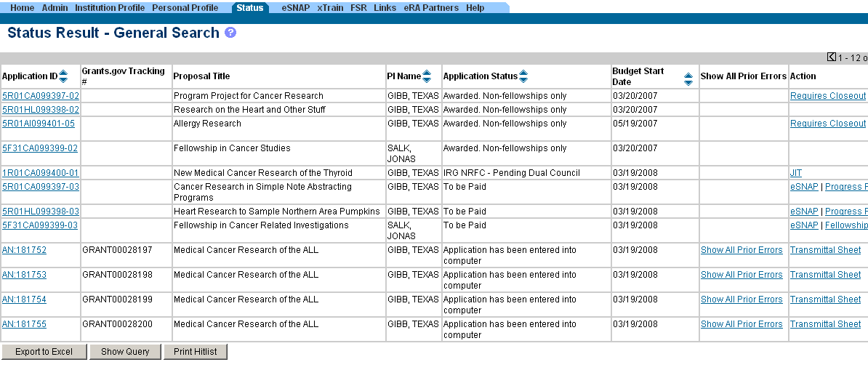
Status Result from General Search
Select the Application ID link to view detailed status information for that particular application.

Slide 101
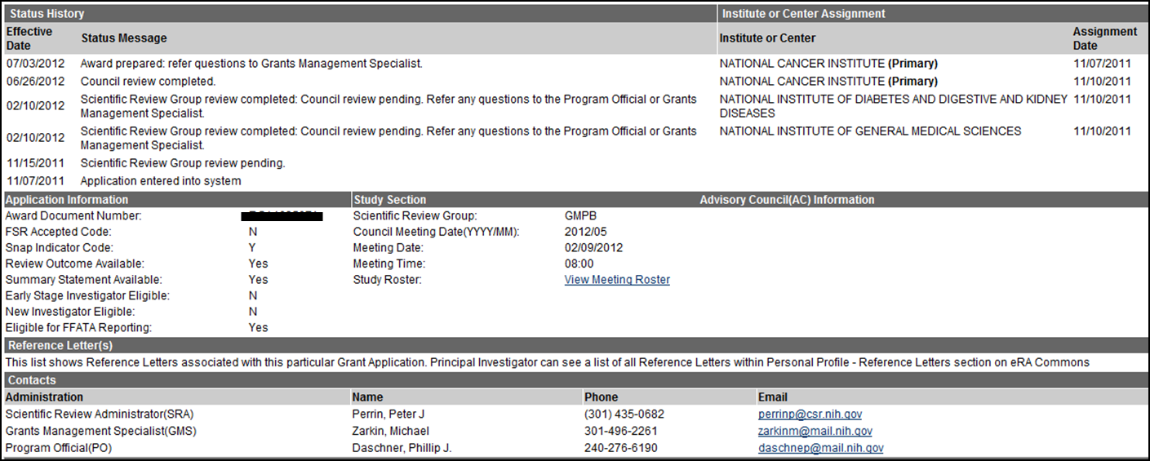
Verifying ESI & NI Application Status
Reflects a snapshot of Early Stage Investigator (ESI) and New Investigator (NI) status at time of application submission.

Slide 102
Reference Letters
NOT part of the application through Grants.gov
Submitted directly by the referee through eRA Commons
Commons registration not required
Can be submitted in advance of application submission
Due by the application submission deadline
Applicants can track the submission of reference letters in the Commons, but cannot view the actual letter
With FORMS-C, Fellowship reference letters no longer have a required format – just a letter
Some NIH grant programs require the submission of reference letters in addition to the grant application (e.g., Mentored Career Development program)

Slide 103
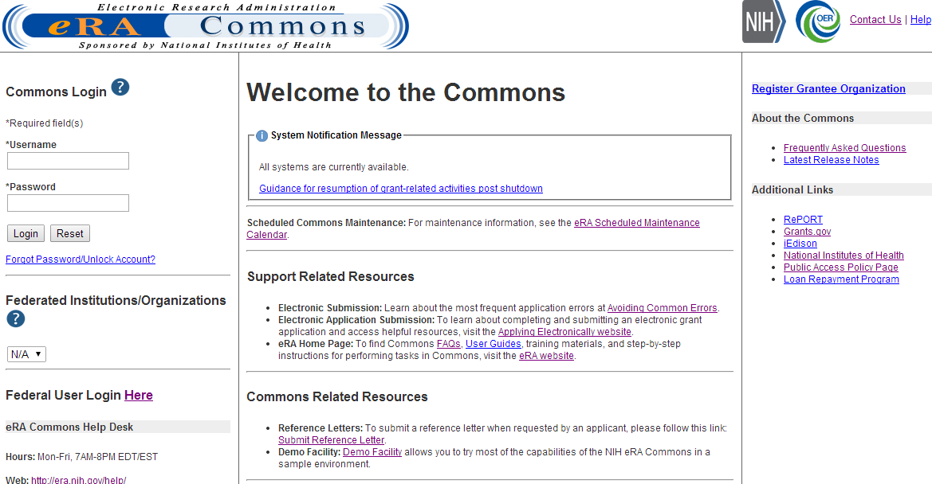
Reference Letters
Referees do not need to login to Commons to submit.

Slide 104
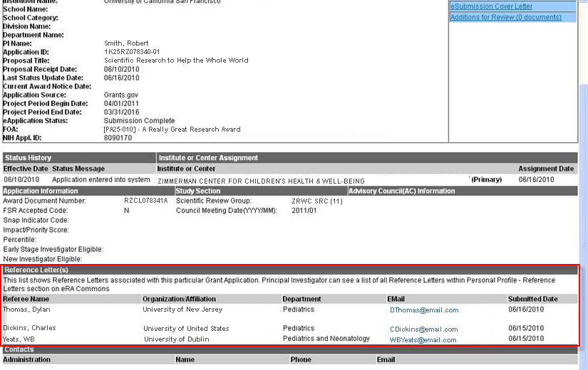
Reference Letters

Slide 105

Reference Letter Resources
Frequently Asked Questions
  http://grants.nih.gov/grants/ElectronicReceipt/faq_full.htm#12
Submitting Reference Letters through eRA Commons (Demo)
  http://era.nih.gov/era_training/tutorials/NIH_Reference_Letter/NIH%20Reference%20Letter.htm

Slide 106
Identifying NIH Contacts
Contacts are added as the application moves through the different stages of processing.

Slide 107
Check Review Assignments
Institute or Center assignment
Study Section assignment

Slide 108
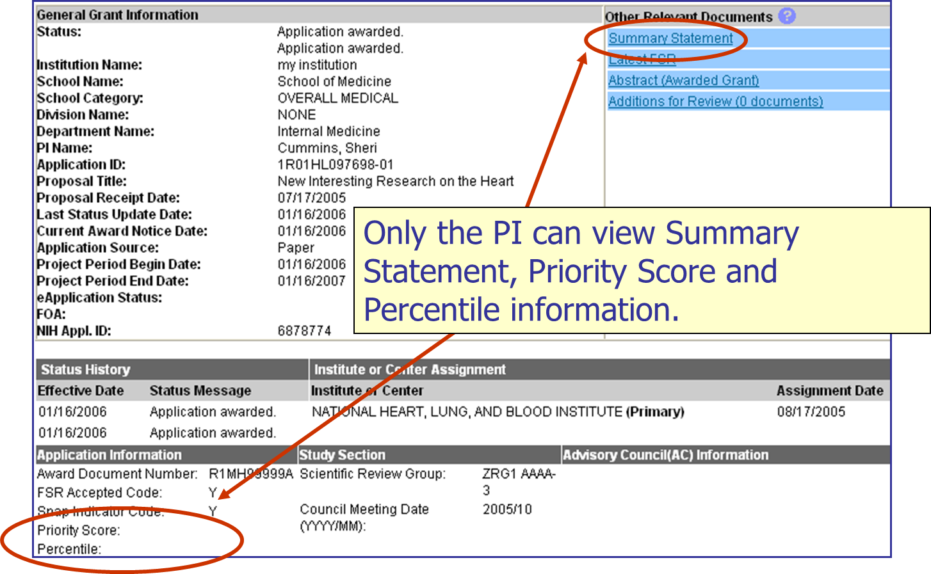
Check Review Outcomes

Slide 109

Viewing Referral and Review Correspondence
NIH Referral and Review staff can post correspondence for the application.

Slide 110
Just-In-Time (JIT)
Submitting JIT information upon nih Request
Anastasiya

Slide 111
Just-In-Time (JIT)
Applicants should never submit JIT info until specifically requested to do so by NIH. A JIT link or request from NIH are not indications that a grant award will be made.
  Other Support File, Budget Upload, Other Upload, Institutional Review Board (IRB) Date, Human Subject Education
  PD/PI can save info in Commons, but only SO can submit JIT info to NIH
  Must be PDF format
Allows an applicant organization to submit additional grant application information after the completion of the peer review, and prior to funding.

Slide 112

JIT Link on Status Result Screen (SO View)
Select JIT link

Slide 113

Just-In-Time (PI View)
PDF document with Other Support documentation is required. Use the Import button to begin the upload.
IRB Approval Date should be within the last 12 months.

Slide 114
JIT – Policy Notices
NOT-OD-12-101
  Notice of Requirement for Electronic Submission of Just-in-Time Information and Related Business Process Changes Beginning April 20, 2012
    JIT link appears for all applications within 24 hours of releasing impact scores
    Applications with impact score of 40 or less receive standard notice and request for JIT information
NOT-OD-10-120
  Revised Policy on Applicant Institution Responsibilities for Ensuring Just-in-Time Submissions are Accurate and Current Up to the Time of Award

Slide 115
Notice of Award (NoA)
Viewing notice of award in status
Anastasiya

Slide 116

Notice of Award (NoA)
Contains or refers to all terms and conditions of the grant
Is posted in the Other Relevant Documents section of the Status Information page
Official document notifying the grantee and others that a grant has been awarded

Slide 117
Video - Notice of Award
http://era.nih.gov/era_training/tutorials/Notice_of_Award/
All eRA Video Tutorials:
http://era.nih.gov/era_training/era_videos.cfm

Slide 118
Financial Conflict of Interest
(FCOI)
Reporting financial conflict of interest
Sheri

Slide 119
FCOI
Initiate and prepare a FCOI report
Submit the report, any necessary supporting documents, and comments (optional) to the agency
Search and view previously submitted FCOI reports (those submitted via Commons only)
Edit or rescind submitted reports (rescinding involves agency involvement)
Access the history of actions
Initiate, prepare, and submit FCOI notification and supporting documents electronically to NIH

Slide 120
FCOI Account Administration
Signing Official at the institution can assign appropriate roles to Commons users to manage the FCOI process for the institution
  FCOI role
    Multiple people at the institution can have the FCOI role
    Only users with FCOI role can submit FCOI reports to the agency
  FCOI ASST role
    Allows user to help with data entry and completion of FCOI reports
  FCOI View-only role
    Allows user to see FCOI reports but cannot edit them

Slide 121
FCOI
Integrated with NIH’s internal FCOI tracking system
Internal FCOI users can request additional information and rescind notifications
  Notification to institution made from internal FCOI system and also is reflected in Commons FCOI history

Slide 122

Initiating FCOI Notification
System provides Contact PD/PI name after initial save. Provides additional info to check that the correct grant # is entered.
System will pull the latest Support Year of the grant.

Slide 123

Search for Existing FCOI
Can search by FCOI #, Grant #, or Name of Investigator with Conflict. Provides list of awarded grants for this institution with previously created FCOI notifications.
Links to FCOI History
Available actions

Slide 124

FCOI Edit
Fields are pre-populated, but can be edited.
Managed, Reduced, or Eliminated
Delete entire record
Delete uploaded file

Slide 125
FCOI – What’s New?
Changes to the FCOI module made in April 2014
  The link to the FCOI report is now available 75 days prior to the report’s due date
  The FCOI report link is now available the day after the grantee activates a No Cost Extension (NCE)

Slide 126
FCOI– Policy Notices
NOT-OD-14-081
  Notice of NIH Improving the Financial Conflict of Interest (FCOI) Module for Submission of Financial Conflict of Interest Reports to the NIH Beginning on April 25, 2014

Slide 127
Progress Reports
Rppr
MYRPPR
ffr
Anastasiya

Slide 128

RPPR
Describes scientific progress, identify significant changes, report on personnel, and describe plans for the subsequent budget period or year.
  http://grants.nih.gov/grants/rppr/
Now available for all SNAP and non-SNAP progress reports.
Progress Report Additional Material (PRAM) functionality available for publication compliancy explanations and additional information requested by grants management staff.
Annual progress report to document grantee accomplishments and compliance with terms of award.
Hello, RPPR!

Slide 129
RPPR Transition Timeline
Required for SNAP and Fellowship Awards with budget start dates on or after July 1, 2013.
Optional for type 5 non-SNAP progress reports as of April 24, 2014.
  RPPR required for all Type 5 non-SNAP Progress Reports on October 17, 2014. NOT-OD-14-092

Slide 130

RPPR Menu Screen

Slide 131
RPPR Data Entry
RPPR sections
  Cover Page
  Accomplishments
  Products
  Participants
  Impact
  Changes
  Special Reporting
  Budget (non-SNAP)
Watch for character limits in data entry fields
Ensure uploads are in PDF format
When completing data tables remember to click ‘Add/New’

Slide 132

Sample RPPR Screen

Slide 133
Progress Report Additional Materials (PRAM)
The PRAM feature provides a means for the grantee to enter, review, route, and submit information to agency following the submission of an RPPR.
  Public Access (PA) PRAM - Generated automatically after an RPPR is submitted with publications that are not compliant with Public Access Policy
  IC (Agency) Requested PRAM – Only available if requested by the Grants Management Specialist (GMS)
PD/PI can enter the PRAM, but can only submit it if they are delegated with Submit Progress Report authority. Otherwise, only the SO can submit the PRAM to Agency.

Slide 134


Progress Report Additional Materials (PRAM)

Slide 135

RPPR – What’s New?
MYRPPR
  Multi Year Progress Reports now use RPPR format
  Link available under the Action Column in Status

Slide 136
RPPR – What’s New?
Submitting progress reports with budgets
  R&R budget and PHS 398 budgets are now available for Non-SNAP RPPR.
  If presented with an option of budget forms, the type that was submitted with the application should be used.
    PHS 398 Budget is available only on training grants.
  Help for R&R Budget and PHS 398 Budget forms can be found in the SF424 R&R User Guides.

Slide 137
RPPR – What’s New?
Submitting progress reports for complex, multi-project grants
  After RPPR is initiated, PI will need to identify if RPPR should contain components.
  RPPR should have the same structure as the originally submitted application.
  Some sections are not available on Overall component (i.e. Budget)
  Some sections are not available on component level (i.e. Participants and Publications are reported on Overall)

Slide 138
New Format for PA PRAM
PA PRAM will require an attachment.
  The PA PRAM will no longer contain a free form text box.
  Using My NCBI the institution will need to generate a PDF of their reported publications showing their compliance.
  For instructions on generating the report please see: http://www.nlm.nih.gov/pubs/techbull/nd12/nd12_myncbi_pdf.html

Slide 139

RPPR Looking Ahead
Coming October 2014:
  RPPR required for all awards.
  Required eRA Commons account for Graduate and Undergraduate individuals with measurable effort on RPPR.

Slide 140
Progress Report – Policy Notices
NOT-OD-14-092
  NIH Will Require the Research Performance Progress Report (RPPR) for All Type 5 Non-SNAP Progress Reports on October 17, 2014
NOT-OD-14-079
  NIH Will Open the Research Performance Progress Report (RPPR) for All Type 5 Non-SNAP Progress Reports on April 25, 2014.

Slide 141
Progress Report – Policy Notices
NOT-OD-14-026
  NIH Will Require Use of Research Performance Progress Report (RPPR) for All Multi-Year Funded Awards
NOT-OD-13-097
  Extension of eRA Commons User IDs to Individuals in Graduate and Undergraduate Student Project Roles with Measurable Effort on an NIH Annual
  Progress Report (PHS2590 & RPPR)

Slide 142
Progress Report – Policy Notices
NOT-OD-13-061
  NIH Reminds Grantee Institutions of the Requirement to Use the RPPR for All SNAP and Fellowship Progress Reports for Awards with Start Dates On or After July 1, 2013
NOT-OD-13-035
  NIH Requires Use of RPPR for All SNAP and Fellowship Progress Reports, and Expands RPPR Functionality
NOT-OD-13-017
  eRA Commons Users Can Now
  Generate a Publications Report for
  the PHS 2590 with My NCBI

Slide 143
Progress Report – Policy Notices
NOT-OD-12-160
  Upcoming Changes to Public Access Policy Reporting Requirements and Related NIH Efforts to Enhance Compliance
NOT-OD-12-152
  Revised Pre- and Post-Award Forms and Instructions Available
NOT-OD-12-142
  Research Performance Progress
  Report (RPPR) Module and Training
  Webinar Available to NIH Grantees

Slide 144
Federal Financial Report (FFR)
FFRs must be submitted in eRA Commons via the FFR/FSR module
  Cash transaction data still submitted via Payment Management System
FSR role for users who have the authority to view, enter, and submit an FFR on behalf of institution
Allows grantees to electronically submit a statement of expenditures associated with their grant to NIH via eRA Commons.

Slide 145
FFR
Annual FFR due date: For non-SNAPs, FFR must be submitted within 90 days of the calendar quarter in which the budget period ends
Final FFR due date: based on the Project Period End Date (PPED):
  Pending Status: If the FFR is not submitted and it is within 90 days of the PPED
  Due Status: If the FFR is not submitted and it is between the PPED and 90 days past the PPED
  Late: If the FFR is not submitted and it is more than 90 days past the PPED

Slide 146

FFR/FSR Screen

Slide 147

FFR Search Result
The Grant Number is a hyperlink that will take you to the FFR/FSR form.

Slide 148
FFR Details Screen
Clicking the hyperlinked grant number opens the FFR Details screen, which displays:
  FFR Status:
    Received, Accepted, Rejected, In Review, or Revision Pending
  Available Actions:
    Accepted status: View or Create New
    Rejected status: View or Create New
    Received status: View or Correct
    Revision Pending status: View or Edit
    In Review status: View

Slide 149

Completing the FFR
As current year entries are completed, calculations are done automatically.

Slide 150

Submission of a FFR
Once FFR/FSR is Submitted, Latest FSR status changes to Received
If a mistake is made on the FFR and the status has changed to In Review, the institution should contact the NIH OFM staff and have them reject the FFR/FSR so that revisions can be made.
OFM staff are assigned by NIH Institute/Center. Identify the correct OFM staff member to speak to by using this link http://ofm.od.nih.gov/fsr.asp

Slide 151
FFR Related – Policy Notices
NOT-OD-13-120
  NIH Domestic Awards to Transition to Payment Management System Subaccounts in FY 2014 and FY 2015
NOT-OD-13-112
  NIH Domestic Awards to Transition to Payment Management System Subaccounts in FY 2014

Slide 152
FFR Related – Policy Notices
NOT-OD-13-111
  NIH to Transition Payment for Individual Fellowships at Foreign and Federal Sponsoring Institutions, and Awards to Federal Institutions to Payment Management System Subaccounts in FY 2014
NOT-OD-13-019
  Notice of Changes to Payment Management System Registration Procedures for NIH Foreign Grantees

Slide 153
No Cost Extension (NCE)
Submitting a no cost extension
Joe

Slide 154
NCE
Only SOs can submit the NCE notification
May be submitted no earlier than 90 days before end of project and no later than project end date
Can request extension of 1-12 months, in one-month increments
E-mail notification sent to NIH Grants Management staff when SO processes the extension
Electronically submit a notification to exercise one-time authority to extend without funds the final budget period of a project period of a grant.

Slide 155

Extension link in Status screen

Slide 156

Extension Screen
Choose an extension of 1 to 12 months.

Slide 157
NCE – Policy Notices
NOT-OD-11-098
  Mandating Use of the Commons to Submit No-Cost Extension Notifications

Slide 158
Electronic Administrative Supplements (Type 3s) Requests
Submitting an administrative supplement
Using Grants.gov
Using Commons
Jessie

Slide 159
Administrative Supplements
Requested additional costs must be within the scope of the peer reviewed and approved project
Multiple submission methods available:
  SF424 (R&R) application forms & standard Grants.gov submission process¹
    Great for system-to-system users
  Streamlined eRA Commons process¹
    Commons pre-populates much of the data needed for request from awarded grant
  Paper process
A request for additional funds during a current project period to provide for an increase in costs due to unforeseen circumstances.
¹Available for single-project activity codes for which competing applications are submitted through Grants.gov.

Slide 160
Admin. Supplement Requests– Grants.gov
Parent Announcement page has general use FOAs
  http://grants.nih.gov/grants/guide/parent_announcements.htm#adminsupp
  NIH Institutes can also post FOAs for administrative supplements targeting specific programs
When completing package…
  Follow all FOA-specific instructions
  Carefully choose appropriate application package
  Use Revision as the Application Type (SF424 RR, item #8)
  Include IC and Serial number of awarded grant as the Federal Identifier (SF424 RR, item #4a)

Slide 161
Admin. Supplement Requests– Grants.gov
Similar submission process as competing applications, except:
  Many of the NIH business rule validations for competing applications are not enforced
  Required forms may vary from competing applications for the same activity code
    Modular budget forms not an option; must use detailed R&R Budget forms
    No cover letters
  After the two-day viewing window the request bypasses Receipt & Referral and goes directly to Grants Management staff for consideration
    Move to Admin Supp Status tab in Commons

Slide 162

Admin. Supplement Requests - Commons
Starting an Administrative Supplement request in Commons you must find eligible grant and Initiate Request

Slide 163

Admin. Supplement Requests - Commons
Complete Form – Required Fields are indicated with red asterisk

Slide 164

Admin. Supplement Requests - Commons
For each Budget Period enter appropriate sections:
  Personnel, Equipment, Travel, Participant/Trainee, Other Direct, Total F&A (Indirect) Costs
Total Requested will be calculated automatically

Slide 165
Admin. Supplement Requests - Commons
Resources:
  eRA Commons Administrative Supplement Module User Guide
    http://era.nih.gov/files/eRA_Commons_Admin-Supp_UG.pdf
  Administrative Supplements (Type 3s) Frequently Asked Questions
    http://era.nih.gov/commons/faq_commons.cfm#XVIII

Slide 166
Admin. Supplement – Policy Notices
NOT-OD-13-031
  Notice of an Extension of Expiration Date for PA-12-100 "Administrative Supplements for Existing NIH Grants and Cooperative Agreements (Parent Admin Supp)"
NOT-OD-12-043
  New Electronic Submission Process Now Available for Administrative Supplement Requests

Slide 167
Grantee and Organizational Changes
Submitting a Relinquishing statement
Submitting a Change of grantee or training institution request (type 7) using grants.gov
Submitting a Change of Organization Status/Successor In Interest
(Type 6) Request using grants.gov
Sheri

Slide 168
Relinquishing Statement
Processed in eRA Commons
  To relinquish any awarded grant
Original institution
  Submits relinquishing statement
  Can select new grantee organization or enter contact information if organization is not Commons Registered
New institution
  Receives eNotification from eRA Commons
  Can view in eRA Commons
NIH Awarding Institute
  Reviews and accepts or returns for correction
PHS 3734 form

Slide 169


Relinquishing Statement
Use Change of Institution Search
  Must provide at least the Institute Code and Serial Number as search parameters

Slide 170

Relinquishing Statement Data Entry Screen
Change of Institution User Guide:
http://era.nih.gov/files/ccoi_userguide.pdf

Slide 171
Change of Grantee (Type 7) Requests
Request for support of a funded project that has been transferred from one grantee or training institution to another.
Also known as Change of Institution or transfer.

Slide 172
Change of Organization Status (Type 6) Request
Request for support of a funded project at an institution where the legal status has been changed.
Formerly known as Successor-In-Interest.

Slide 173

Type 6/7 Requests – Grants.gov
Available for post-award requests for single-project activity codes for which competing applications are submitted through Grants.gov
Though not yet required, applicants are encouraged to use and become familiar with the electronic option
Talk to your awarding Institute prior to submission

Slide 174
Type 6/7 Requests – Grants.gov
Parent Announcement page has general use FOAs
  http://grants.nih.gov/grants/guide/parent_announcements.htm#post
When completing package…
  Follow all FOA-specific instructions
  Carefully choose appropriate application package
  Use Revision as the Application Type (SF424 RR, item #8)
  Include IC and Serial number of awarded grant as the Federal Identifier (SF424 RR, item #4a)

Slide 175
Type 6/7 Requests – Grants.gov
Similar to competing application process, except:
  Many of the NIH business rule validations for competing applications are not enforced
  Required forms may vary from competing applications for the same activity code
    Modular budget forms not an option; must use R&R Budget forms
    Type 6
      Only a few required forms
        SF424 (R&R) cover, Other Project Information, SR/Key Information
      Optional forms vary by program
    Type 7
      Budget forms added to some Type 7 form packages (e.g., DP1, DP2, DP3)

Slide 176
Type 6/7 Requests – Grants.gov
  After the two-day viewing window the request bypasses Receipt & Referral and goes directly to Grants Management staff for consideration
    Requests move to List of Applications for PIs and General Search (for SOs) like competing applications

Slide 177
Grantee & Org. Changes – Policy Notices
NOT-OD-12-132
  Notice of Pilot Processes for Submitting of Post-Award Relinquishing Statements to NIH
NOT-OD-12-133
  Notice of Pilot for Processing Post-Award Changes in Grantee Organizational Status: Successor-in-Interest
NOT-OD-12-134
  Notice of Pilot Processes for Post-Award Change of Grantee Organization Applications to NIH

Slide 178
Close0ut
Wrapping up the ‘paperwork’ with closeout
Gabrielle

Slide 179
Closeout
Closeout items include:
  Federal Financial Report (FFR)
  Final Progress Report
  Final Invention Statement
NIH must mark the grant “ready for close out” for link to appear in Commons
  Contact the Division of Central Grants Processing (DCGP) or assigned Grants Management Specialist (GMS) if link is not appearing
Electronically submit required Closeout documents for grants in Closeout status

Slide 180
Closeout Capabilities
Identify expiring and terminating grants
Request and track required closeout documents
Track submission of boxed archived paper grant records at the Federal Record Center (FRC)

Slide 181
NIH Grant Closeout Process
Notice of Award (Final Year) is sent to the grantee including Closeout clause
Process Owners
Program Official - Assigned by the Institutes
OFM – NIH Office of Financial Management
DEITR - Division of Extramural Inventions and Technology Resources
DCGP – Division of Central Grants Processing
Within 90 days
When Project Period Ends
Funding Ends
Identify Grants ready for closeout (Monthly)
Grants are flagged to allow grantees to submit official documents online or on paper
Review
Final Progress Rpt-by NIH Program Official
Final Fed Financial Report – by OFM
Invention Reported – by DEITR
OFM generates appropriate transaction to close PMS record
Grantees Submit:
Final Progress Report
Final Fed Financial Report
Final Invention Statement
Initial Reminder Notification is sent to Grantee
Official documents are marked “Accepted”
Color Key
DCGP Staff through Grants Closeout
Grant family is marked “Closed” in eRA system
Grantee through Commons
After 90 days a second Reminder notification is sent if necessary
OFM Staff through FFR module
Record retention policies apply
NIH staff - Not system specific

Slide 182

Search screen shows grants that are Closed or Requires Closeout

Slide 183

Closeout - FFR
You must have an account with the FSR role to create/submit the FFR/FSR.

Slide 184


Closeout – Final Progress Report
Either the PI or the SO can create/upload the Final Progress Report.
Browse to select file for upload.
Select Submit.
Read certification information and select OK.

Slide 185


Closeout – Final Invention Statement
If inventions are to be reported, the specific inventions must be listed.
Either the PI or the SO can start the process, but the SO must verify the report before submitting it to the agency.
If Yes is selected, Add Invention screen appears.

Slide 186


Closeout – Add Invention
Verify saved inventions.
Remove any that do not apply.
Add any that are missing.
Select Verify.
Select OK.

Slide 187

Closeout – Awaiting SO Verification
Status of Final Invention Statement is changed to Awaiting SO Verification. SO can now verify and submit.

Slide 188
Closeout – Policy Notices
NOT-OD-14-084
  NIH Updating Grant Closeout Policies and Procedures to Align with New HHS Requirements
NOT-OD-12-152
  Revised Pre- and Post-Award Forms and Instructions Available

Slide 189
xTrain
Using xtrain to prepare and submit appointment and termination forms
Gabrielle

Slide 190
xTrain
The use of the Commons xTrain feature is required for the electronic submission of appointment forms and termination notices related to institutional research training, fellowship, education and career development awards.
Paper forms and notices are NOT accepted
System for grantees, institution staff and agency staff to create, manage, route, submit and process appointments, reappointments, amendments, and termination notices electronically and to track the status and timing of training actions

Slide 191
xTrain User Roles
Business Official (BO):
  Similar to a Signing Official; has signature or other authority related to administering grantee institution training grants
Trainee:
  A person appointed to and supported by a training award
  Can view, update and route his or her own appointments, amendments, and terminations
Sponsor:
  A person who mentors a fellow (recipient of a fellowship award)
  Can initiate and facilitate the termination of a fellowship; can submit termination notice for foreign and federal fellowships only
ASST with Sponsor Delegation:
  Can perform functions similar to the Sponsor role, but cannot submit the fellowship termination notice to the agency

Slide 192

xTrain Trainee Roster
Appointment/Termination Source:
Paper or Electronic
Action:
2271 Form
Amend 2271
Initiate TN
Term Notice

Slide 193
xTrain Trainee Roster (continued)
Termination Status:
In Progress BO/In Progress PI
In Progress Trainee
Pending Agency Review
Accepted
Appointment Type:
New
Reappointment
Amendment
Appointment Status:
In Progress PI
In Progress Trainee
Pending Agency Review
Accepted
Terminated
View:
View 2271
View TN
View Payback

Slide 194
xTrain Help
Take advantage of on-line resources
  On-line help
  FAQs
  Training Resources
  And more…
xTrain On-line Resources:
http://era.nih.gov/grantees/manage_trainees_fellows.cfm

Slide 195
Recent xTrain Changes
BO and SO roles can search for appointments and terminations by a Trainee’s name.
From the xTrain main menu:
  Select the Search for WIP Appointments and Terminations tab to open the screen.

Slide 196
xTrain – Policy Notices
NOT-OD-12-152
  Revised Pre- and Post-Award Forms and Instructions Available
NOT-OD-11-026
  Reminder: Beginning January 1, 2011, the NIH Will Require Use of xTrain for the Electronic Submission of Appointment Forms and/or Termination Notices for Institutional Research Training and Career Awards, Individual Fellowships and Research Education Awards

Slide 197
Finding Help
Help Desks
On-line resources &Web sites
Sheri

Slide 198
Help Desks
eRA Commons Help Desk
Grants.gov Contact
Center
Web: http://era.nih.gov/help/index.cfm#era
Phone: 1-866-504-9552
TTY: 301-451-5939
Hours : Mon-Fri, 7a.m. to 8 p.m. ET
Toll-free: 1-800-518-4726
Hours : 24x7 (Except Federal Holidays)
Email : support@grants.gov
Resources: http://www.grants.gov/help/help.jsp

Slide 199

Web Sites
eRA Commons: https://commons.era.nih.gov/commons/
Electronic Research Administration: http://era.nih.gov/
Applying Electronically: http://grants.nih.gov/grants/ElectronicReceipt/
NIH About Grants: http://grants.nih.gov/grants/oer.htm

Slide 200

Thank you

